Slide 1
World War II
The Build Up

Slide 2
SSWH18 - Examine the major political & economic factors that shaped world societies between World War I & World War II
c. Describe the nature of totalitarianism & the police state that existed in the Soviet Union, Germany, & Italy & how they differ from authoritarian governments

Slide 3
Objectives
Students will be able to:
Explain how the political legacy of World War I combined with regional & global economic challenges like income inequality, inflation, & unemployment to undermine public confidence in many governments.
Explain how the lack of confidence in government led to the rise of authoritarian and in some cases totalitarian regimes in Russia, Germany, Italy, Spain, & Japan
explain how the rise of authoritarian & totalitarian regimes led to World War II.

Slide 4
Totalitarian Regimes of Russia, Italy, & Germany
The totalitarian regimes of the Soviet Union, Germany, & Italy utilized three tools to exert control over both the state & the people
Extensive police networks that operated both publicly & in secret
State run propaganda networks that controlled the flow of information & built powerful cults of personality around the leader
Complex legislation that legalized the dictatorial rule of the head of state & limited the civil liberties of the rest of the population

Slide 5
Totalitarian Police Networks
The NKVD in the Soviet Union (Stalin)
Gestapo and SS in Germany (Hitler)
OVRA in Italy (Mussolini)
served as the eyes and ears of the leader within each country
had the authority to use covert methods to monitor the civilian population.

Slide 6
Totalitarian Police Networks
Police networks benefited from judicial systems that allowed for swift punishments that included death, prison, forced labor, & exile
All 3 used internment camps to house political dissidents
Germany & the Soviet Union interned dissidents at levels unprecedented in human history
German concentration camps & Soviet gulags housed millions of German & Soviet citizens who challenged or were simply accused of challenging the authority of the regime

Slide 7
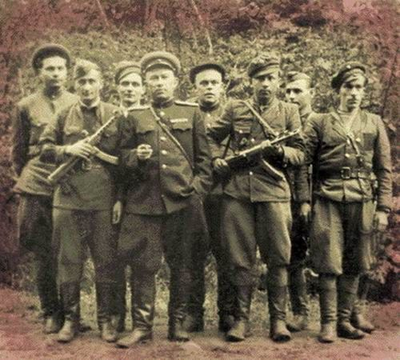
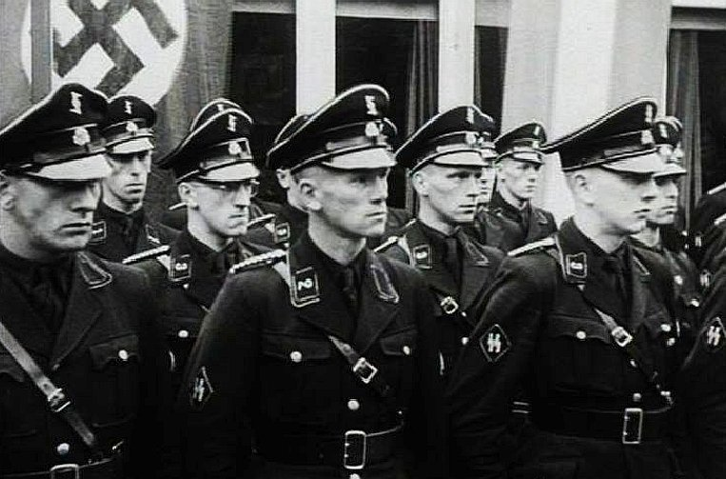
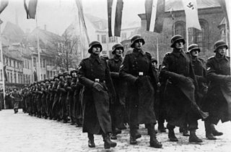
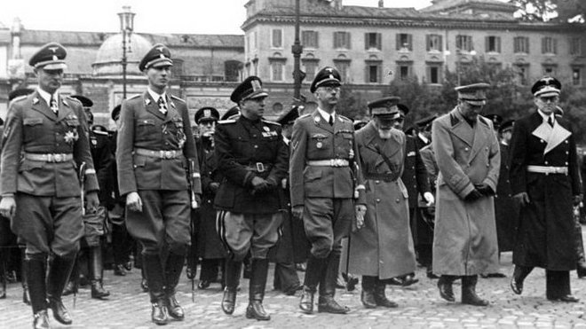

Slide 8
Propaganda Machines
State run propaganda networks like the Reich Ministry of Public Enlightenment and Propaganda in Nazi Germany controlled the flow of information to the population.
Soviet, German, and Italian propaganda departments censored foreign and domestic media, eliminating anything deemed unfit or dangerous to the regime
State agencies in all three countries produced print, audio, and film media designed to indoctrinate the population and glorify the leader
In the Soviet Union, the glorification of Stalin was so successful that inmates sentenced to years of forced labor in Siberian gulags often wrote letters to Stalin asking for help, falsely believing that their misfortune was the product of a mistake not the policies of the leader

Slide 9
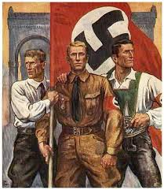
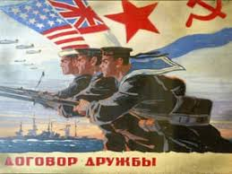
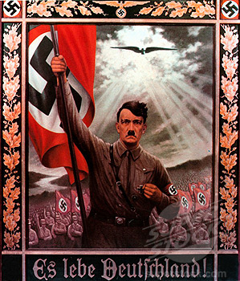
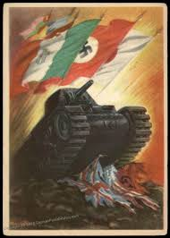

Slide 10
Totalitarian Government Control
The Communist, Nazi, & Fascist Parties in each country utilized the legislative bodies to pass legislation that transferred massive power to the leader
Also severely limited the civil liberties of the people
Freedom of speech
Freedom of assembly
Freedom of press

Slide 11
Fascist Aggressions Set The Stage for World War II

Slide 12
SSWH18 - Examine the major political and economic factors that shaped world societies between World War I and World War II
d. Explain the aggression & conflict leading to World War II in Europe & Asia; include the Italian invasion of Ethiopia, Spanish Civil War, Rape of Nanjing in China, & the German violation of the Treaty of Versailles.

Slide 13
The Build Up
World War I left many feeling like war no longer had a place in society
Attempts were made to reduce the likelihood of conflict
League of Nations
Kellogg–Briand Pact
renounced war as a tool of state
These efforts failed
By 1930s, a series of regional conflicts began
Over the course of the decade, these regional conflicts drew the attention of an increasing number of global powers & by the 1940s they culminated in the Second World War

Slide 14
Invasion of Manchuria
In 1931, Japan invaded the northern Chinese territory of Manchuria
Japanese business interests were heavily invested in the regions iron & coal resources
The Japanese military used an explosion along a Japanese owned railroad in the Manchurian town of Mukden as a reason for invasion
Once in control, the Japanese set up a puppet government to give Manchuria independence
Members of League of Nations saw the invasion as Japanese imperialism
The League demanded Japan withdraw from Manchuria
Japan opted to stay in Manchuria and withdraw from the League of Nations instead
The Japanese invasion of Manchuria was the 1st in series of regional conflicts that led to World War II
Japan

Slide 15
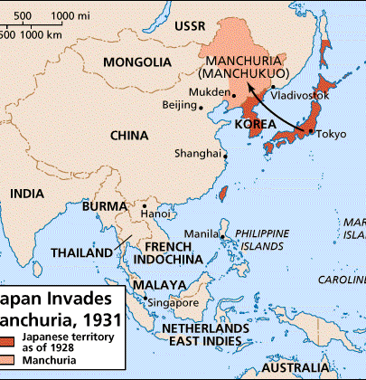
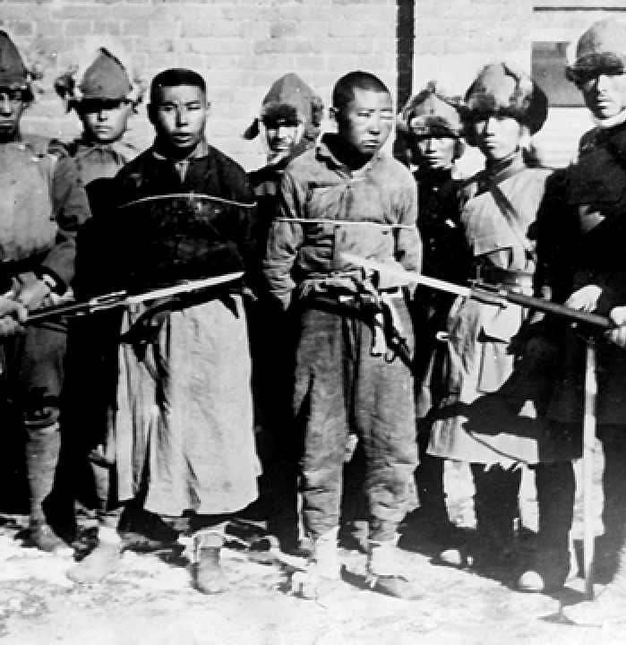

Slide 16
Invasion of Ethiopia
1935 - Mussolini ordered an invasion of Ethiopia
Mussolini sought to glorify his nation through imperialism
Also wished to avenge defeat to Ethiopia in 1890s
Haile Selassie, the emperor of Ethiopia, looked to League of Nations for help
The League condemned the invasion but none of the great powers did anything to stop him
In fact, the British allowed the Italian military to use the Suez Canal to move supplies & troops to East Africa for the invasion
Italy

Slide 17
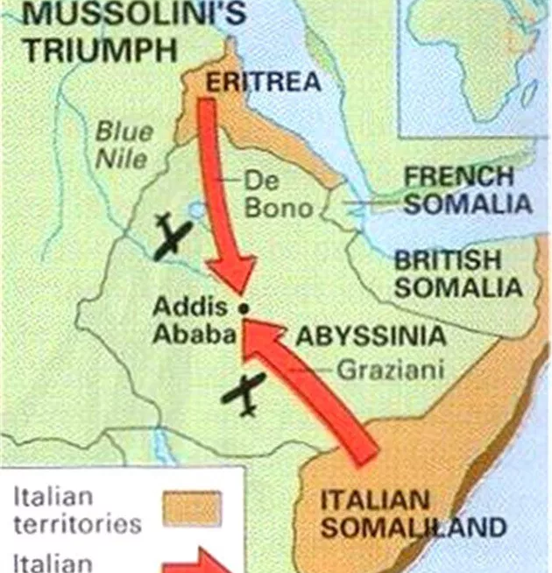
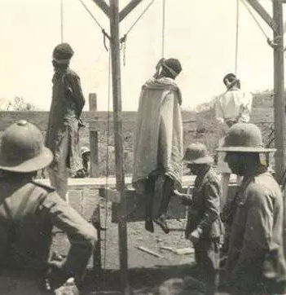

Slide 18
Violation of the Treaty of Versailles
1935 - Hitler announced that Germany would no longer obey the troop limits placed on them by the Treaty of Versailles
The League condemned this move but did nothing
March 1936 - Hitler violated the treaty again by moving German troops into the demilitarized buffer zone between Germany & France called the Rhineland
The League again took no action
Britain tried a policy of appeasement to keep the peace
This failed
October – November 1936 – Germany, Italy, & Japan made an alliance
Axis Powers
Germany

Slide 19
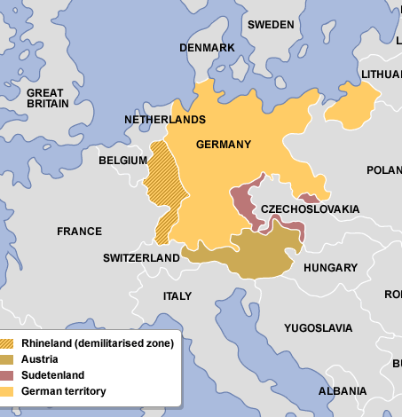
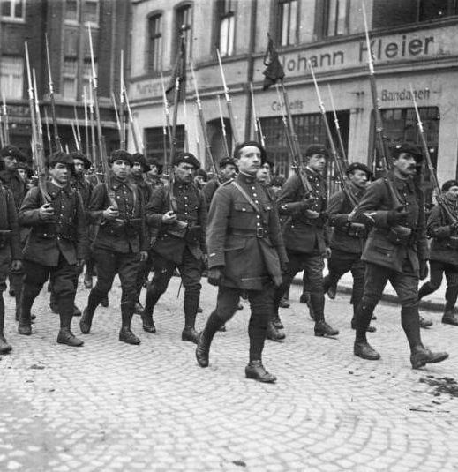

Slide 20
Spanish Civil War
July 1936 - Francisco Franco, a Spanish General, led a revolt against Spain’s Republican government
Franco & his supports in the military wished to establish a fascist regime similar to that of Hitler & Mussolini
Civil war broke out & lasted until Franco’s victory in 1939
Mussolini & Hitler sent troops & equipment to support Franco during the civil war
Only the Soviet Union supported the forces of the Spanish Republic
Spain

Slide 21
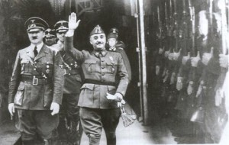

Slide 22
Rape of Nanjing
July 1937 - Japan mounted a full scale invasion of China
Japanese forces, who were better equipped, advanced quickly
December 1937 - Japan took the Chinese capital city of Nanjing
In what is called the Rape of Nanjing, Japanese troops killed 200,000 prisoners of war & civilians & raped 20,000 women
The treatment of Chinese civilians in Nanjing was savagely violent & public with photographers recording the carnage
Japan

Slide 23
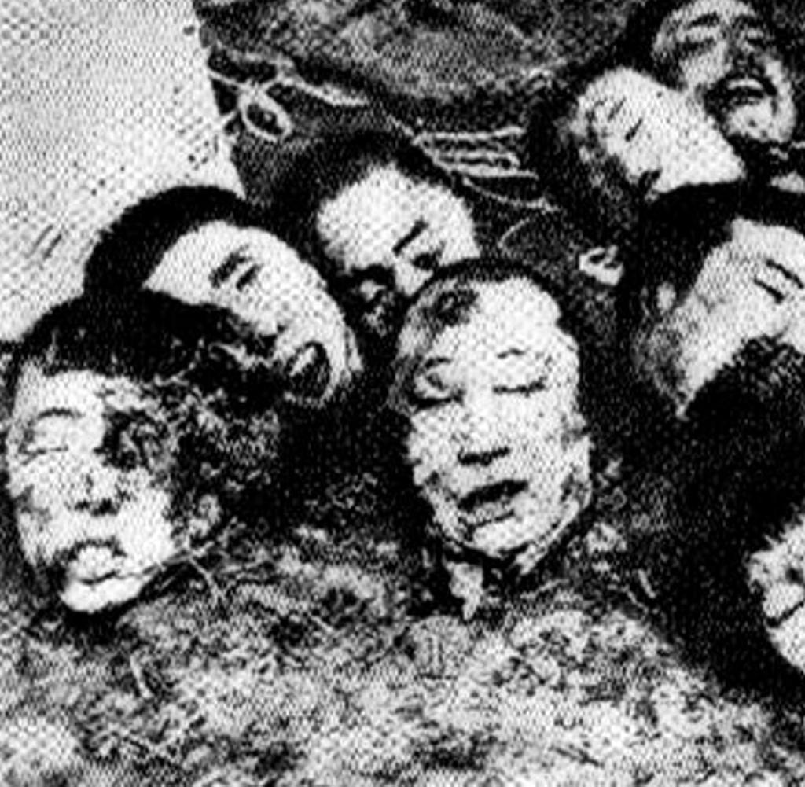
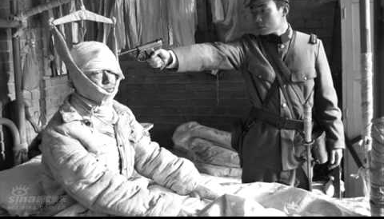
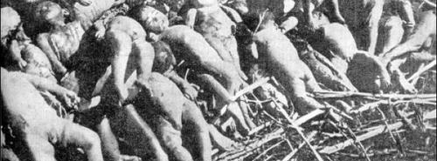

Slide 24
Hitler Continues to Violate the Peace
November 1937 - Hitler announced plans for the Anschluss, unification of Germany & Austria
move was prohibited by the Treaty of Versailles
March 1938 - Hitler carried out the annexation of Austria with little resistance from other European nations
Next he turned to the German speaking region of Czechoslovakia called the Sudetenland
Hitler demanded that this land be turned over to Germany in September of 1938
German, French, British, & Italian leaders met to discuss these demands in Munich
France and Britain agreed to the German annexation of the Sudetenland at the Munich Conference
March 1939 - Hitler took all of Czechoslovakia
With this move it became increasing clear that appeasement would not prevent war;
Britain & France pledged to declare war on Germany if Hitler threatened Poland
Germany

