Slide 1
World War II
The Build Up

Slide 2
SSWH18 - Examine the major political & economic factors that shaped world societies between World War I & World War II
a. Determine the causes & results of the Russian Revolution from the rise of the Bolsheviks under Lenin to Stalin’s first Five Year Plan

Slide 3
Objectives
Students will be able to:
Explain how the political legacy of World War I combined with regional & global economic challenges like income inequality, inflation, & unemployment to undermine public confidence in many governments.
Explain how the lack of confidence in government led to the rise of authoritarian and in some cases totalitarian regimes in Russia, Germany, Italy, Spain, & Japan
explain how the rise of authoritarian & totalitarian regimes led to World War II.

Slide 4
The Russian Revolution
Nicholas II, the last tsar of the Russian Empire spent much of his early reign highly distracted by family concerns, including his son Alexei's hemophilia
This distraction was heightened by the royal family’s close association with Rasputin
A Russian peasant priest that claimed to talk to Mary & heal the sick
A heavy drinker & womanizer
Political rivals of Nicholas II used his association with Rasputin as a political tool

Slide 5
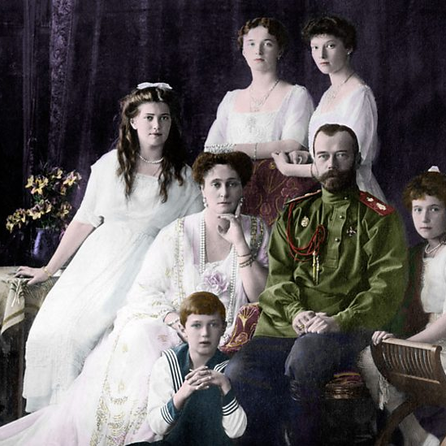
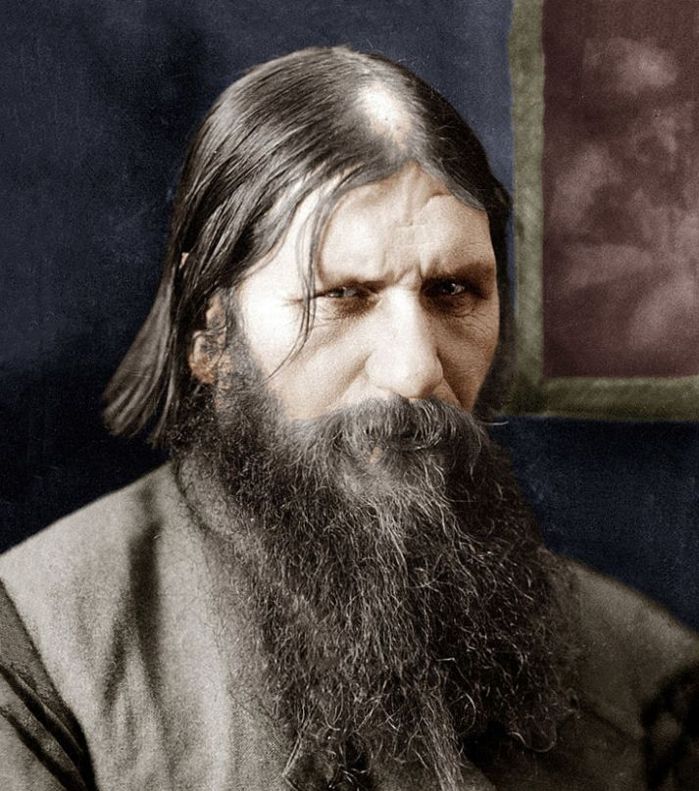
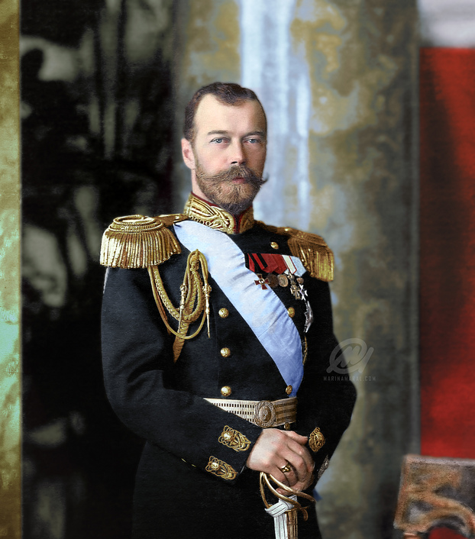

Slide 6
The Russian Revolution
Outside of Nicholas II’s personal issues, Russia took major losses in conflicts versus more industrialized nations
Took an unexpected loss to Japan in the Russo-Japanese War
Took several humiliating defeats in World War I
Each defeat attributed to the weak leadership of Nicholas II & lack of industrialization

Slide 7
The Russian Revolution
During World War I, military defeat was coupled with major food shortages leading to open rebellion in Russia cities
February Revolution of 1917
Tsar was forced to abdicate, give up his throne
Liberal Provisional Government was formed
Provisional Government attempted economic & political reforms
Reforms were not enough for the Russian people
The Russian people wanted peace but this government continued the fight in World War I.

Slide 8
The Russian Revolution
Russia still had a number of issues
Massive war casualties
Food shortages
Lack of industrialization
Unequal distribution of land
Large peasant population
Russia’s many issues led to a radical Bolshevik Revolution
Led by Vladimir Lenin, Bolshevik Party leader
Seized power in a violent coup
Civil war ensued between Bolshevik forces (Reds) & the tsarist and republican forces (Whites)
Russian Civil War lasted until 1920 when Reds emerged victorious

Slide 9
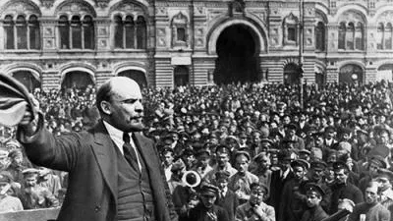

Slide 10
The Russian Revolution
Russia still had a number of issues
Massive war casualties
Food shortages
Lack of industrialization
Unequal distribution of land
Large peasant population
Russia’s many issues led to a radical Bolshevik Revolution
Led by Vladimir Lenin, Bolshevik Party leader
Seized power in a violent coup
Civil war ensued between Bolshevik forces (Reds) & the tsarist and republican forces (Whites)
Russian Civil War lasted until 1920 when Reds emerged victorious

Slide 11
Communist Russia
Lenin took power & set up a 1 party dictatorship
Lenin began to move towards a communist Russia
United Soviet Socialist Republic
Creating a pure communist Russia was difficult
Attempted to follow Marxist Communist Manifest
Population was majority peasant farmers, not urban factory workers
To help make the transition easier, Lenin put into place his New Economic Policy (NEP) which was designed to gradually move the Soviet economy to centralized communist party control (1921)
Under Lenin

Slide 12
Communist Russia
Lenin died in 1924 while Russia was still in transition
Power struggle between 2 of his closest associates ensued
Joseph Stalin
Leon Trotsky
Stalin eventually took control
Exiled Trotsky in 1928
Consolidated the Soviet government under his control
Stalin rejected the gradual transition of Lenin’s NEP & pushed for a more immediate transition thru a series of 5 Year Plans
1st 5 Year Plan
Construction of factories
Construction of transportation networks
State took over private farms which were used to fund industrialization
Mismanagement of private farms led to Great Famine in Ukraine
Under Stalin

Slide 13
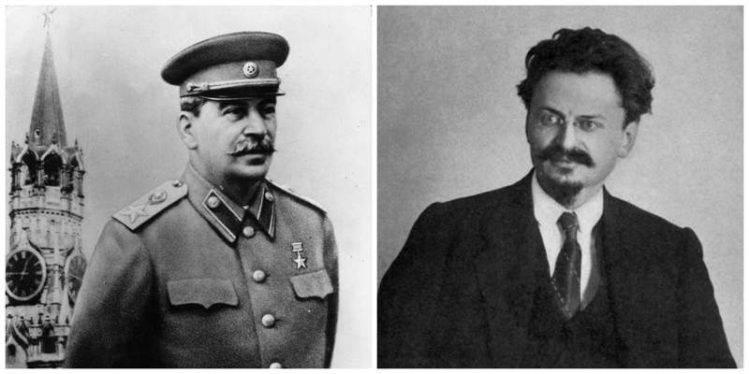

Slide 14
Communist Russia
Stalin used propaganda to create a powerful cult of personality that maintained his popularity despite the suffering he imposed on his people
Secret police rounded up political opponents, dissenters, and counter-revolutionaries
From 1936 to 1938 Stalin ordered the execution of about 1 million of his people & sent millions more into exile in Siberia
These efforts created a totalitarian communist state & made the Soviet Union into a global industrial power.
Under Stalin

Slide 15
The Rise of Facism: Italy, Germany & Japan

Slide 16
SSWH18 - Examine the major political & economic factors that shaped world societies between World War I and World War II
b. Describe the rise of fascism in Europe & Asia by comparing the policies of Benito Mussolini in Italy, Adolf Hitler in Germany, & Hirohito in Japan

Slide 17
The Rise of Facism
Fascism as a political philosophy was born in Italy in 1919 & spread to other countries in Europe & South America
A Fascist like regimes emerged in Japan during the 1930s under the military dictatorship headed by Hideki Tojo
These regimes were characterized by ultra-nationalistic, antidemocratic dictatorships
The leaders of these regimes argued that democracy was ineffective in solving the problems faced by a nation & the glory & pride of a state was best maintained by a strong totalitarian leader

Slide 18
The Rise of Facism
In Germany, Italy, & Japan, facist regimes emerged out of democratic states after an economic crisis
Perceived national humiliations resulting from the peace negotiations after World War I made these economic crisis worse
Germany’s treatment in Treaty of Versailles angered Germans
Italy’s inability to obtain additional land angered Italians
Inability of the democratic governments of Italy, Germany and Japan to solve the economic crisis and the blame that the German and Italian governments received for post war humiliation ultimately led to their downfall

Slide 19
The Rise of Facism: Italy
Democracy failed in Italy first
Rising inflation & unemployment in the early 1920s led to social unrest & a rise in the influence of the Socialists & Communist parties in Italy
These conditions generated fear among the middle & upper classes who became impatient with the government's inability to maintain order & prosperity
Benito Mussolini’s Fascist party began to win support from these groups when Fascist party members known as Black Shirts began to attack Communist & Socialists on the streets

Slide 20
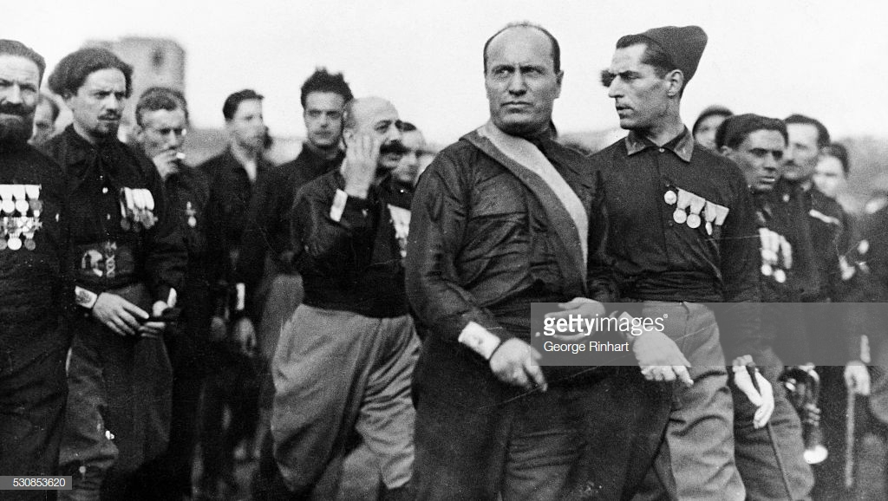

Slide 21
The Rise of Facism: Italy
In 1922, with growing support from the middle & upper classes, Mussolini led a march of 30,000 Fascist party members on Rome
Fearing a revolution, King Victor Emmanuel III named Mussolini Prime Minister
Over the next several years, Mussolini consolidate his power as Fascist took control over the Italian parliament & seceded parliamentary authority to Mussolini
By 1925 Mussolini had almost complete control over government

Slide 22
The Rise of Facism:
Now known as Il Duce, Mussolini built a totalitarian regime
abolished democracy
banned opposing political parties
jailed opponents
limited speech
censored the press
outlawed strikes
utilized an intense propaganda machine to maintain the obedience of the citizenry
Though his methods were harsh, Mussolini was generally respected at home & abroad
Successful reforms modernized Italy with highway construction, industrial development, & literacy campaigns.
Italy

Slide 23
The Rise of Facism:
The failure of democracy in Germany came with onset of Great Depression
Inspired by Mussolini, Hitler formed the National Socialist German Workers Party (Nazi) in 1919
1923 he tried to replicate Mussolini’s success in the March on Rome with a coup attempt in Munich
The Beer Hall Putsch as it is now called was a failure & resulted in a prison sentence for Hitler
Hitler served nine months of 5-year sentence
Authored Mein Kampf, which laid out his political beliefs & goals
Germany

Slide 24
The Rise of Facism:
In Mein Kampf, Hitler reiterated Mussolini’s ideas about weakness of democracy & communism
He agreed with Mussolini that ultra-nationalist dictatorship by a single strong leader was the best way to maintain order & restore pride & prosperity
Hitler added to Mussolini’s Fascist Party platform the principle of German racial superiority.
Hitler argued that the German people (along with a few other northern European populations) were the members of the ancient Aryan “race” & naturally superior to the rest of the world’s population
Germany

Slide 25
The Rise of Facism:
In Mein Kampf, Hitler established the basic goals of the Nazi party
Like the Fascists of Italy & the Militarists of Japan, the Nazis would end democracy, build a strong military, use government power to improve the economy, & expand their territory.
Hitler, Mussolini, & Tojo (supported by Hirohito) all believed that their nation’s success depended on the conquest of new territory
Germany

Slide 26
The Rise of Facism:
Hitler’s rise to power was very similar to Mussolini
During 1920s, Hitler built a power base that included a Nazi Party militia called the Brown Shirts
Like the Black Shirts of Italy, Hitler’s Brown Shirts used the threat & sometimes actual violence to win political influence
After the collapse of the German economy in the Great Depression, Nazis became Germany’s largest political party
Like in Italy, they gained support from the middle & upper classes by opposing the threat of a communist revolution
In 1933, President Paul von Hindenburg named Hitler chancellor (a position similar to prime minister)
Germany

Slide 27
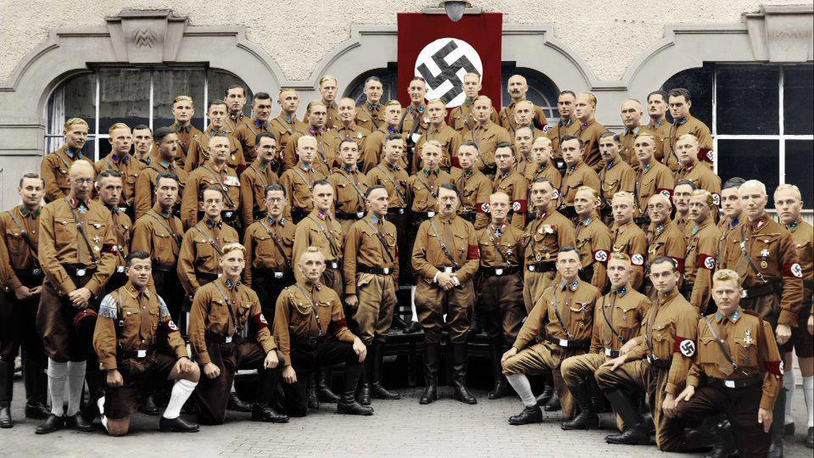

Slide 28
The Rise of Facism:
Hitler immediately called for new elections for the Reichstag or German parliament
He hoped that his increasing popularity would lead to a Nazi majority
6 days before the election the Reichstag building mysteriously caught fire
Nazi party leaders blamed the fire on the Communist Party & called on citizens to elect Nazis to protect the nation from the threat
Nazis won a slim majority in the Reichstag & like in Italy they began to vote to secede their power to Hitler
Germany

Slide 29
The Rise of Facism:
In 1934, Hitler was named Führer, taking complete control of the German government
Like Mussolini he built a totalitarian regime
abolished democracy
banned opposing political parties
jailed opponents
limited speech
censored the press
outlawed strikes
utilized intense propaganda machine & police force to maintain obedience of the people
And, like Mussolini, Hitler enjoyed widespread support because of successful reforms that dramatically reduced unemployment, increased industrial output & improved infrastructure
Germany

Slide 30
The Rise of Facism:
Unlike Italy & Germany, Japan never had a single man with total government control
small group of military leaders ruled with the support of Emperor Hirohito
Of these men Hideki Tojo emerged as the most powerful
In the Japanese parliamentary democracy of 1920s, the civil government had no control over the military
According to the constitution, the military reported directly to the Emperor
Traditionally the Japanese emperors did not yield power, this meant that the military was essential independent in its authority
Japan

Slide 31
The Rise of Facism:
Until the Great Depression, the military generally respected the authority of the civil government over Japan
This changed when economic hard times hit
turned the Japanese people against the civil government
In 1929, military took control of government
Social unrest & popular support facilitated the militaries gradual seizure of power
1931 - the military invaded Manchuria
1941 - Hideki Tojo, the head of the military became prime minister
Japan

Slide 32
The Rise of Facism:
Like in Italy & Germany, militaristic nationalism supported the power of the new regime
In Japan this nationalism was supported by a religious movement, State Shinto
State Shinto gave the Japanese regime a race based political ideology similar to the Germans
As Nazism argued that the Germans were entitled to build an empire in Europe based on their perceived racial superiority, State Shinto argued that the Japanese were a master race destined to rule Asia
Like their counterparts in Europe, the Japanese regime commanded the obedience of the population & enjoyed widespread popularity because of their success in coping with the Great Depression.
Japan

