Slide 1
World War II: The AfterMath
Notes:
NOTE:
To change the image on this slide, select the picture and delete it. Then click the Pictures icon in the placeholder to insert your own image.

Slide 2
Georgia Standards of Excellence
SSWH19 – Demonstrate an understanding of the global political, economic, & social impact of World War II
c. Analyze the impact of the military & diplomatic negotiations between the leaders of Great Britain, the Soviet Union, & the United States.
d. Explain Post-World War II policies & plans for economic recovery, include: the Marshall Plan for Europe, MacArthur’s plan for Japan, & the formation of the United Nations, NATO, & the Warsaw Pact

Slide 3
World War II: Closing Out the War
1943 – 1st significant meeting between the leaders of Great Britain, Soviet Union, & U.S. took place in the city of Tehran, Iran (prior to end of war)
Roosevelt, Churchill, & Stalin discussed plans for the invasion of northern France & another Soviet offensive in the east
The Soviet Union agreed to join the war against Japan following the defeat of the Axis Powers in Europe.
1945 – The 3 major powers would meet again in the Russian town of Yalta (Yalta Conference)

Slide 4
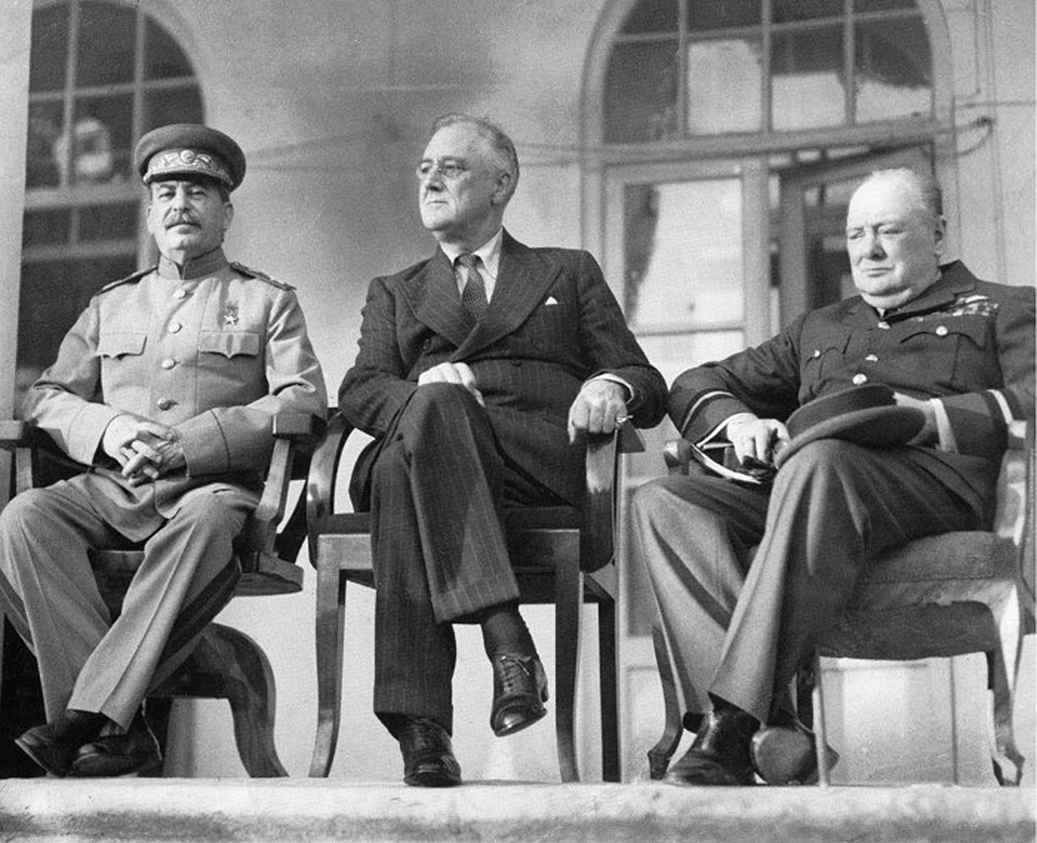

Slide 5
World War II: Closing Out the War
Yalta Conference - 1945
By this time, the allies were confident that the defeat of the European Axis Powers was within reach
At this conference the allies discussed the future of Germany, Austria & Eastern Europe
The allies agreed to divide Germany and Austria into four occupational zones, the Soviet Union, America, Britain or France would each take responsibility for one of the zones.
The capital of Berlin would likewise be divided.
The Soviet Union agreed to allow free elections in all of the Eastern European countries that it liberated from Nazi control
Allies agreed to the basic structure of the United Nations
U.S., Britain, France, the Soviet Union & China would each be given a permanent seat on the Security Council & the power to veto any UN action
Stalin also reaffirmed the Soviet Union’s commitment to declare war on Japan

Slide 6
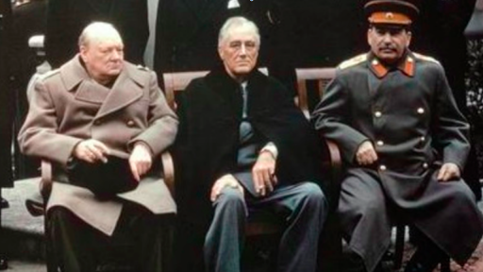

Slide 7
World War II: Closing Out the War
Potsdam Conference - 1945
The final major meeting of the leaders of the U.S., Britain, & Soviet Union was held in Potsdam, Germany in July of 1945 after the Nazi surrender
Roosevelt died in April of 1945 so he was replaced by Harry Truman
Churchill was replaced after an election by Clement Attlee
Allies implemented their plans for division of Germany into occupied zones & agreed to the demilitarization of Germany
Developed a plan to purge Nazi elements from German society with a system of courts (the Nuremberg Trials) designed to identify, try, & punish war criminals
However, Stalin reneged on his promise to allow free elections in Eastern Europe kicking off the Cold War
Britain, the U.S. & China issued the Potsdam Declaration in which they threatened Japan with “prompt and utter destruction” if they did not surrender immediately

Slide 8
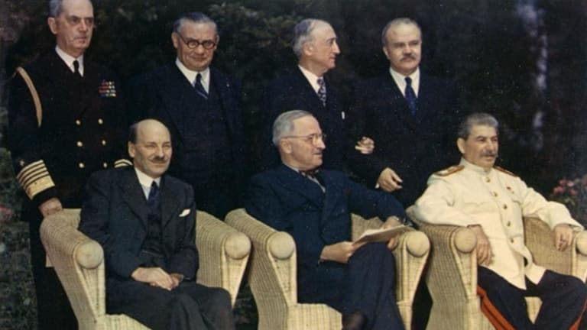

Slide 9
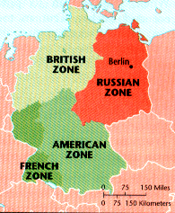

Slide 10
World War II: Rebuild & Recovery of Europe
Europe was devasted by war
areas that were not physically destroyed suffered from economic hardship & political distrust
In this environment of economic & political instability many Europeans turned to the Communist Party
1947 – President Harry Truman declared in the Truman Doctrine that the U.S. would work to prevent the spread of communism
Marshall Plan – U.S. Secretary of State, George Marshall, proposed a $12.5 billion plan to rebuild Europe
Congress approved the plan after the fall of Czechoslovakia to Communist in 1948
The plan was a great success, the European economy recovered quickly & Communist Parties declined in popularity across Western Europe

Slide 11
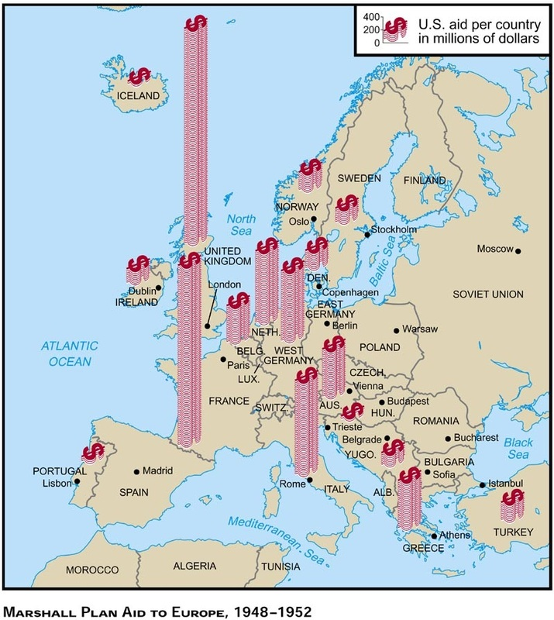
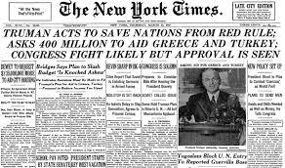

Slide 12
World War II: Rebuild & Recovery of Japan
Japan was also in ruins after the war
U.S. took responsibility for the post-war occupation & administration of Japan
Occupation was overseen by General Douglas MacArthur
MacArthur designed a plan that would democratize Japan, stimulate economic growth & prevent future Japanese aggression
The wartime leaders of Japan were arrested & put on trial for war crimes
7 of the most egregious offenders were put to death
Emperor Hirohito was spared from trial & allowed to remain on the throne
MacArthur’s investigators claimed that Emperor Hirohito was only a figurehead & did not direct the Japanese government during the war
Hirohito’s innocence is still a matter of debate among historians

Slide 13
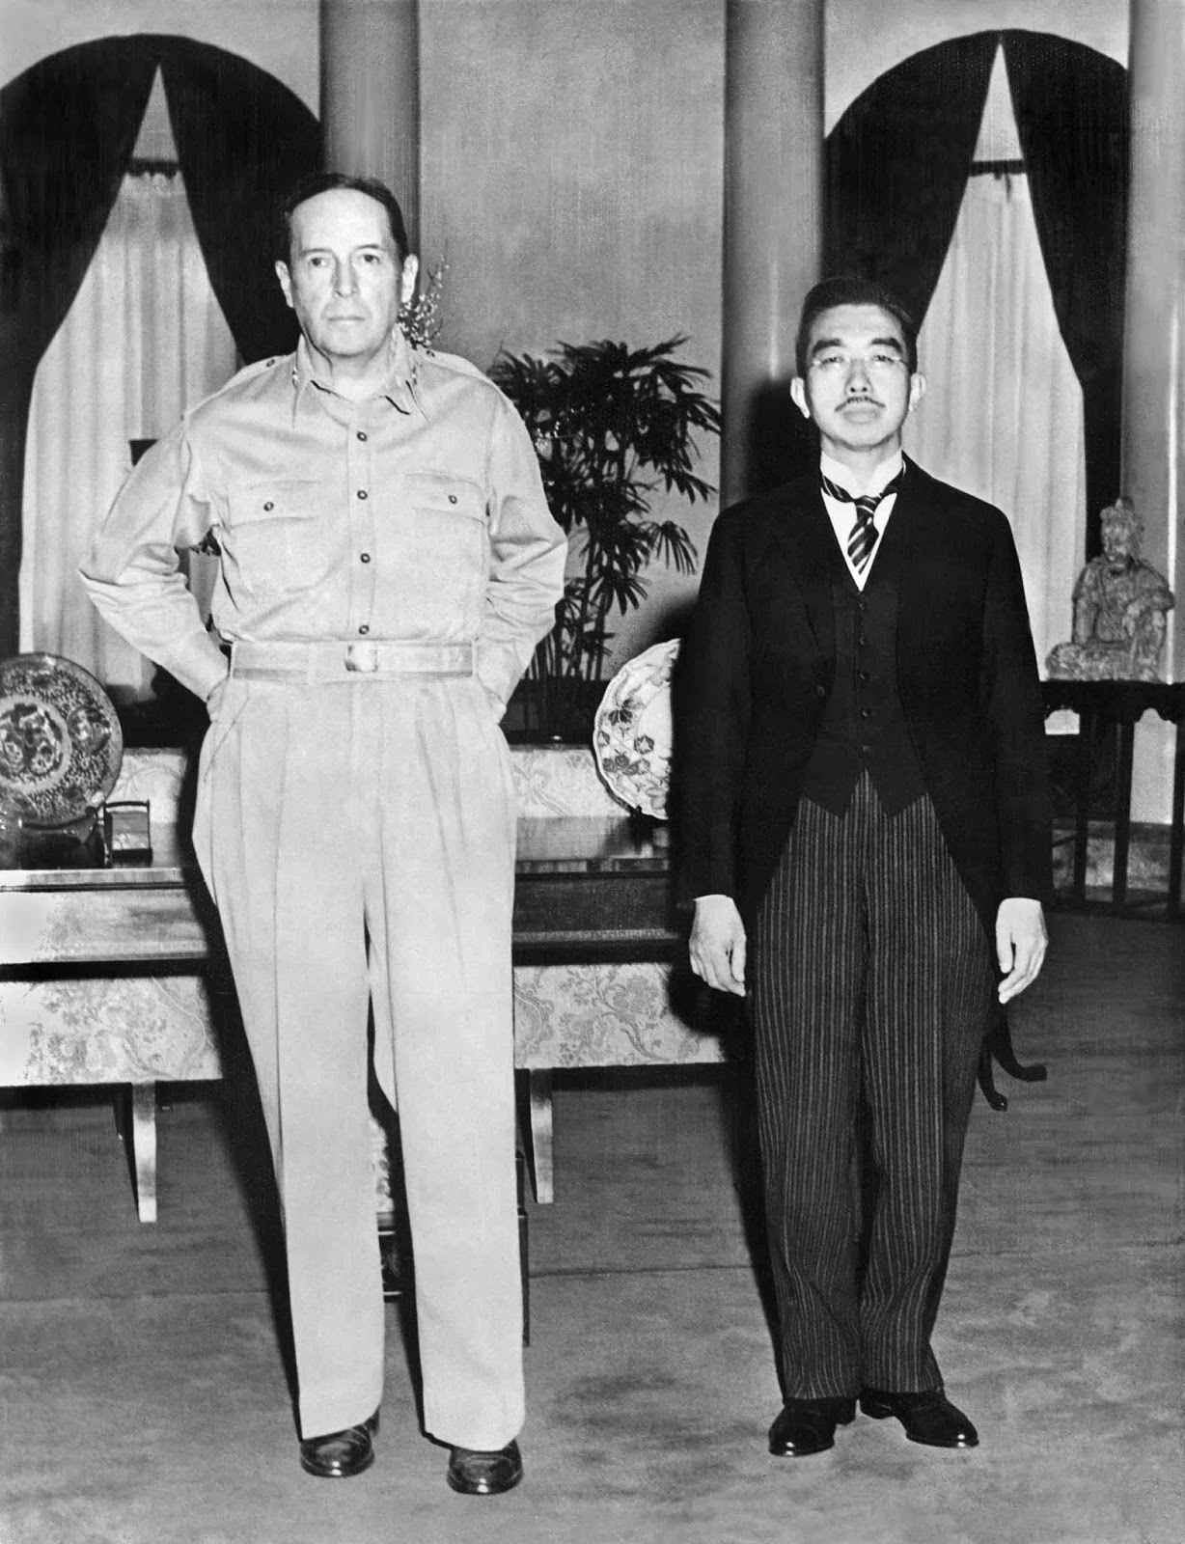

Slide 14
World War II: Rebuild & Recovery of Japan
MacArthur did substantially decrease the Japanese emperor’s influence in Japanese life & government however
Hirohito had to renounce both his claim to divinity & all rights to direct the actions of government
MacArthur & his advisors wrote a new constitution for Japan that made it into a constitutional monarchy like Britain
A two house legislature elected by all citizens over the age of 20 would run the country
A bill of rights protected the basic freedoms of the Japanese people.
Japan was permanently demilitarized
The Japanese armed forces was disbanded immediately after the war & a provision was written into the constitution forbidding offensive war & maintenance of a military with offensive capabilities

Slide 15
World War II: Rebuild & Recovery of Japan
To stimulate economic growth & opportunity in Japan, MacArthur developed a plan to redistribute land
Large landholders were required to sell their holdings to the government who in turn sold it at low cost to former tenant farmers
MacArthur also allowed factory workers to create independent labor unions

Slide 16
World War II: The AfterMath
Keeping The Peace

Slide 17
The United Nations
1946 – The failure of the League of Nations to prevent World War II led to it being disbanded & replaced by the United Nations
The United Nations was chartered in 1945 & like the League was designed to prevent war
The founders of the United Nations attempted to remedy some of the weaknesses of the League of Nations by giving the United Nations the power to enforce its decisions
The UN was organized into two bodies, the General Assembly in which all member countries were given an equal vote & the Security Council.
The principle role of the General Assembly included wielding international opinion

Slide 18
The United Nations
The Security Council was given the power to issue enforceable directives
The Council included 11 members, 6 elected by the General Assembly & 5 permanent members with veto power
The 5 countries given permanent seats in the Security Council were the United States, the United Kingdom of Great Britain, France, the Union of Soviet Socialist Republics, & the Chinese Republic
Today the seat of the USSR is held by Russia & the seat of the Chinese Republic is held by the People’s Republic of China

Slide 19
Tensions Between Russia & U.S.
1948 – Post war tensions between the U.S. & Soviet Union came to a head
The Soviet Union responded to the American, British & French decision to allow West Germany to reunite & become an independent country by blockading West Berlin
Berlin was located inside of the Soviet occupied zone of Germany
In June of 1948 the Soviet Union attempted to force the U.S., Britain & France into allowing the USSR to take control of West Berlin
They did this by closing off all land access to the city
The U.S. & Britain responded by airlifting supplies into the city
The airlifts lasted until May of 1949 when the Soviet Union finally backed down & reopened land access
.

Slide 20
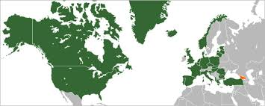
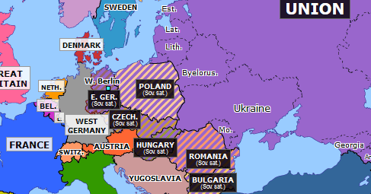
Tensions Between Russia & U.S.
The tension caused by the blockade of Berlin resulted in the formation of the North Atlantic Treaty Organization (NATO)
10 western European nations plus the U.S. & Canada formed a military alliance in which they agreed that an attack on one would be considered an attack on all
The NATO alliance went far in mitigating the threat of Soviet aggression in Europe but also increased Cold War tensions
In 1955 the Soviet Union formed its own military alliance known as the Warsaw Pact. 7 Eastern European countries joined with the USSR in this alliance

