Slide 1
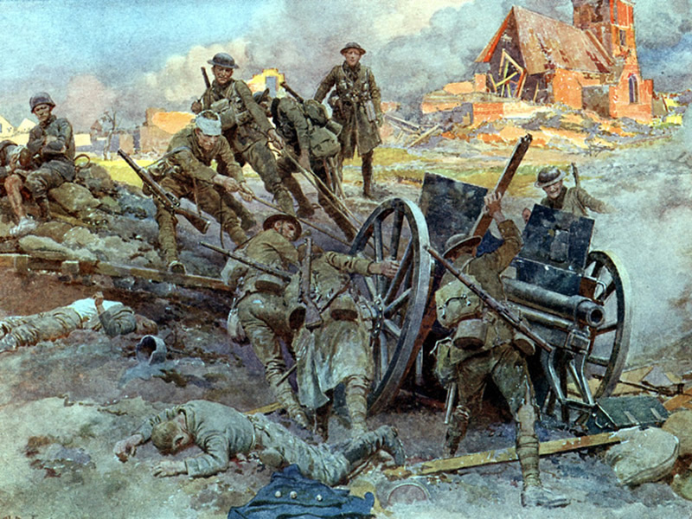
World War I

Slide 2
World War I
The Aftermath

Slide 3
SSWH17 - Demonstrate an understanding of long-term causes of World War I and its global impact.
c. Explain the major decisions made in the Versailles Treaty, include: German reparations & the mandate system that replaced Ottoman control

Slide 4
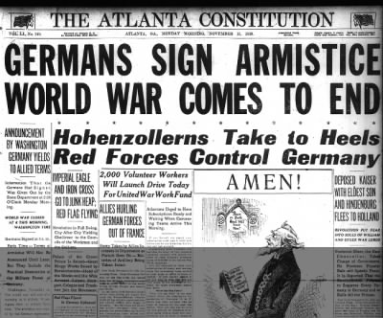
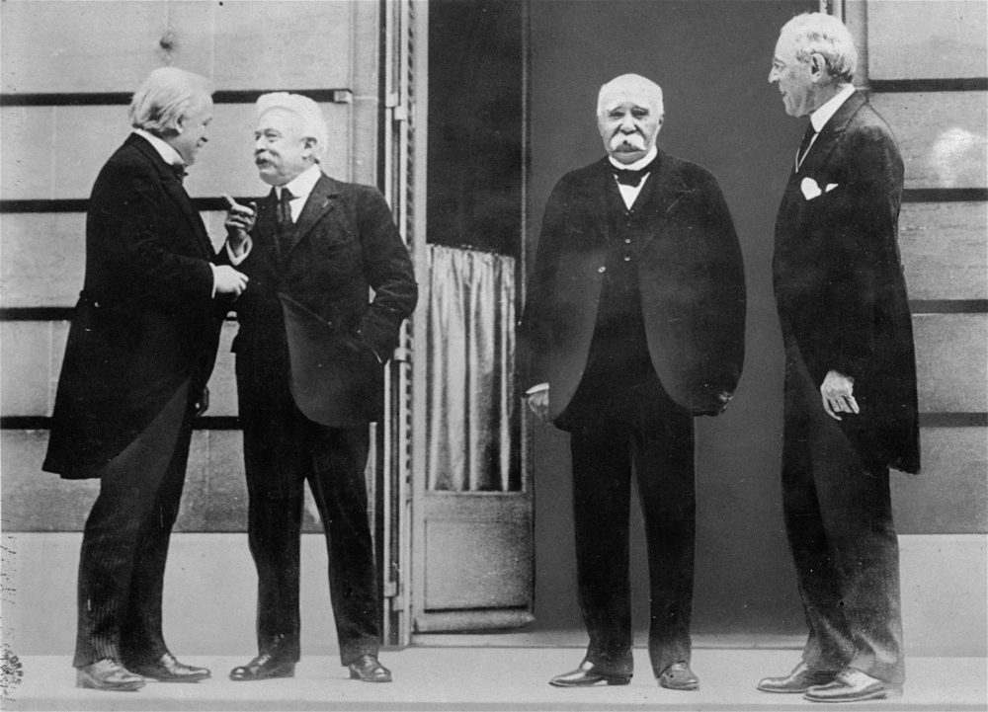

Slide 5
World War I: The Aftermath
1919 – The war ends with the Allies defeating the Central Powers
November 11th, 1918 – Germany surrenders to Allies
Central Powers felt that all the countries of Europe involved were equally responsible for the war
Expected this to be reflected in the peace treaty
This did not happen
Paris Peace conference begins in 1919
Dominated by the United States, Britain, France and Italy
Felt that Central Powers should be punished harshly, Germany in particular

Slide 6
World War I: Paris Peace Conference
Group of leaders known as the Big Four
U.S. president Woodrow Wilson
French ruler Georges Clemenceau
David Lloyd George of Great Britain
Vittorio Orlando of Italy

Slide 7
World War I: Paris Peace Conference
U.S. President Woodrow Wilson
14 Points – Plan to make this “War to End All Wars”
Britain, France, and Italy leaders were less concerned with this idealistic goal and more concerned with punishing the Central Powers for causing the war
In the end the treaties that emerged from the conference included some of the idealism of Wilson’s 14 Points & a great deal of the punishment planned by the European representatives
While 5 treaties were actually negotiated & executed (one for each of the defeated nations), the treaty imposed on Germany, the Versailles Treaty, proved the most consequential

Slide 8
World War I: Treaty of Versailles
Included ideas from Wilson’s 14 Points
League of Nations - international body designed to prevent war by creating a forum for conflict resolution
Wilson’s beliefs about national self-determination were largely realized with the creation of new countries:
Poland, Yugoslavia, Czechoslovakia, Finland, Latvia, Lithuania, Estonia, Austria, & Hungary out of lands once controlled by the German, Russian, and Austro-Hungarian Empires
Wilson’s calls for decolonization were heard with the creation of the mandate system

Slide 9
World War I: Treaty of Versailles
Included ideas from Wilson’s 14 Points
According to the treaty, the overseas colonies of Germany & non-Turkish speaking lands of the Ottoman Empire were to become temporary mandates of the League of Nations
As a mandate, each of these territories would be temporarily assigned to one of the Allied powers, mostly Britain & France
The mandate holder was supposed to administer the territory temporarily while preparations were made for independence
In practice most of the mandates simply proved to be new colonies for the mandate holder
In the long-term, the mandates in the Middle East proved the most consequential
In the British mandate of Palestine, Britain promised in the Balfour Declaration to create a Jewish State, over time this created conflict with the Palestinian Arabs already living in the region

Slide 11
World War I: Treaty of Versailles
These provisions designed to punish Germany humiliated the German people & laid the foundation for the rise of Hitler in the 1930s
They also aggravated the U.S. Senate who refused to ratify the Treaty of Versailles
Without ratification, the United States never joined the League of Nations
Without the United States as a member, the League of Nations was severely weakened & failed to maintain peace in the years leading to up to World War II

Slide 12
World War I
Collapse of Empires

Slide 13
SSWH17 - Demonstrate an understanding of long-term causes of World War I and its global impact.
d. Analyze the destabilization of Europe in the collapse of the great empires

Slide 14
World War I: Fall of Empires
After WWI, 4 great European empires came to an end
The German Reich under the Hohenzollern dynasty ended & was replaced by the Weimar Republic
The Weimar government was generally weak & ineffective because of a lack of public confidence as well as political infighting among the multitude of political parties
The Habsburg dynasty of Austria-Hungary fell as this empire was split into several successor states
Austria became a republic
Hungary went through a period of political instability during which it had succession of governments
In Russia, 300 years of Romanov rule ended with the Bolshevik Revolution, replacing the tsars with communist party rule

Slide 15
World War I: Fall of Empires
In the territory lost by these empires several new nation-states were created, including Poland, Yugoslavia, Czechoslovakia, Finland, Latvia, Lithuania, & Estonia.
Political, social & economic insecurity dominated in these new states in the years after the war.
To the south, the Ottoman Empire ended in 1922 when the Ottoman sultan was replaced by the Turkish Republic.

Slide 16
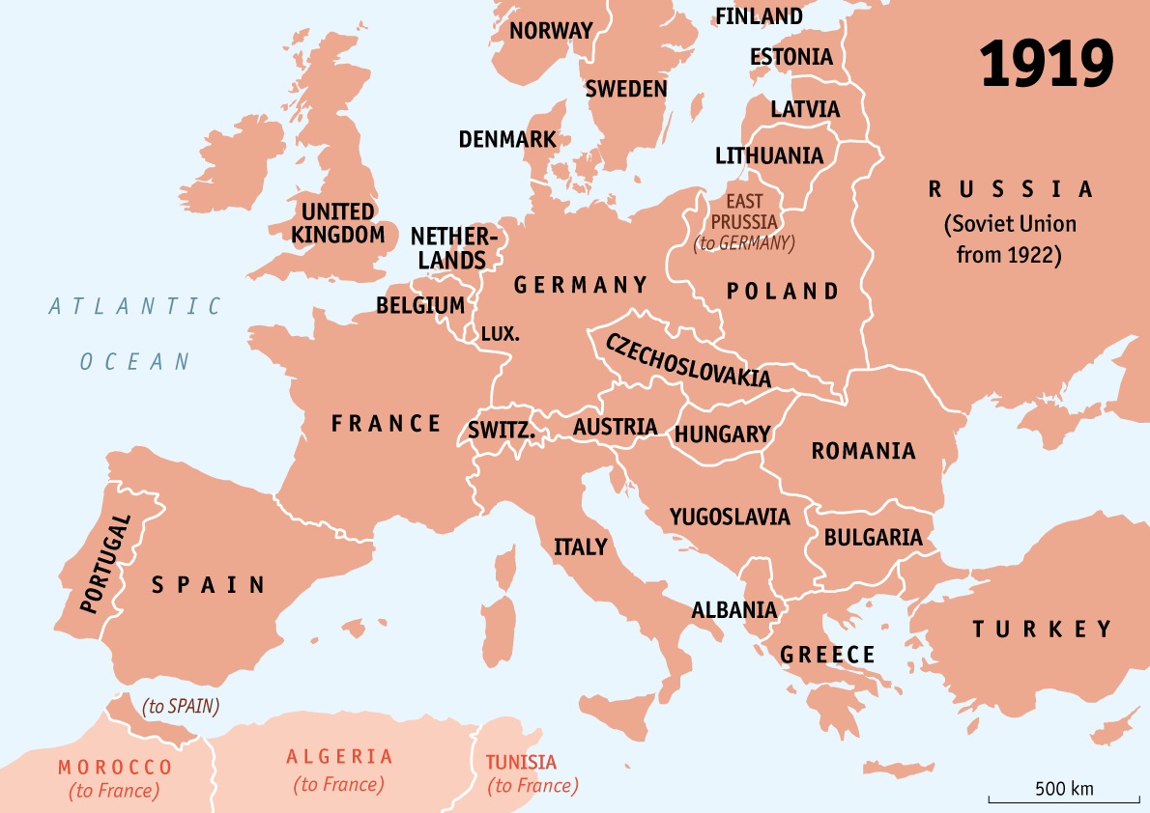

Slide 17
