Slide 1
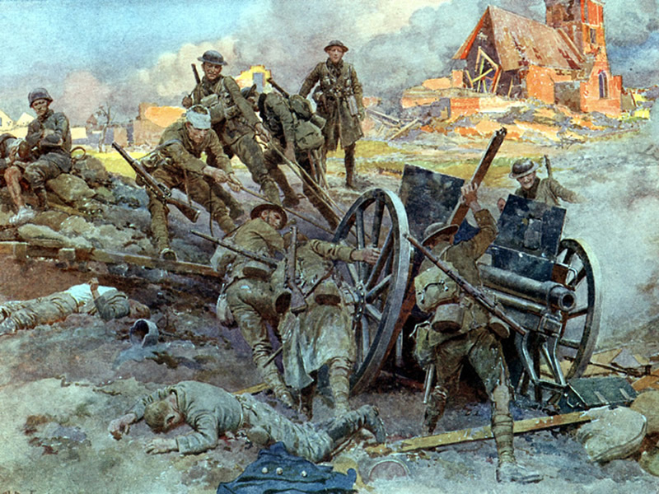
World War I

Slide 2
SSWH17 - Demonstrate an understanding of long-term causes of World War I & its global impact.
a. Identify causes of the war, include: nationalism, entangling alliances, militarism, & imperialism.
Notes:
Notes to presenter:
What is your purpose for sharing this reflection?
Is it at the end of a unit or project?
Are you sharing this reflection, at the attainment of a learning goal you set for yourself?
Is it at the end of a course?
State your purpose for the reflection or even the purpose of the learning experience or learning goal. Be clear and be specific in stating your purpose.

Slide 3
Students will be able to:
Explain how industrialization, imperialism, nationalism, militarization, & the alliance system worked together & led to World War I
Explain how these factors created the “powder keg of Europe” in the Balkans that sparked the global conflict
Describe how industrialization affected the battlefronts of World War I
Analyze the impacts on the countries who fought in World War I
Notes:
Notes to presenter:
Description of what you learned in your own words on one side.
Include information about the topic
Details about the topic will also be helpful here.
Tell the story of your learning experience. Just like a story there should always be a beginning, middle and an end.
On the other side, you can add a graphic that provides evidence of what you learned.
Feel free to use more than one slide to reflect upon your process. It also helps to add some video of your process.

Slide 4
World War I: The Causes
A combination of factors led to World War I
Industrialization
Led to a high demand from products
Need for more resources to produce goods
Need for new markets to sell goods
Imperialism
Arose from need from new markets & more resources due to industrialization
Conflict between European countries, as well as U.S. & Japan, arose during colonization of Africa, Asia, & Australia
Militarism
Competing countries used industry to produce bigger & better weapons (Military Build Up)
Notes:
Notes to presenter:
What did you think at first?
What obstacles did you encounter along the way?
How did you overcome those obstacles?
What images can you add to support your process?
This SmartArt allows you add images and text to help outline your process. If a picture is worth a thousand words, then pictures and words should help you communicate this reflection on learning perfectly! You can always click on Insert>SmartArt to change this graphic or select the graphic and click on the Design contextual menu to change the colors.
Feel free to use more than one slide to reflect upon your process. It also helps to add some video of your process.

Slide 5
World War I: The Causes
A combination of factors led to World War I
Alliances
Militarism led to instability in Europe
European countries began to from alliances to balance power & keep the peace
Alliances tended to be secretive & unstable which led to even more conflict & competition
Nationalism
Countries began to build up nationalist sentiment because of competition
Ethnic groups like the Slavs began to be suppressed & oppressed
Notes:
Notes to presenter:
What did you think at first?
What obstacles did you encounter along the way?
How did you overcome those obstacles?
What images can you add to support your process?
This SmartArt allows you add images and text to help outline your process. If a picture is worth a thousand words, then pictures and words should help you communicate this reflection on learning perfectly! You can always click on Insert>SmartArt to change this graphic or select the graphic and click on the Design contextual menu to change the colors.
Feel free to use more than one slide to reflect upon your process. It also helps to add some video of your process.

Slide 6
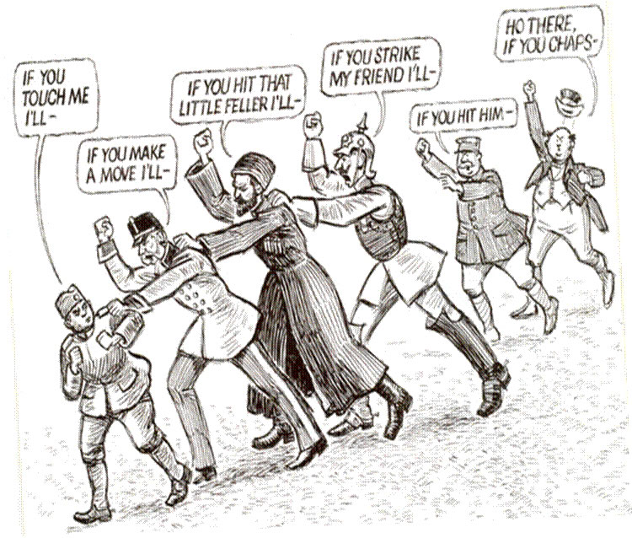

Slide 7
World War I: Causes
Germany’s Otto von Bismarck works to keep peace in Europe after 1871
Believes France wants revenge for loss in 1870 Franco-Prussian War
Seeks to isolate the French with a series of treaties & alliances:
signs treaty with Russia in 1881
forms Triple Alliance — Germany, Austria-Hungary, Italy — in 1882

Slide 8
World War I: Causes
Kaiser Wilhelm II becomes German ruler in 1888
Foreign policy changes begin in 1890 with dismissal of Bismarck
alliance with Russia dropped; Russia then allies with France
effort to strengthen German navy, which alarms Britain
Britain, France, Russia form Triple Entente alliance in 1907

Slide 9
World War I: Causes
A Restless Region
Many groups in Balkans win independence during early 1900s
New nation of Serbia made up largely of Slavs
Austria-Hungary annexes Slavic region Bosnia & Herzegovina (1908)
Serbia outraged, sees itself as rightful ruler of these Slavic lands
A Shot Rings Throughout Europe
Serbian rebel from an ultra-nationalist Slavic organization called the Black Hand kills Austro-Hungarian crown prince Archduke Franz Ferdinand in June 1914
Austria declares war on Serbia; Russia comes to aid of Serbia

Slide 10
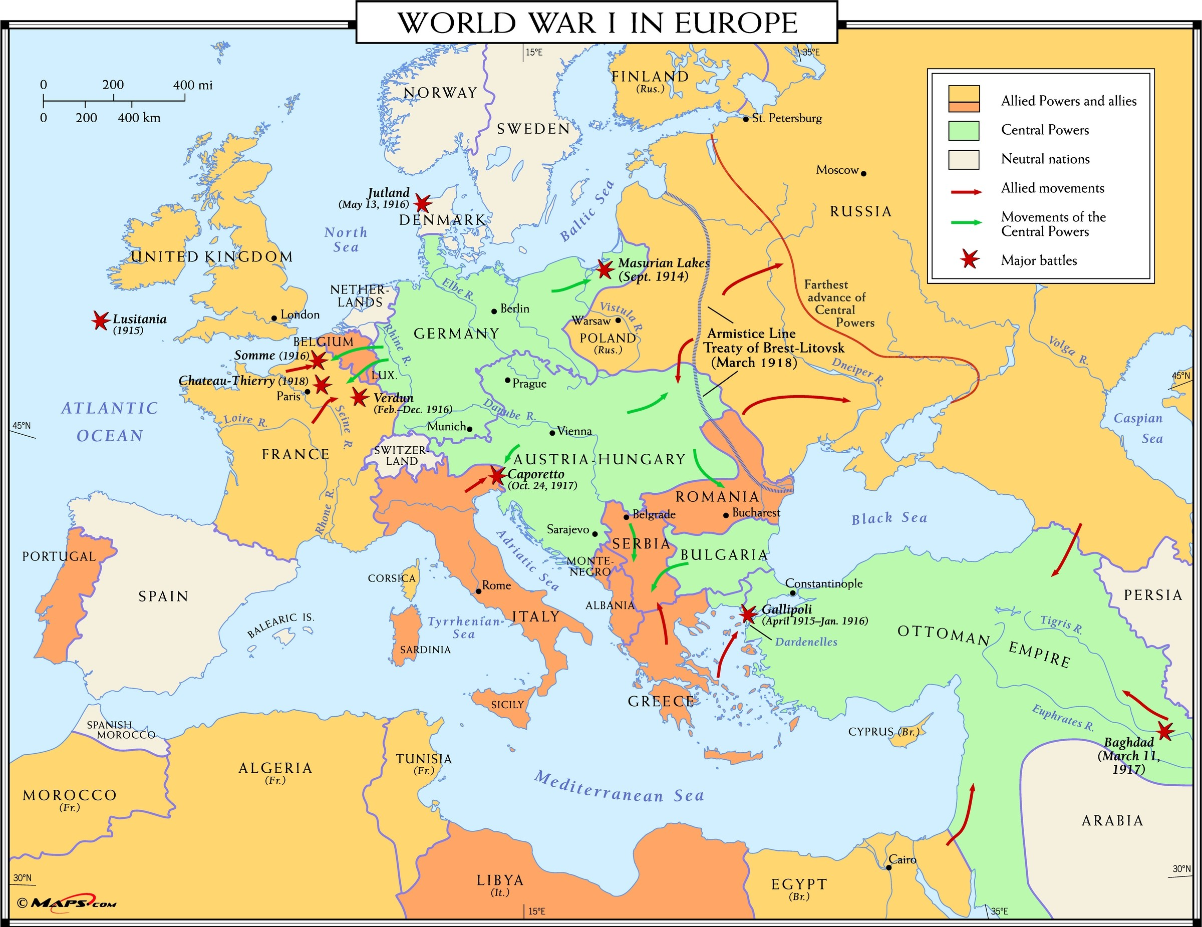

Slide 11
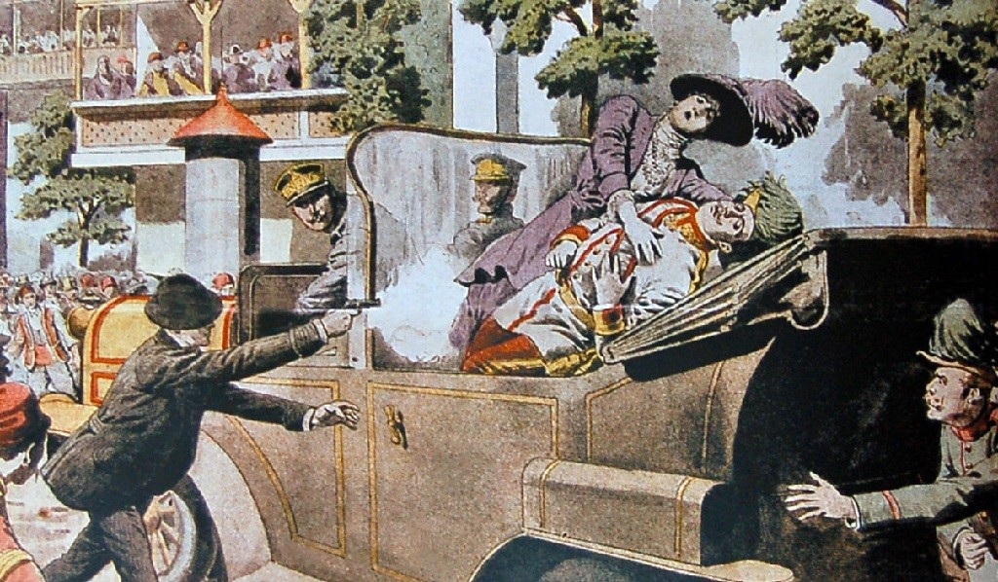

Slide 12
World War I
The Outset of War

Slide 13
SSWH17 - Demonstrate an understanding of long-term causes of World War I and its global impact.
b. Describe conditions on the war front for soldiers, include: new technology & war tactics

Slide 14
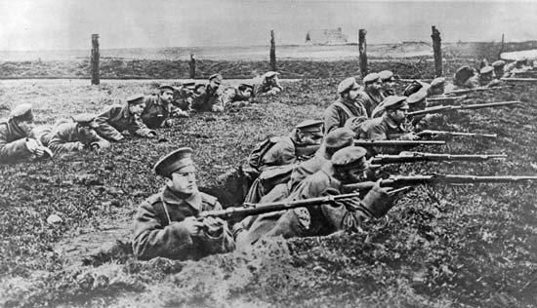

Slide 15
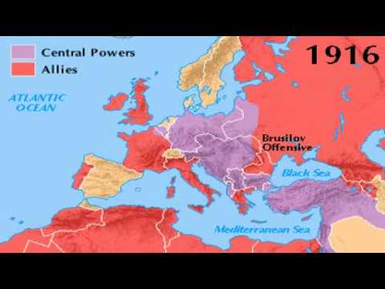
World War I: The Combatants

Slide 16
World War I
World War I was fought on 3 principal fronts:
Western Front
between France & Germany
Eastern Front
between Russia & Germany
At Sea
between the British & Germany
First conflict with industrialized warfare
Technological advances had both positive & negative affects on the war

Slide 17
World War I: Technological Advances
Germans develop synthetic rubber
Germans & British create new chemical weapons
Mustard Gas
Advances in firearms
Flamethrowers
Tanks
Fighter planes developed
Medical advancements
mobile x-ray units
rudimentary blood banks
reconstructive surgery

Slide 18
World War I: Western Front
Quickly developed a reputation for slaughter
Nicknamed “The Meat Grinder”
500-mile long network for trenches, bunkers, minefields, machine gun nests, & artillery
ran from Switzerland to the English Channel
Represented both the failures & successes of industrialized warfare
Mass production of weapons & ammunition made defensive positions easy to hold
Weak transportation technology made offense difficult
Led to a stalemate on Western Front

Slide 19
World War I: Western Front
Life on the Western Front for soldiers was horrible
Soldiers were confined to trenches & underground bunkers by the constant threat of artillery, gunfire and poison gas
Trenches were muddy leading to chronic foot infections known as trench foot, serious cases could lead to amputations
Vermin were everywhere and
Disease was common
Massive losses for both sides at battles of Verdun and Somme (1916)

Slide 20
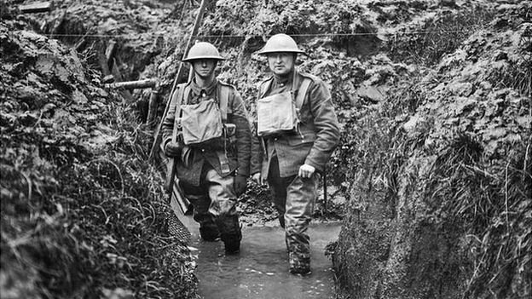
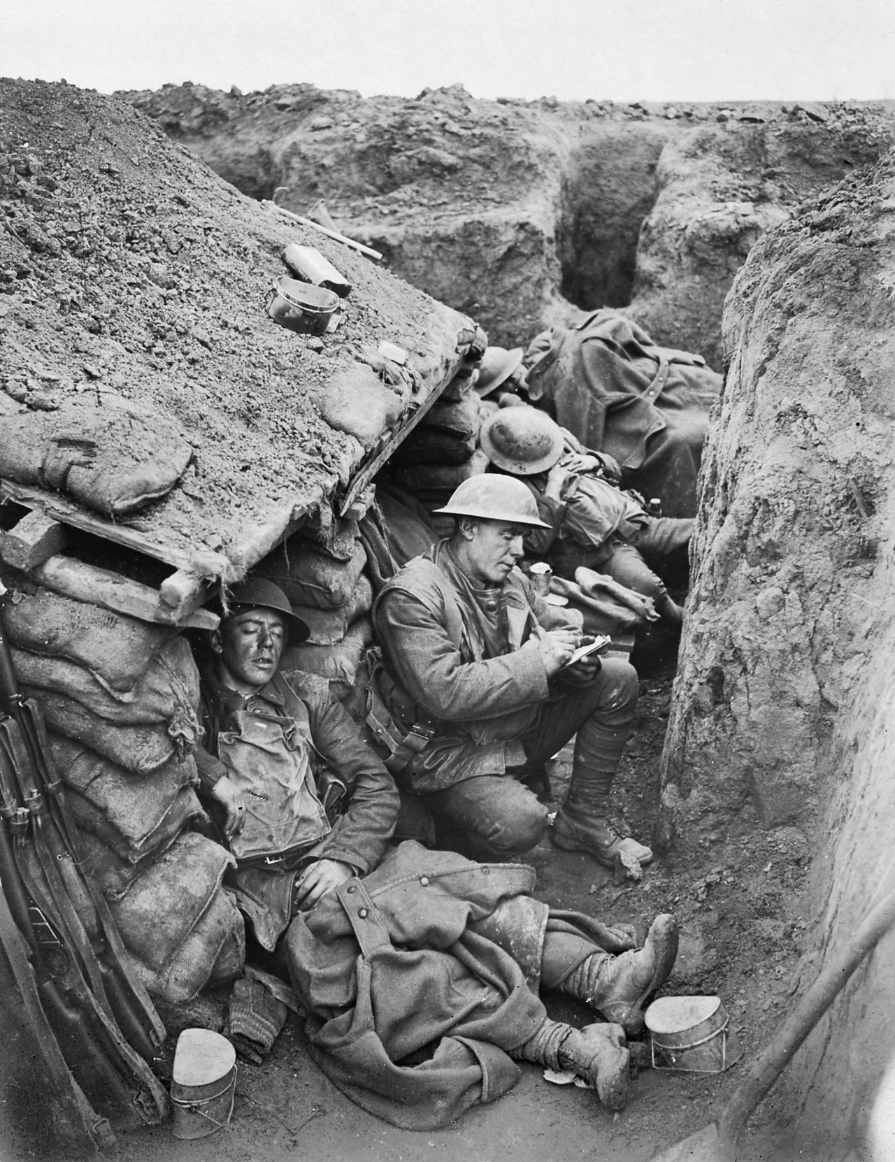

Slide 21
World War I: Western Front
Schlieffen Plan — German plan to quickly defeat France, then fight Russia in order to avoid a 2-front war
German army quickly advances to outskirts of Paris
Forced to retreat at First Battle of the Marne
Schlieffen Plan fails
Germany has to fight 2-front war

Slide 22
World War I: Eastern Front
Fighting along the Eastern Front demonstrated the superiority of highly industrialized nations over their less industrialized counterparts
By 1914, Germany was an industrial powerhouse while Russia was only in the early phases of industrialization
As a result, Germany dominated the Eastern Front
Russia was only able to hold off German forces with superior manpower & support from their allies
Germany’s domination of the Eastern Front led to a revolution in Russia & Russia’s subsequent withdrawal from the war in 1917

Slide 23
World War I: Naval Warfare
The success of the Allied Powers was largely due to the British Navy
Britain used superior weaponry, including underwater mines, to blockade Germany
The blockade cut off Germany from its colonies & raw materials
Germany tried to retaliate by using submarines to blockade Britain
Blockade was mildly successful
A German U-boat sank the British passenger liner Lusitania in 1915
several American civilians were on board
The sinking of the Lusitania shifted U.S. public opinion towards war
The U.S. entered the war in 1917
With the support of American factories, the American Navy, & American soldiers the Allies were able to outlast the Central Powers leading to an Allied victory in 1919

Slide 24
World War I: Outside of Europe
The Gallipoli Campaign
Allies move to capture Ottoman Dardanelles strait in February 1915
Hope to defeat Ottoman Empire, a Central Powers ally
Also want to open a supply line through region to Russia
Effort ends in costly Allied defeat
Battles in Africa and Asia
Allies take control of German holdings in Asia, Africa
Britain & France use their colonial subjects to help in war effort
Soldiers from colonies fought in colonies & in Europe
The deployment of troops from all over the world spread a particularly deadly strain of flu virus
From 1918 to 1919 soldiers spread this strain of flu to almost every person on earth & it killed 1 in 40 of those infected, more than 20 million people

