Slide 1
World Religions

Slide 2
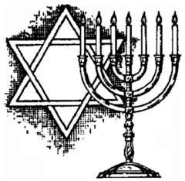
Judaism

Slide 3
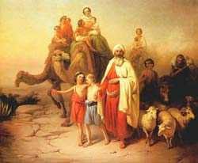
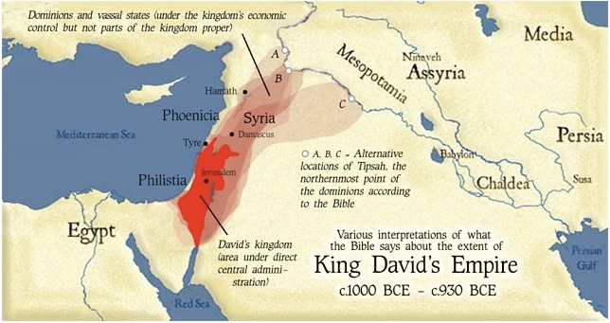
Founder, Origin, History
Abraham
“Hebrews”
Circa 1500 BCE

Slide 4
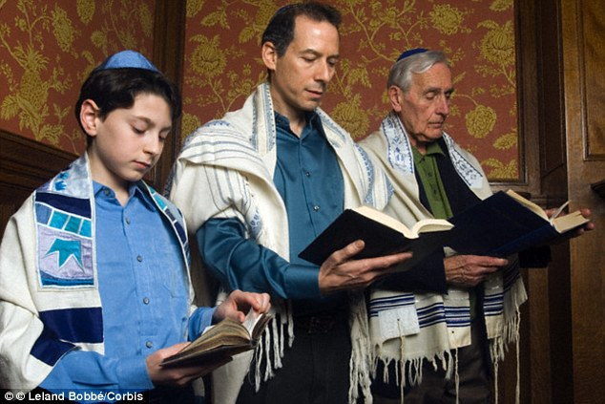
Adherents Worldwide
Approx. 200 million

Slide 5
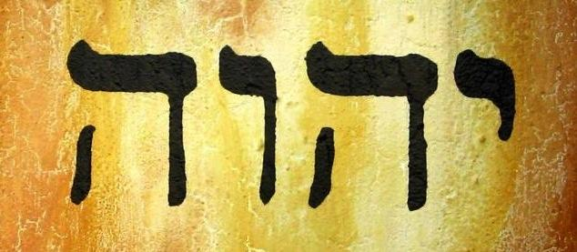
God(s) & Universe
One God
YHWH aka Yahweh

Slide 6
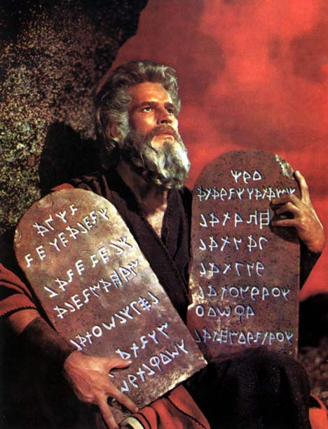
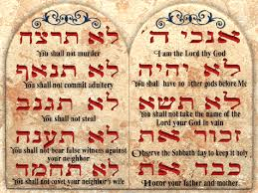
Human Situation & Life’s Purpose
Obey God’s commandments
Live ethically
Focus is more on this life than the next

Slide 7
Afterlife
Not historically emphasized
Beliefs vary from no afterlife to shadowy existence to the World to Come (similar to Christian Heaven)

Slide 8
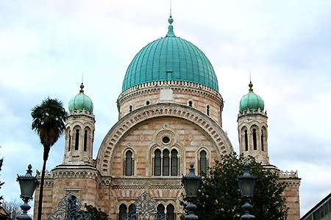
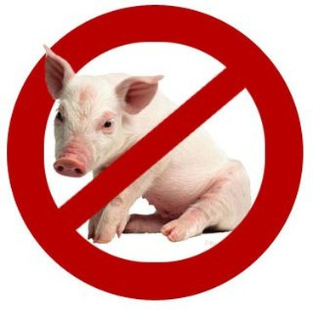
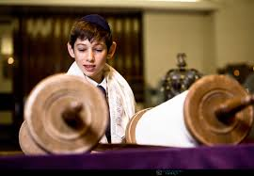
Practices
Male circumcision at birth
Bar/bat mitzvah at adulthood (13)
Synagogue services on Saturdays
No pork or other non-Kosher foods
Holidays related to historical events

Slide 9
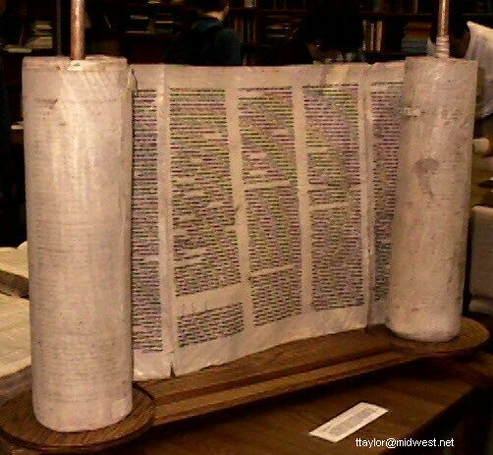
Texts
Bible (Old Testament)
Talmud
Torah

Slide 10
Christianity

Slide 11
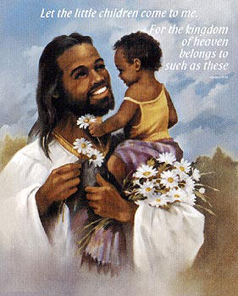
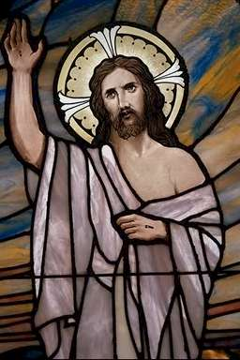
Founder, Origin, & History
Jesus Christ
Circa 30 AD
Jerusalem area
Modern day Israel

Slide 12
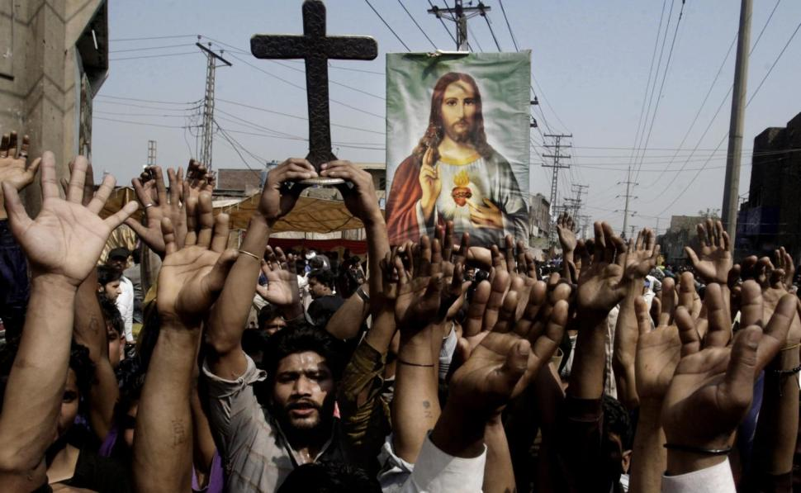
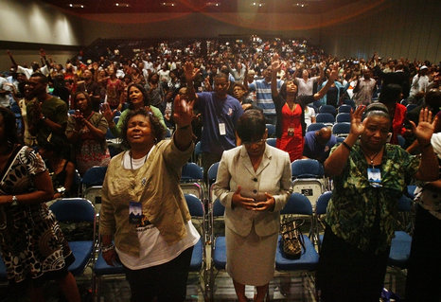
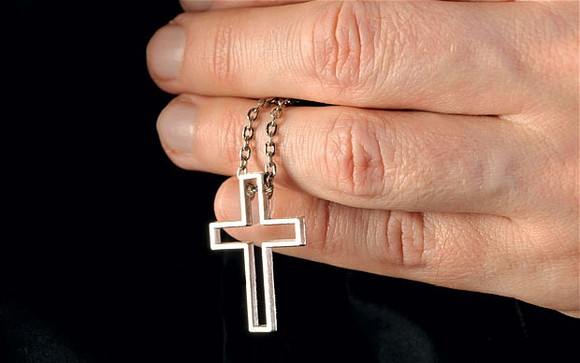
Adherents Worldwide
2 billion

Slide 13
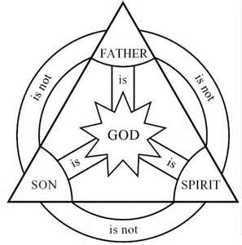
God(s) & Universe
One God who is a Trinity of Father, Son and Holy Ghost

Slide 14
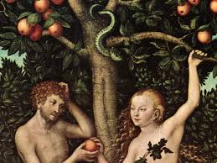
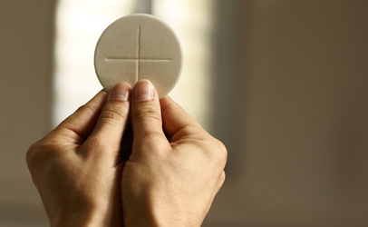
Human Situation & Life’s Purpose
All have sinned and are thereby separated from God
Salvation is through faith in Christ
For some sacraments and good works

Slide 15
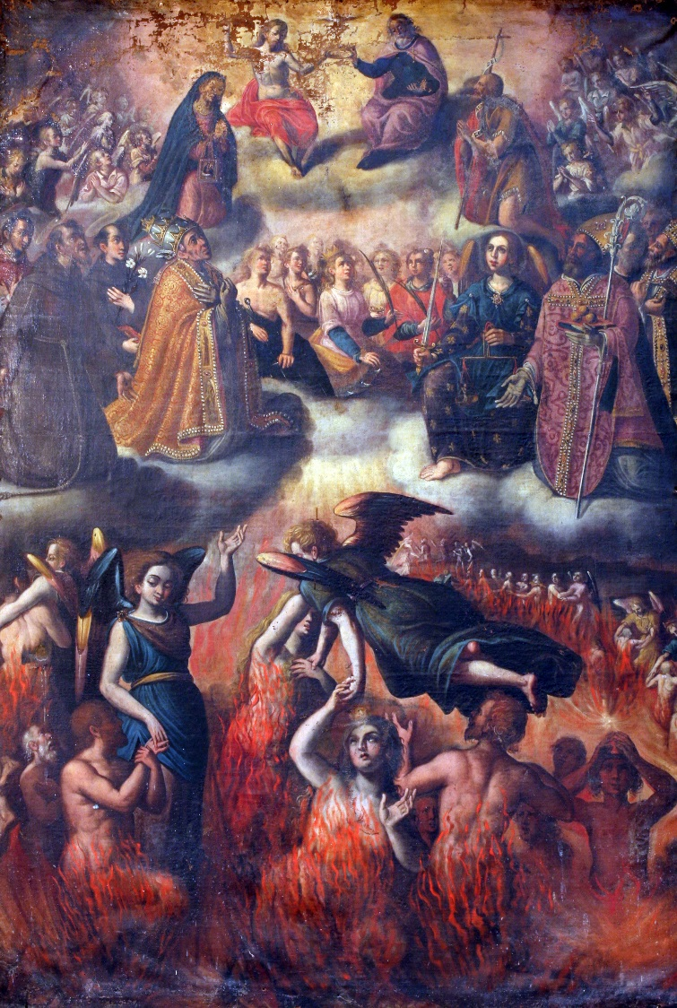
Afterlife
Eternal Heaven or hell
Temporary purgatory

Slide 16
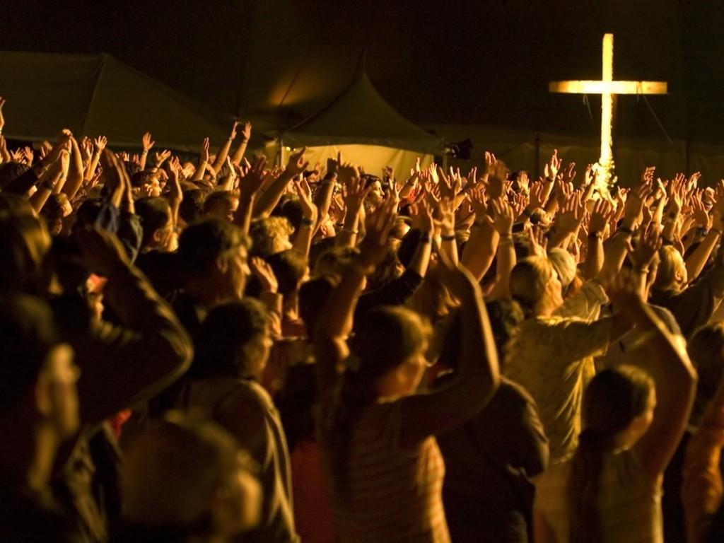
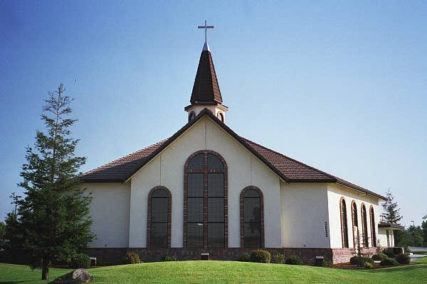
Practices
Prayer
Bible study
Baptism
Eucharist
Church on Sundays
Numerous holidays

Slide 17
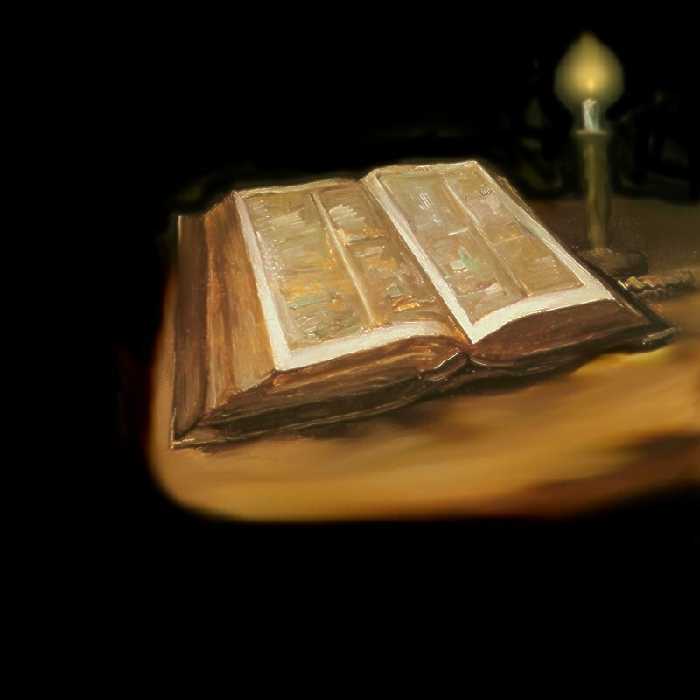
Texts
Bible
Old Testament
New Testament

Slide 18
Islam

Slide 19
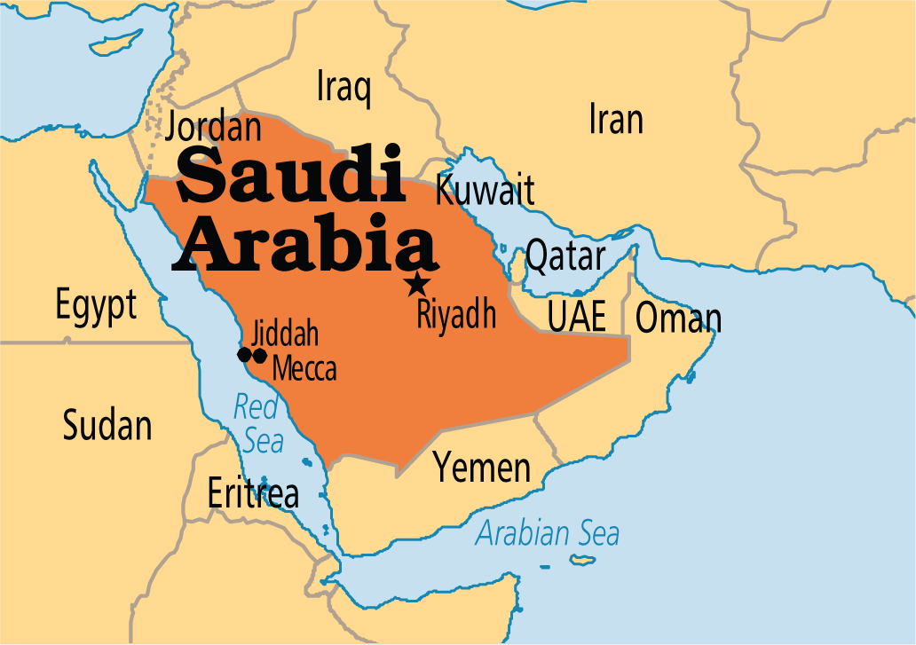
Founder, Origin & History
Muhammad
622 AD
Saudi Arabia

Slide 20
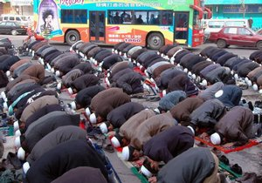
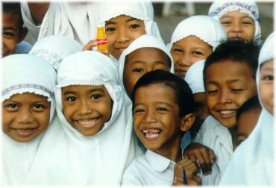
Adherents Worldwide
1.3 Billion

Slide 21
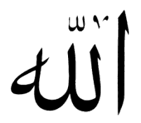
God(s) & Universe
One God
Allah
Muhammad is the last true Prophet

Slide 22
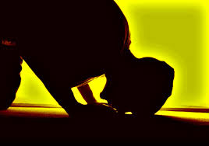
Human Situation and Life’s Purpose
Humans must submit to the will of God to gain admittance to paradise after death
Islam – submission to God’s will
Muslim – one who submits

Slide 23
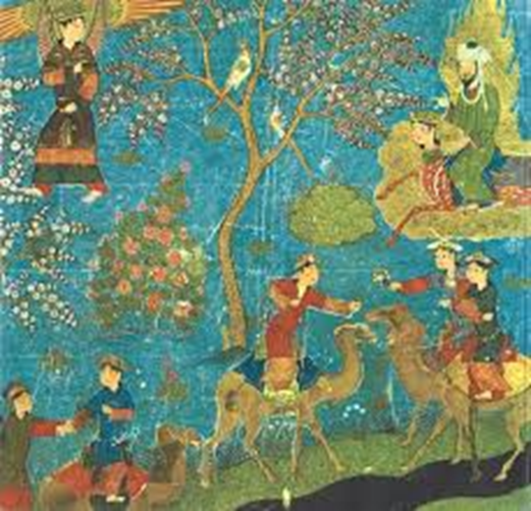
Afterlife
Paradise
Hell

Slide 24
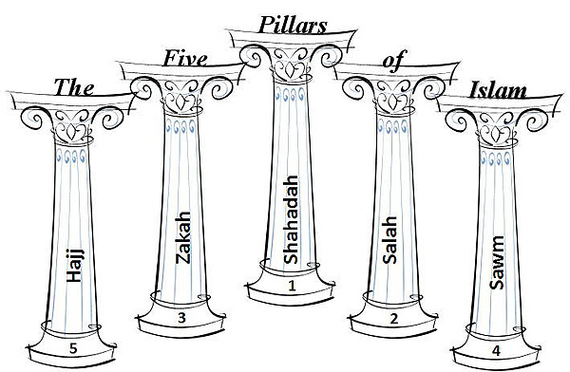
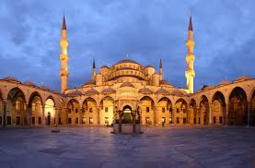
Practices
Five Pillars
Faith
Prayer
Alms
Pilgrimage -- Hajj
Fasting
Mosque services on Fridays
Ablutions before prayer
No alcohol or pork
Holidays related to the pilgrimage
Fast of Ramadan

Slide 25
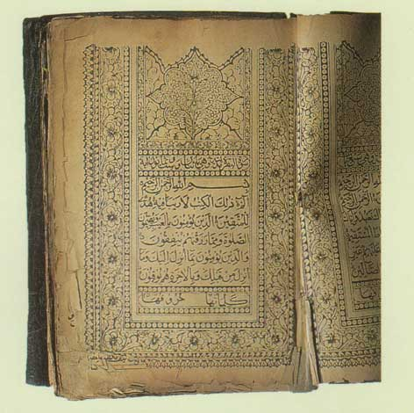
Texts
Qur’an (scripture)
Hadith (tradition)

Slide 26
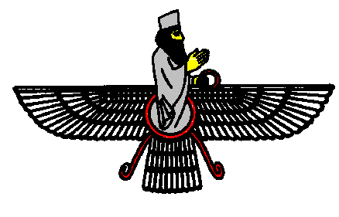
Zoroastrianism

Slide 27
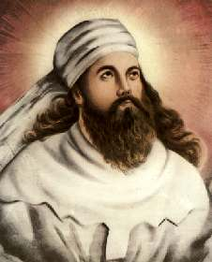
Founder, Origin & History
Zoroaster
Circa 6000 BC
Persia

Slide 28
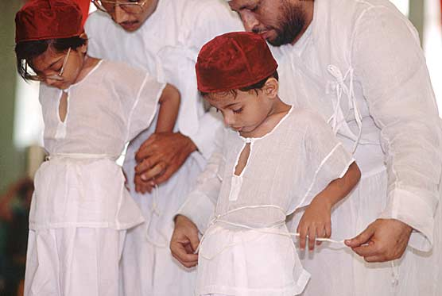
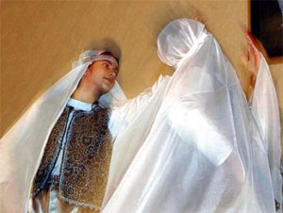
Adherents Worldwide
200,000

Slide 29
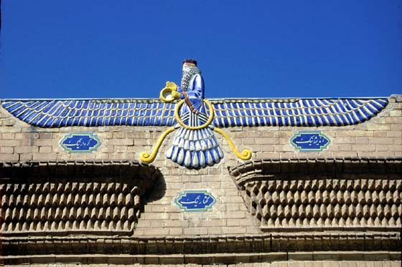
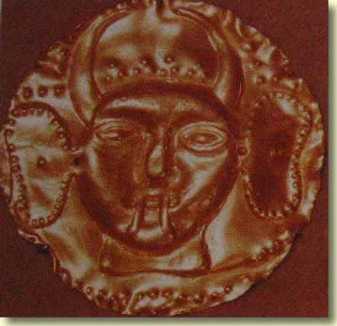
God(s) & Universe
One God, with two sides
Ahura Mazda -- Good
Angra Mainyu -- Evil

Slide 30
Human Situation & Life’s Purpose
Humans are free to do good or evil
Must choose the side of good

Slide 31
Afterlife
Judgment followed by heaven or hell
Hell is temporary until final purgation and return to Ahura Mazda

Slide 32
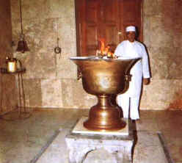
Practices
Good deeds
Charity
Equality
Hard work
Fire ritual

Slide 33
Texts
Zend Avesta

Slide 34
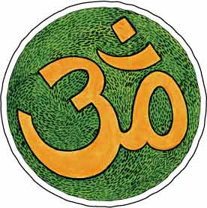
Hinduism

Slide 35
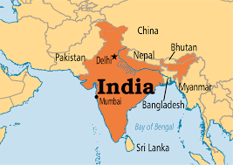
Founder, Origins & History
Indigenous Religion of India
Developed to present day

Slide 36
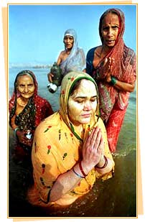
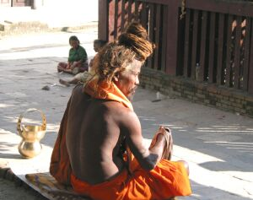
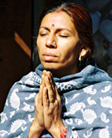
Adherents Worldwide
900 Million

Slide 37
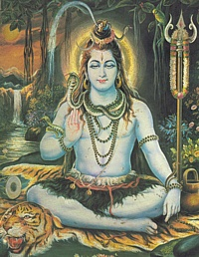
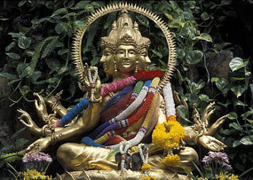
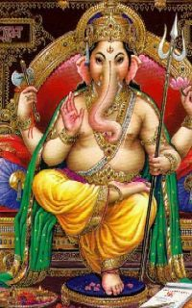
God(s) & Universe
One supreme Reality (Brahman) manifested in many gods and goddesses
Monotheistic
Trimurti statue of Brahma, Shiva & Vishnu symbolizing the supreme being.
Ganesh

Slide 38
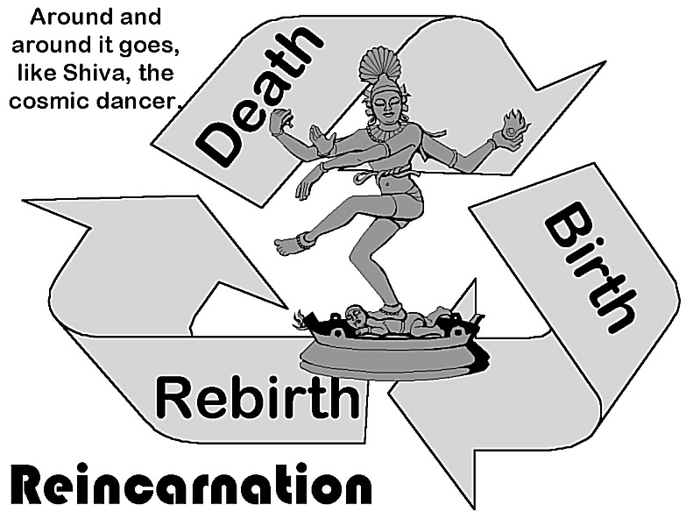
Human Situation & Life’s Purpose
Humans are in bondage to ignorance and illusion
But are able to escape
Purpose is to gain release from rebirth, or at least a better rebirth
Reincarnation

Slide 39
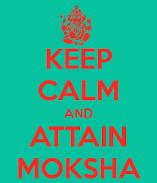
Afterlife
Reincarnation until enlightenment is gained
Moksha

Slide 40
Practices
Yoga
Meditation
Devotion to a god or goddess
Pilgrimage to holy cities
Live according to one’s dharma (purpose or role in life)

Slide 41
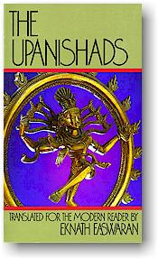
Texts
The Vedas
Upanishads
Bhagavad-Gita
Ramayana

Slide 42
Buddhism
Dharma Wheels

Slide 43
Founder, Origins & History
Siddharta Gautama (the Buddha)
Circa. 520 BC
North East India

Slide 44
Adherents Worldwide
360 Million

Slide 45
God(s) & Universe
Varies
Theravada – atheistic
Mayana – polytheistic
Buddha taught that nothing is permanent

Slide 46
Human Situation & Life’s Purpose
The purpose is to avoid suffering
Gain enlightenment and release from cycle of rebirth
Or at least attain a better rebirth by gaining merit
Reincarnation

Slide 47
Human Situation & Life’s Purpose, con’t
Four Noble Truths 1. Suffering exists 2. Suffering arises from attachment to desires 3. Suffering ceases when attachment to desire ceases 4. Freedom from suffering is possible by practicing the Eightfold Path

Slide 48
Human Situation & Life’s Purpose, con’t
Eightfold Path:
Right View
Right Thought
Right Speech
Right Action
Right Livelihood
Right Effort
Right Mindfulness
Right Contemplation

Slide 49
Afterlife
Reincarnation until enlightenment is gained
Nirvana

Slide 50
Practices
Meditation
Mantras
Devotion to deities (in some sects)

Slide 51
Texts
Tripitaka

Slide 52
Confucianism

Slide 53
Founder, Origin & History
Confucius
Circa 551-479 BC
China

Slide 54
Confucianism Adherents: 5 million

Slide 55
God(s) & Universe
none

Slide 56
Human Situation & Life’s Purpose
Purpose of life is to fulfill one’s role in society with propriety, honor and loyalty
Five Relationships
Subject to Ruler
Son to Father
Younger Brother to Elder Brother
Wife to Husband
Friend to Friend

Slide 57
Afterlife
Not addressed

Slide 58
Practices
Honesty
Politeness
Humaneness
Perform correct role in society
Loyalty to family and nation

Slide 59
Texts
Analects

Slide 60
Animism

Slide 61
Founder, Origins & History
Indigenous religion of pre-historic peoples from all over the world

Slide 62
Adherents Worldwide
unknown

Slide 63
God(s) & Universe
Multitude of gods and goddesses
Represented in all forms of nature
ALL THINGS HAVE A SPIRIT AND ALL SPIRITS MUST BE APPEASED

Slide 64
Human Situation and Life Purposes
The basis for animism is acknowledgment that there is a spiritual realm which humans share the universe with.
The concepts that humans possess souls and that souls have life apart from human bodies before and after death are central to animism, along with the ideas that animals, plants, and celestial bodies have spirits.

Slide 65
Afterlife
None addressed

Slide 66
Practices
gods often are immortalized by mythology explaining the creation of fire, wind, water, man, animals, and other natural earthly things.
Although specific beliefs of animism vary widely, similarities between the characteristics of gods and goddesses and rituals practiced by animistic societies exist.

Slide 67
Texts
none

