Slide 1
Women As World Leaders

Slide 2
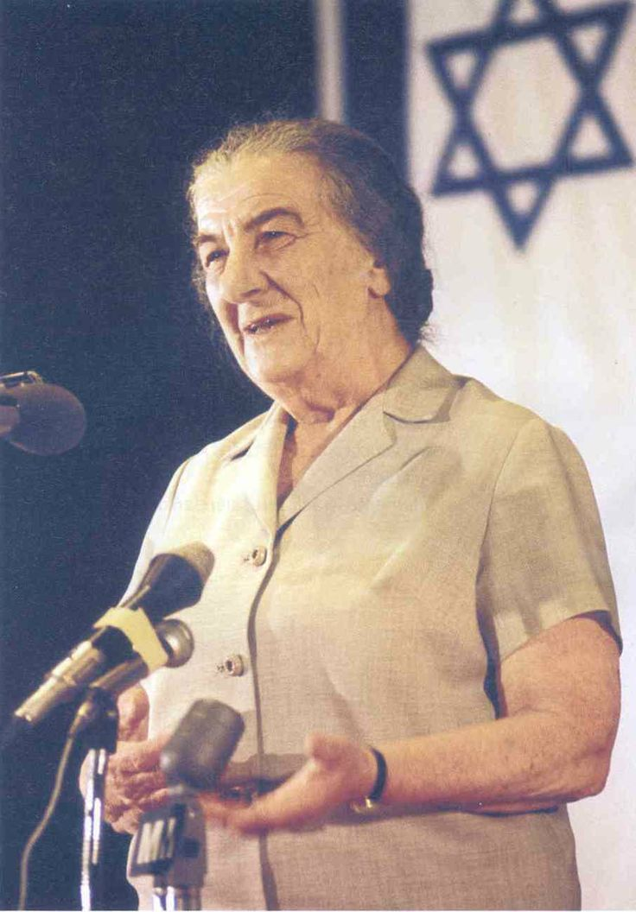
Golda Meir
Biographical Information
Born May 3, 1898 in Kiev (Capital of Ukraine)
1906 – Migrated to U.S.
1921 – Migrated to Palestine with husband
Died December 8, 1978

Slide 3
Golda Meir
Major Accomplishments
1920s – became a leader of the Zionist movement
supported unrestricted immigration of Jews to Israel
1946 – became leader of Jewish Agency
1948 – signed Israel’s Declaration of Independence
1949 – became a member of the Knesset, Israel’s parliament
1956 – served as foreign minister of Israel
1969 – elected Prime Minister of Israel
Resigned as Prime Minister in 1974

Slide 4
Golda Meir
Policies/Political Legacy
As prime minister, Meir instituted major programs in housing & road construction in Israel
Made attempts to form enduring peace agreements with Arab countries
efforts came to an unsuccessful end with the Yom Kippur War in 1973

Slide 5
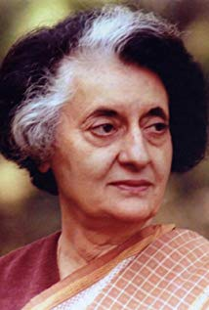
Indira Ghandi
Biographical Information
Born November 19, 1917
Father, Jawaharlal Nehru, 1st Prime Minister of India
No relation to Mohandas Ghandi
Grew up in the Indian independence movement
Died October 31, 1984
Assassinated by 2 of her bodyguards

Slide 6
Indira Ghandi
Major Accomplishments
jailed by the British for her efforts during Indian independence movement
1964 – became India’s 2nd prime
1977 – She was voted out of office
1980 – re-elected as Prime Minister

Slide 7
Indira Ghandi
Policies/Political Legacy
1980 – Sikhs in the Punjab region began to protest for an independent state
1982 – Thousands occupied the Golden Temple in Amritsar, the holiest site for Sikh worship
1984 – Gandhi sent troops to attack the demonstrators & killed more than a thousand Sikhs
In response, two of Gandhi’s Sikh bodyguards assassinated her within a few months.

Slide 8
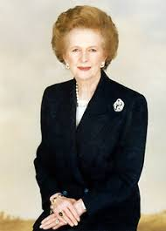
Margaret Thathcher
Biographical Information
Born October 3,1925 in Grantham, United Kingdom
Family owned 2 grocery stores
Methodist upbringing
Graduated from Oxford University in 1947
Died April 8, 2013

Slide 9
Margaret Thatcher
Major Accomplishments
1979-1990 – led the Conservative Party in Britain
1st female prime minister in Europe
Resigned in 1990 after becoming unpopular due to tax reforms

Slide 10
Margaret Thatcher
Policies/Political Legacy
fiercely opposed communism
embraced free-market economy
dramatically cut social welfare programs, ease government controls on business, reduce labor unions’ power, & privatize state-run industries
maintained close ties with United States throughout her tenure
political decline came when she replaced the property tax with the poll tax
The poll tax was the same percentage of tax, regardless of income level

Slide 11
Globalization

Slide 12
Globalization: Technology
The development of television, satellite, & computer technology since the 1980s has made access to information easy & immediate
Satellites are used for communications, weather, navigation, & military purposes
Television spreads information & art to large numbers of people simultaneously
American & British programs are broadcast internationally, increasing the use of English as a principle world language
there remains diversity, as telenovelas, for example, also find audiences outside of Latin America
CNN’s broadcast of the Persian Gulf War was watched around the world & inspired international versions of the news network

Slide 13
Globalization: Technology
Computers changed problem solving & processing capabilities.
Computers also have provided artists of all types with new tools for film, photography, music, & writing
Miniaturization made computers and many other electronic technologies available to huge numbers of people
The Internet has allowed people to exchange information almost instantly, a phenomenon that has been dubbed the information revolution
It has been embraced as a vehicle for business, dubbed “ecommerce”
many companies, both global & local, use the internet for marketing, sales, & research

Slide 15
Globalization: Organizations
Multinational corporations have been agents of technological change and global transfers of wealth
Companies in industrialized nations had the economic power to invest directly in mines & plantations in poorer countries
made even easier by international trade agreements & open markets
Trade agreements also made it possible for companies to relocate to escape restrictions & regulations imposed by any one nation, especially those in the industrialized world
Developing nations, desperate for foreign investment offered fewer regulations, usually resulting in lower wages & fewer environmental protections in these countries

Slide 16
Globalization: Organizations
1945 – Countries around the world joined together to create the United Nations
designed to maintain peace & security for member nations, & promote international cooperation culturally, politically, & economically
made up of a General Assembly in which each member nation has one vote & a Security Council with 10 rotating member states & 5 permanent state members.
These permanent members have veto power
The UN administers several organizations that promote peaceful cooperation globally
World Health Organization to fight disease
Food & Agricultural Organization to guard against food scarcity
UNICEF works to protect children around the world
UNESCO coordinates international cooperation as it relates to education, science, & culture

Slide 17
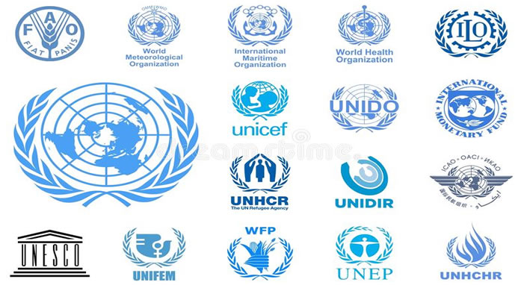

Slide 18
Globalization: Organizations
1951 – Iran nationalized its oil industry in an effort to receive greater economic benefit from its oil reserves
A boycott of Iranian oil demonstrated, however, that individual countries had little power on the world oil market
1960 – oil countries in the Middle East & Latin America formed OPEC - Organization of Petroleum Exporting Countries
Formed to promote their collective interests in the global oil market
OPEC has proven to have considerable political as well as economic power
1973 – Political & economic power most clearly demonstrated when OPEC cut off shipments of oil to the U.S. & the Netherlands in response to support for Israel in the Yom Kippur War
This created high prices & an oil shortage in the U.S.
Price hikes that followed in 1974 hurt many other countries, including Japan & its manufacturing industries that relied heavily on oil

Slide 19
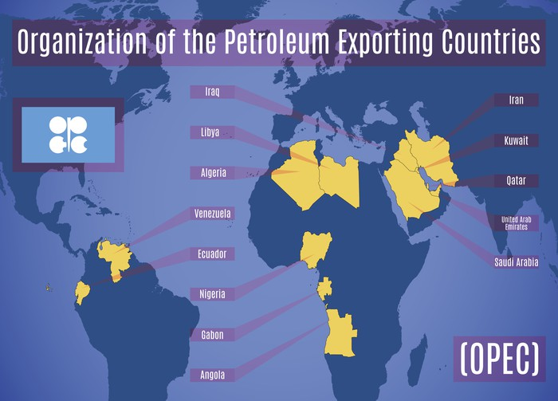
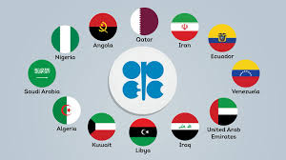

Slide 20
Globalization: Organizations
1995 – over 100 nations joined together to create the World Trade Organization
Created to facilitate free & reliable trade around the world
designed to reduce trade barriers & enforce trade agreement between nations
Free trade, however, was not universally beneficial
put pressure on manufacturers & workers in developed countries who lost job security
put pressure for domestic social and political reforms on developing countries as conditions for financial support & investment
Division over the WTO’s mission was also evident at a 2003 meeting
Nations were unable to come together when developing countries pushed richer countries to lower their agricultural subsidies that left poorer countries at a disadvantage in the world market.

Slide 21
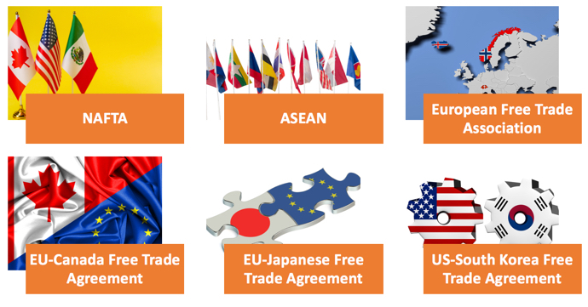

Slide 22
Globalization: Organizations
Industrialization around the world stripped natural resources & polluted the environment
Nations have struggled to come together on solutions
Strip mines ruined land
Pesticides destroyed soil, water, & insects
Oil spills killed marine life
air pollution led to acid rain
emission of greenhouse gases contributed to global climate change

Slide 23
Globalization: Organizations
1984 – a leak at a pesticide plant in India killed over 3,500 people
The meltdown of the Chernobyl nuclear power plant in Russia exposed thousands to lethal levels of radiation
As developing nations worked to gain economic footing through industrialization, solutions to overpopulation & environmental damage are challenging
These nations opposed environmental treaties that would regulate pollution in a way that inhibits their industrial growth
They point to the deforestation & pollution caused by industrialized countries in decades & centuries past.
The Kyoto Protocol adopted by over 100 nations at a meeting in 1997, as part of the United Nations Framework Convention on Climate Change, bound participating nations to meet certain emission reduction targets
It put a greater burden on developed countries as they were the ones primarily responsible for high levels of greenhouse gases, but required action by all countries
Though signed by U.S. President Clinton, the Senate never ratified the agreement, and thus the U.S. remained outside the Kyoto Protocol

