Slide 1
Foundations of Economics
Role of Government in Economics

Slide 2
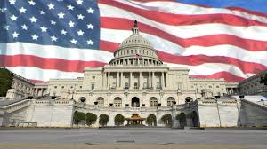
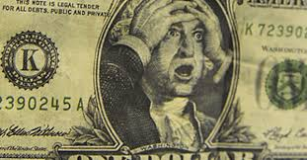
Government Role In Economics
Government is involved in economics on the federal, state, & local levels
Level of involvement rises & falls
Reasons for this rise & fall in level of involvement vary

Slide 3
Why is the Government Involved?
To provide public goods & services
To redistribute income
To protect property rights
To resolve market failures

Slide 4
Public Goods & Services
Public goods & services are those goods & services provided for publicly, usually by government
Ex. Police, schools, parks, highways, etc.
Governments typically provide public goods & services when the private sector cannot provide them on a level that is beneficial to society

Slide 5
Public Goods & Services
Public goods & services are typically paid for through tax revenue
“Purely” public goods share 2 characteristics
Shared consumption/non-rival - the consumption of the good by one person does not diminish the satisfaction enjoyed by another consumer who consumes the exact same good
Non-exclusion – one cannot be excluded from benefits whether paying or non paying
Free rider – one who enjoys the benefit of a good without incurring the cost of paying for it

Slide 6
Redistribution of Income
Governments may choose to redistribute income in order to pursue the social economic goal of equity
Redistribution in the U.S. occurs in the form of taking tax money from one group & giving to another group
Ex. Social Security, unemployment insurance, tax breaks, etc.
Also know as Transfer Payments
These payments subsidize the income of recipients to allow the consumption of necessities.
Safety net - collection of services provided by the state or other institutions such as friendly societies, including welfare, unemployment benefit, universal healthcare, etc

Slide 7
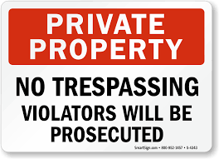
Protection of Property
the protection of private property rights is essential in a market economy
Consumers & business are more likely to purchase goods or invest in and expand their businesses if they have protections
Property rights are protected by intellectual property laws such as copyrights and patents, legal documents like deeds for real estate or titles for cars, and business licenses or corporate charter recognize the legal owner of a business
the courts hear property disputes and settles them based on an impartial “rule of law”

Slide 8
Market Failures
Market Failures occur when the private market is unable to produce goods and services in a way that the marginal benefit to society from the production of the good is equal to or greater than the marginal cost to society for producing the good
Market failures include externalities and market power

Slide 9
Externalities
Externalities can be both positive and negative
externalities occur when a third party, other than the consumer or producer of a good, is hurt or benefits from the production or consumption of that good
Ex. of negative externality – air pollution from a factory
Ex. of positive externality – new school decreasing class sizes
U.S. government usually tries to correct negative externalities with fines and other incentives to make it more expensive to produce the good
Intended to slow production of the good or service
U.S. government usually subsidizes positive externalities
Intended to increase production of good or service

Slide 10
Market Power
Market power refers to a market failure resulting from the formation of monopoly and oligopoly market structures
Monopoly – market controlled primarily by one seller of a good or service
Oligarchy – market controlled by several large firms

Slide 11
Government Regulation
the goal of the government is to provide for the health and safety of its citizens and its businesses
The government does this through regulation or deregulation
Government regulations take many forms
Some regulations protect citizens from corporate abuse.
Other government regulations help businesses recover from external problems by offering money to help offset an unforeseen disaster.

Slide 12
Example of Government Regulations
Examples of Increased Regulation:
The Sarbanes–Oxley Act of 2002 was a response to major problems with the accounting practices of large public companies. In the wake of corporate bankruptcies like Enron, Tyco, and WorldCom, Congress passed the act to regulate the way public companies handle their accounting. The purpose of the act was to increase the responsibility of the corporate board of directors for published financial records and to protect investors from financial loss due deceptive accounting practices. On the consumer side, government may pass laws regulating the information companies must provide to consumers. As obesity has become more of a problem in the United States, some states now require certain restaurants to publish nutritional information so consumers can make better choices. Credit card companies must publish information about how long it will take customers to pay off debt.

Slide 13
Government Regulations
Example of Decreased Regulation:
The Banking Act of 1933 or Glass-Steagall included many provisions connected with the U.S. banking system. Many believe, although there are those who disagree, that Glass-Steagall did not permit commercial banks to be involved in investment banking activities. In 1999, Congress repealed the parts of Glass-Steagall that many believed prevented commercial banks from acting as investment banks. This increased competition among financial institutions in the investment banking industry. However, some believe this increased risk-taking contributed to the Subprime Mortgage Crisis and Great Recession of the late 2000s.

