Slide 1
Economic Systems

Slide 2
Traditional Economy
Agriculture, hunting, fishing, and gathering based (typically 1 or more)
Barter/trade is used instead of money
Rarely surplus
Tribal or family based predominantly
Resources allocated based on inheritance
Based around wildlife and nature of the area
No private ownership; All work for the good of the group
There are still forms of specialization
original economic system in which traditions, customs, and beliefs help shape the goods and services the economy produces, as well as the rules and manner of distribution
Example of traditional economy:
Inuit of Canada

Slide 3
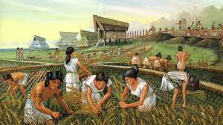
Traditional Economy
Inuit people of Northern Canada
South American Tribe

Slide 4
Traditional Economy
Advantages
Well defined roles
Very little waste & destruction of environent
Understanding of resources & how they are to be used
Understanding of what is received when doing their job
Advantages & Disadvantages
Disadvantages
Economy adversely affected by changes in weather
Very dependent on hunting, fishing, & gathering so if those areas are lacking they have to go without

Slide 5
Command Economy
Government creates economic plan
Supply & Demand not a determinant
Government allocates all resources
Government owns all businesses
Decide which businesses operate
Government sets prices of goods & number of goods produced
Ideally operates efficiently & eliminates unemployment, homelessness, poverty, etc.
Economic system in which the government owns and operates the factors of production
Example of a command economy
Cuba
North Korea

Slide 6
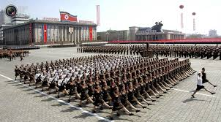
Command Economy
North Korea is last true command economy

Slide 7
Command Economy
Advantages
Quick & easy mobilization of resources on a large scale
Ability to transform a society
Little to no unemployment
Everyone equal
Lack of competition
Disadvantages
Lack of individual freedom
Lack of innovation
Lack of incentive
Lack of competition
Over/under production
Advantages & Disadvantages

Slide 8
Market Economy
Privately owned goods & services
Freedom to produce, sell, buy, or trade at will
Prices are controlled by supply & demand
Competition creates innovation
Limited government involvement
Profit is primary motivation for business owners
system in which economic decisions and the pricing of goods and services are guided solely by the market, or interactions of consumers and businesses
Example of Market Economy
United States

Slide 9
Market Economy
United States

Slide 10
Market Economy
Advantages
Most desired goods & services are produced
Goods & services tend to be as efficient as possible
Fosters & rewards innovation
Businesses invest in other successful businesses
Disadvantages
Competition hurts those who are at a competitive disadvantage (disabled, elderly, children, etc)
Human resources are not always optimized
Caters to the “winners” or the “haves”
Advantages & Disadvantages

Slide 11
Mixed Economy
Protects private property
Protects consumers
Protects those at a competitive advantage
Government regulates international trade, military, & public services such as transportation
Distributes goods & services where needed most
Rewards most efficient producers
Encourages innovation
system which combines aspects of pure market and command economic systems
Example of mixed economy
United States

