Slide 1
Foundations of Economics

Slide 2
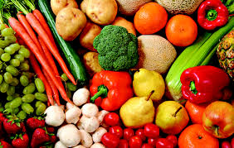
Needs vs Wants
What is a need?
good or service that is essential for life or required
Ex. Of Needs – Food, Shelter, Clothing, & Health Care
What is a want?
non-essential good or service; usually for pleasure
Ex. Of Wants – Luxury vehicle, Designer clothing, Mansion, etc.

Slide 3
Scarcity
Fundamental problem that all nations face
What is scarcity?
having seemingly unlimited human wants in a world of limited resources
How does scarcity come about?
People want more of something than there is available

Slide 4
Scarcity
Ex. – Mercedez-Benz Stadium holds 70,000 fans for an Atlanta Falcons game
100,000 fans want tickets.
How is it decided who gets tickets to the game?

Slide 5
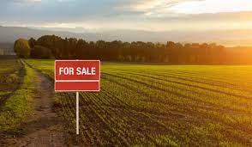
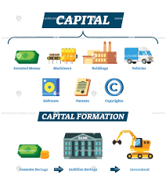
Factors of Production
Land
Labor
Capital
Entrepreneurship
inputs used in the production of goods or services in order to make an economic profit

Slide 6
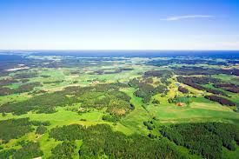
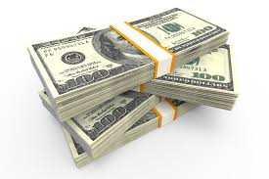
Productive Resources
materials, labor, or money used to create goods and services
Land, labor, & capital
Basic factors of production

Slide 7
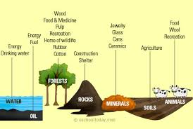
Productive Resources
Natural Resources
material sources of wealth that occur naturally and have economic value such as timber, fresh water, and mineral deposits
Land
Includes anything that comes from land
Ex. – lumber, gold, copper, water, oil, etc.
Human Resources
those who make up the workforce of an organization, business sector, or economy
Labor
Workforce
Human capital
Ex. – Teachers, employees of your favorite restaurant, doctors, lawyers, etc.

Slide 8
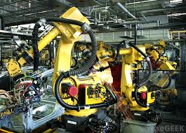
Productive Resources
Physical Capital
factor of production (or input into the process of production), consisting of machinery, buildings, computers, and the like
Ex. – Printing press, telephone, vehicle, etc.
Entrepreneurship
The capacity and willingness to develop, organize, and manage a business venture along with any of its risks in order to make a profit
Ex. – Starting a business

Slide 9
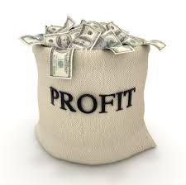
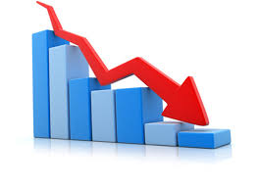
Risks & Motivations
Risks
Motivations
What is a risk?
The probability that an actual return on an investment will be lower than the expected return
What are examples of risks?
LOSS!!!
What is a motivation?
Driving force behind an action
What motivates entrepreneurs?
Profit, job creation, innovation, & improving society

Slide 10
Trade Offs
What is a trade off?
sacrifice that must be made to get a certain product or experience
Opportunity Cost
a benefit, profit, or value of something that must be given up to acquire something else
the next best alternative given up when individuals, businesses, and governments confront scarcity by making choices

Slide 11
Opportunity Costs
Individuals
Give an example of an opportunity cost for an individual or consumer
Ex. – purchasing a compact vehicle vs purchasing a luxury vehicle
Businesses
Give an example of an opportunity cost for a business
Ex. – hiring 5 new employees to meet long term demand vs using temporary employees to meet short term demand
Government
Give an example of an opportunity cost for a government
Ex. – spending on the military vs spending on health care

