Slide 1
The Rise of Imperialism & Nationalism

Slide 2
Objectives
Students will be expected to:
List the factors that led to the rise of nationalism
Explain how nationalism led to the rise of imperialism
Describe the influence of industrialization on imperialism
Explain the impact of imperialism

Slide 3
Standards
SSWH16 – Analyze the rise of nationalism & worldwide imperialism.
a. Compare & contrast the rise of the nation state in Germany under Otto von Bismarck & Japan during the Meiji Restoration
b. Assess imperialism in Africa & Asia, include: the influence of geography & natural resources

Slide 4
Germany & Japan: Factors that led to Rise of Nationalism
Germany
Became a nation-state in 1871
Shared history & cultural identity drove unification
Religion
Social customs
Common language
Foreign threats
Japan
Became a modern nation-state in 1867
Shared history & cultural identity drove unification
Religion
Social customs
Common language
Foreign threats

Slide 5
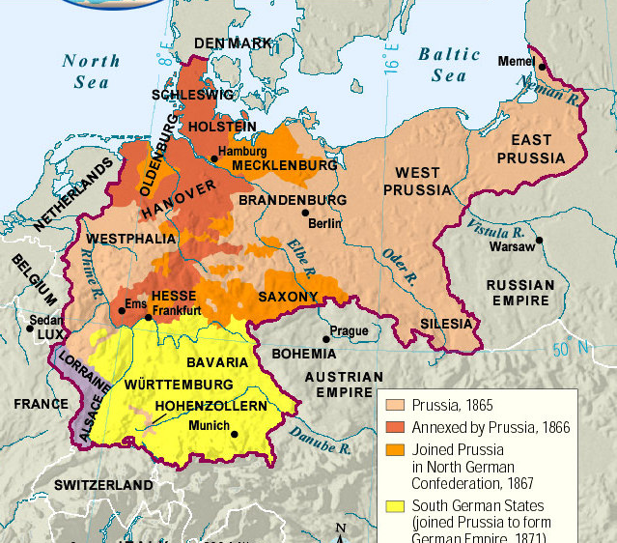

Slide 6
Germany & Japan: Factors that led to Rise of Nationalism
Germany
Japan
Otto von Bismark
Prussian Prime Minister
Unified Germany
Ruled “blood & iron”
Manufactured much of the foreign threat against Germany
Incited 3 wars
France
Austria
Denmark
Unlike Germany’s threats, Japan’s foreign threats were very real
U.S., Russia, France, & Britain
Meiji Restoration led to Japanese unity & nationalism
Restored a sense of stability with Japanese people
Emperor had no real power but became a symbol of unity
Meiji reforms led to modernization, westernization, & industrialization

Slide 7
Germany & Japan: Factors that led to Rise of Imperialism
Germany & Japan:
Evolved into modern-nation states
Industrialized rapidly
Built powerful militaries
Were motivated by nationalism & economics to turn to imperialism, or empire building
Germany
Built a vast empire in Africa and Southeast Asia
Japan
Took large parts of East Asia (Korea, Manchuria, Taiwan)

Slide 8
Imperialism
Africa & Asia

Slide 9
Imperialism: Factors
European, U.S., & Japanese imperialism in the 19th & 20th century grew out of industrialization
Need for raw materials such as metals, coal, rubber, cotton, & palm oil to mass produce goods
Need for new markets to sell the goods produced
Desire for luxury goods & spread of Christianity still factors
European nations, U.S., & Japan used military might to conquer vast empires
Industrialization led to military might
Nationalism used to justify conquering other people & lands

Slide 10
Imperialism
1815 – Western European & U.S. controlled 35% of the earth’s habitable territory
1914 – Western European & U.S. controlled 85% of this territory.

Slide 12
Imperialism: Justification
While imperialism during 1600’s was easily justified by religion, new imperialism needed different justification
Darwin’s book Origin of the Species gave these countries the natural selection justification
U.S. & European nations had evolutionary advantage thus the right to conquer
White Man’s Burden
It was more advanced peoples’ (Europeans & Americans) job to help the less advanced peoples’ (people of color) become more civilized

Slide 13
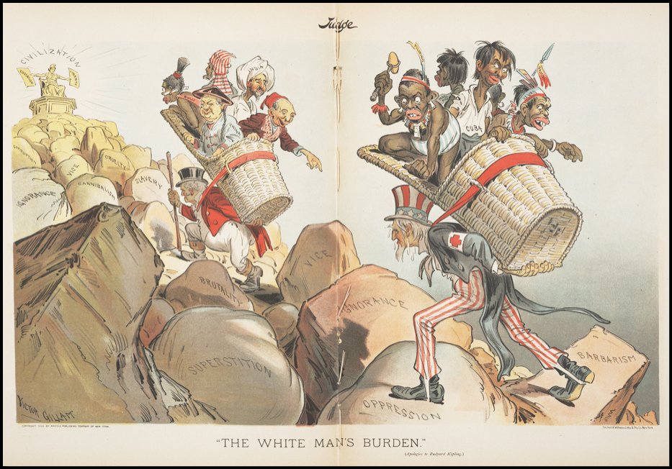

Slide 14
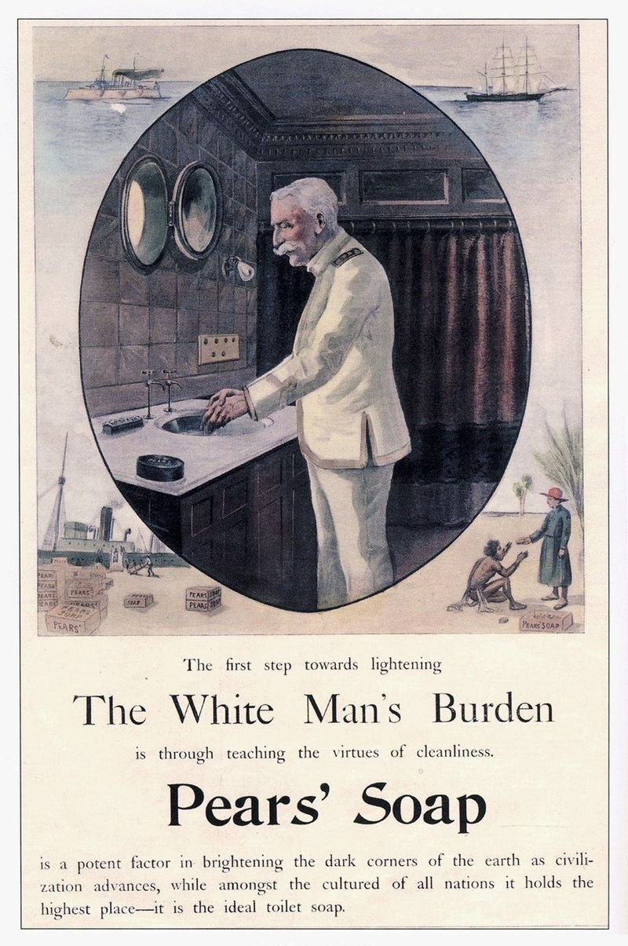

Slide 15
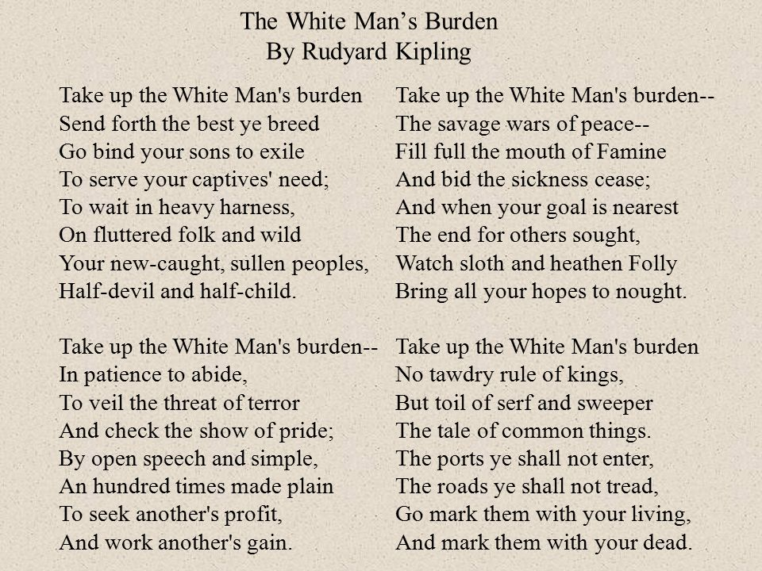

Slide 16
Imperialism: Africa
17th century – Europeans first established colonies in Africa
Dutch (Belgium) established a colony in South Africa
Portuguese formed a colony in Angola
Tropical regions were generally safe from European power because of tropical diseases like malaria until 19th century
19th century – use of quinine to treat malaria greatly reduced the threat of disease
Allowed for Europeans’ systematic conquest of the continent

Slide 17
Imperialism: Africa
1800s – British arrived in southern Africa
Pushed the descendants of Dutch settlers, called Boers, north into Zulu and Xhosa territory
Boers established 2 independent countries
The discovery of gold & diamonds in these territories brought war with the British & expansion of British territory in South Africa
1899 – Boer War
Around the same time, French began a brutal campaign to take Northwest Africa
1880s – France, Britain, Portugal, Belgium, Germany, Italy & Spain were racing to take over the continent in what is called the Scramble for Africa

Slide 18
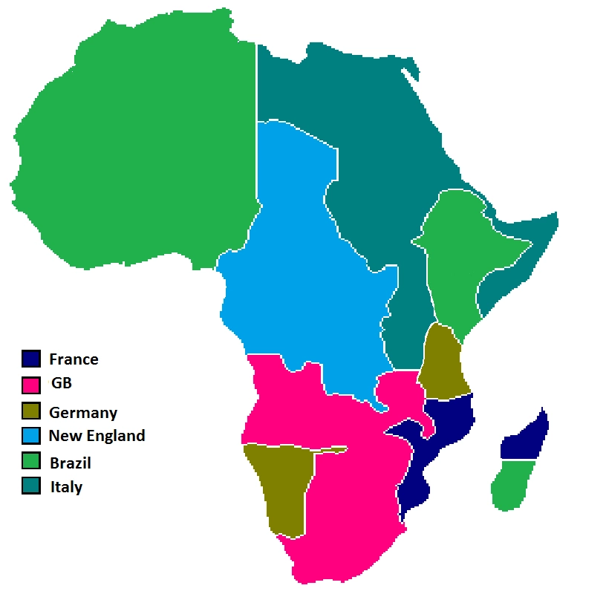
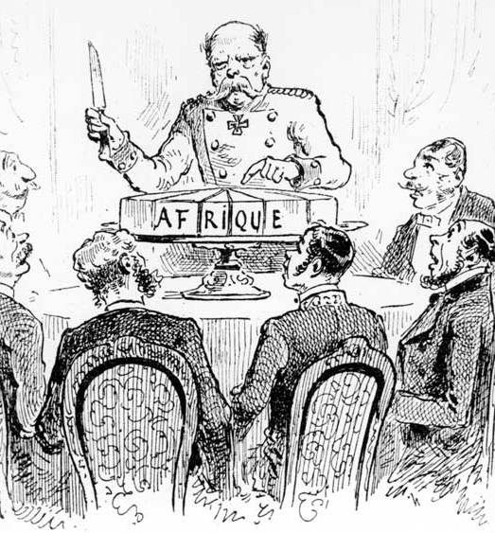

Slide 19
Imperialism: Africa
1884 – European powers met in Berlin in 1884 to divide up the African continent
Berlin Conference – 14 countries
Countries must claim land & prove ability to control it
Following the conference, only 2 African nations remained independent
Ethiopia managed to modernize fast enough to fight off Italy
Liberia was protected by the U.S.
Europeans began to drain African natural resources including palm oil, ivory, rubber, gold, diamonds, metals, & cotton

Slide 20
Imperialism: Africa
The European rule in Africa was a mixture of economic exploitation, racist subjugation & well-meaning reform
Belgium, Germany, & Portugal tended to be more ruthless
Britain & France more benevolent, or well meaning
All of the Europeans contributed to economic exploitation, ethnic tension & modernization
Negatives
Natural resources & luxury goods were harvested & mined for the exclusive benefit of European overlords
Ethnic tensions between African groups were exacerbated by poorly placed borders & sometimes exploited to facilitate European control
Violent conflict killed thousands as modern European armies crushed poorly equipped but determined Africans

Slide 21
Imperialism: Africa
All of the Europeans contributed to economic exploitation, ethnic tension & modernization
Positives
Schools, hospitals, & infrastructure were built that became an asset to the African people
The slave trade was suppressed
educated African elite were allowed to help in administration
European rule spurred African nationalism, unified diverse peoples & eventually planted the seeds for independence in the 20th century.

Slide 22
Imperialism: India
Imperialism in Asia also dates back to the Age of Exploration
1500s & 1600s – Europeans begin to colonize Asia
1700s & 1800s – Vast Asia empires established by European nations
Portuguese, Dutch, & French established coastal footholds in South Asia
British ended Mughal rule & brought all of South Asia into their empire

Slide 23
Imperialism: India
British East India Company (BEIC)
Motivated by lucrative commodities like cotton, spices, tea, & opium
Used a combination of diplomacy & warfare to gain control of India
After decline of Mughal Empire, BEIC offered services including military protection, tax collection, & administration to local rulers in exchange for access to trade
Over time, the BEIC became the dominate power in the region
BEIC employed a multitude of both native administrators & soldiers (called sepoy).

Slide 24
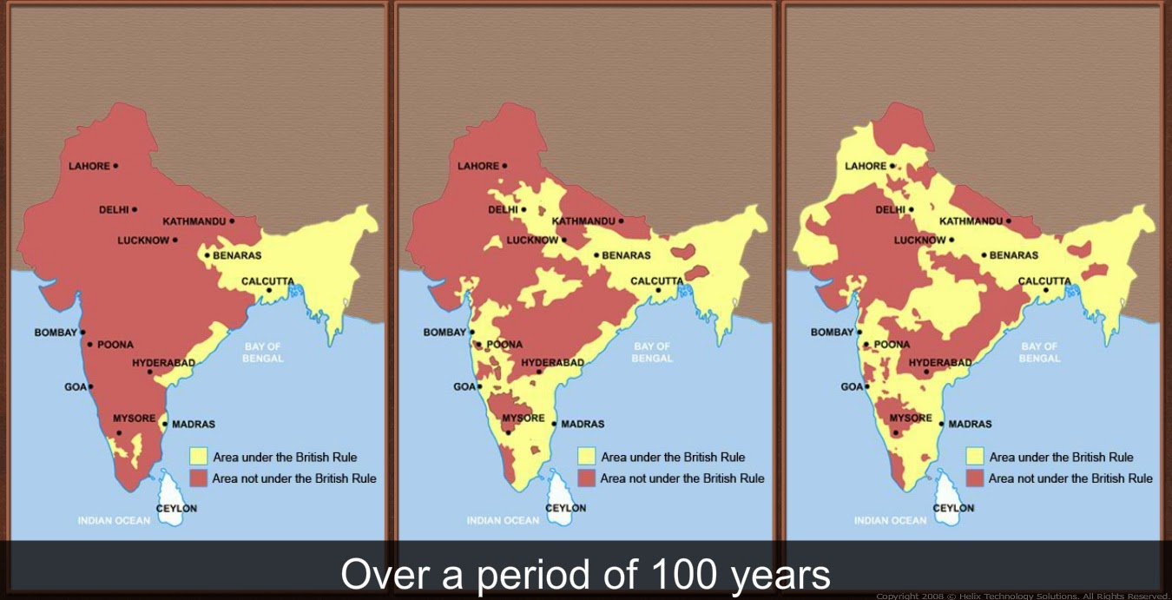

Slide 25
Imperialism: India
British East India Company rule over India came with exploitation & benefit
Negatives
Mismanagement & greed caused famines & cholera epidemics
Positives
The philosophy of “white man’s burden” brought schools, hospitals, & improved food distribution systems
Trade brought railroads & telegraphs
Following the Sepoy Mutiny, British took direct control of India from 1757 to 1947
India was the “crown jewel” of Britain in southern Asia for over 90 years

Slide 26
Imperialism: China
China became a target of European imperialism due to political arrogance & ignorance as well as the trade of lucrative goods like silk, porcelain, & tea
Qing Dynasty of China continued to view their home as the Middle Kingdom surrounded by barbarians with nothing to offer the culturally superior Chinese.
This attitude led to the creation of the Canton System
The Chinese government limited foreign merchants to a small number of ports, with Canton being the most significant
Merchants only allowed to purchase Chinese goods with silver

Slide 27
Imperialism: China
Western diplomats protested this trade imbalance & asked for right to sell European goods in China
Chinese government responded by dismissing the usefulness of European goods to the Chinese
British turned to highly addictive opium, which they began to market for recreational use in Chinese ports
British marketing efforts were successful
Reversed trade imbalance in Chinese ports
Many Chinese addicted to Opium
Led to Opium Wars

Slide 28
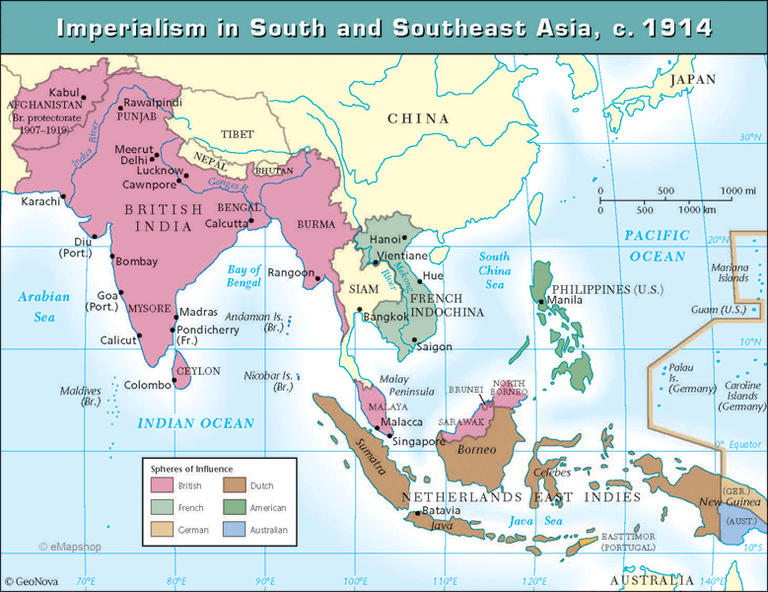
Imperialism: China
Access to commodities like rubber, petroleum, & metals combined with a strategic location along key trade routes motivated Dutch, French, German, American & British corporations & governments to establish colonies in Southeast Asia

