Slide 1
The Holocaust
Ideology & Consequences

Slide 2
Georgia Standards of Excellence
SSWH19 – Demonstrate an understanding of the global political, economic, & social impact of World War II
b. Identify Nazi ideology & policies that led to the Holocaust & its consequences

Slide 3
Hitler’s Nazi Racial Ideology
Hitler defined Nazi racial ideology in his book, Mein Kamph
Nazi Party Beliefs
Germanic people of Europe were the only pure descendants of the ancient Aryans
Success of the Aryans in spreading their language across Eurasia was proof of their superiority
Modern Germanic peoples inherited this superiority & were entitled to become a master race
Non-Aryan people were ranked

Slide 5
Hitler’s Nazi Racial Ideology
Non-Aryan Peoples
Some groups were considered tolerable
Slavs were considered naturally inclined to slavery
Roma were considered genetically criminal
Jews were considered dangerous
Germanic people who threatened the purity & security of the race were also viewed as a danger
Germans with severe congenital disabilities, mental illness, & criminal backgrounds were considered a pollutant to the German bloodline
Homosexuals were viewed as a threat to the virility (strength, manliness) of the race
Over the course of Nazi rule a variety of policies were put into action in response to these ideas.

Slide 6
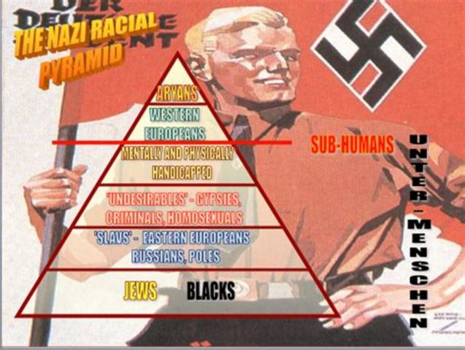
Sample Footer Text
12/3/2018
3

Slide 7
Hitler’s Nazi Policies
Approximately 100,000 German men were arrested for homosexuality between 1933 & 1945
While most homosexuals were held in traditional prisons between 5,000 & 15,000 were interned in concentration camps where they were used as forced labor
1934 – 300,000 to 400,000 people were forced to undergo sterilization procedures either because of a disability or ethnicity
Around 200,000 disabled & mentally ill Germans were executed between 1940 and 1942 during Nazi euthanasia programs
In the mid-1930s, Roma populations in Germany were corralled by police & forced into government camps

Slide 8
Hitler’s Nazi Policies
1940 – Nazis began sending the Roma to concentration camps where they were used as forced labor, subjected to bizarre research by Nazi doctors or executed
By the end of the war, as many as 200,000 European Roma were dead
When the Nazis invaded Poland in 1939 they began to systematically execute Polish Catholic professionals, teachers, & government leaders
The Nazis believed that without leadership, the Polish people would easily submit to slavery
Approximately 3 million Polish Catholics were dead by the end of the war
Several thousand German & Austrian Jehovah's Witness were arrested in the late 1930s for refusing to swear loyalty to the state
Many of these Witnesses were subjected to forced labor in concentration camps, more than 1,000 died in these camps

Slide 9
Hitler’s Nazi Policies
While the Nazis targeted many groups in the Holocaust, the Jewish population of Europe was targeted with particular fanaticism
Hitler exploited long held anti-Semitic feelings in Europe, arguing that the Jewish population was at fault for most of the country’s hardships including defeat in World War I & the financial crisis of the Great Depression
Hitler argued that Jewish people were dangerously clever & worked in collusion to exploit the non-Jewish population of Europe
When Hitler took power in the 1930s he planned to drive the Jewish population out of Germany

Slide 10
Hitler’s Nazi Policies
1935 – Nuremberg Laws revoked German citizenship from the Jewish population
Later laws restricted Jewish business activities & tightly regulated financial transactions
Hitler & the Nazi Party hoped this would pressure the Jewish population to leave Germany
many did; but by 1940 most of the world refused to accept any more German Jewish immigrants
November 1938 – Nazi party members systematically attacked Jewish owned property all over Germany
Windows of Jewish businesses, homes, & synagogues were smashed leading to the name Kristallnacht, or the “night of broken glass”

Slide 11
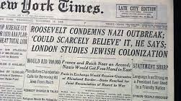
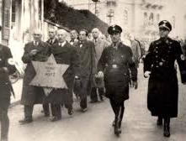

Slide 12
Hitler’s Nazi Policies
1939 – Nazis began forcing the Jewish population into walled ghettos in German & Polish cities
As ghettos became overcrowded & the war raged on, Nazis built massive concentration camps in Germany & Poland where Jews from all over Europe were sent to work as slave laborers
1942 – Nazi leadership decided to carry out the “final solution to the Jewish problem,” the systematic execution of Jewish population of Europe
Before 1942 Nazi SS units killed Jews with firing squads & mobile gas chambers in box trucks but these methods were deemed too slow
In 1942 massive complexes were built designed to kill & incinerate up to 12,000 people per day
Most of these were in Poland
Inmates arrived from all over Europe, those deemed fit enough to work became slave labor, the weak were sent to gas chambers
By the end of the war 6,000,000 Jewish people were dead.

Slide 13
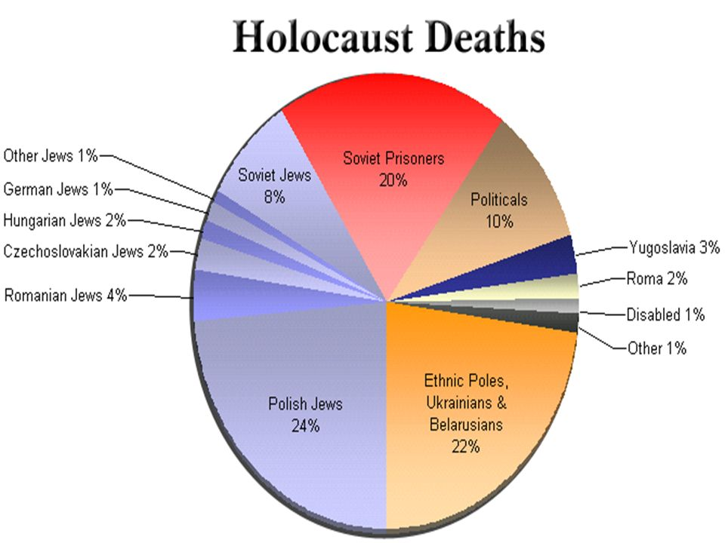

Slide 14
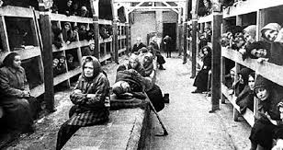
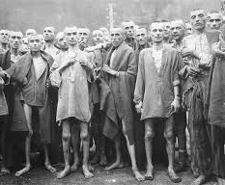
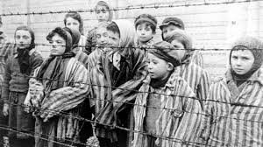

Slide 15
