Slide 1
The Development of

Slide 2
Development of Monotheism
Aspects of monotheism emerged in a variety of places and times during the rise of civilization
Egypt under the Pharaoh Amenhotep IV in the mid-1300s BCE
Persia after growth of Zoroastrianism in the 600s BCE
Monotheism reached its most complete & enduring form among the Hebrews starting around 1250 BCE.

Slide 3
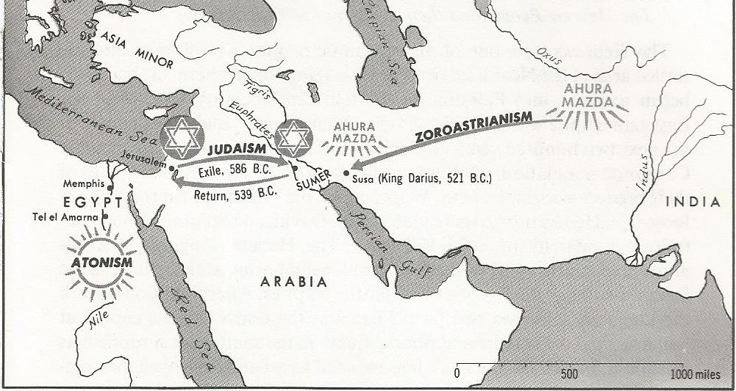
Development of Monotheism

Slide 4
Development of Monotheism
The beliefs of the Hebrews were recorded in the Hebrew Bible
began with the Hebrew people (led by Moses) entering into a covenant with God in which God promises to protect His chosen people in exchange for their exclusive obedience to Him.
The basic tenants and Judaism, including monotheism, were established in this period as the Ten Commandments.

Slide 5
Development of Monotheism
The Hebrew people established a kingdom on the eastern Mediterranean in about 1020 BCE
split into two kingdoms in 920 BCE.
The concept of monotheism became more formalized during this period

Slide 6
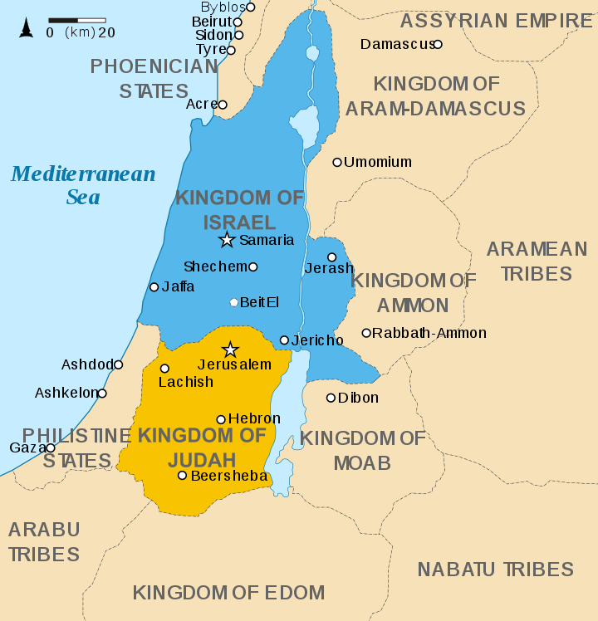
Development of Monetheism

Slide 7
Development of Monotheism
Hebrew version of monotheism spread to other areas by the Jewish diaspora
began with the conquest of the northern Kingdom of Israel by the Assyrians in 721 BCE & the deportation of many Jewish leaders to Babylonia in 587 BCE
While in Babylonia, the institution of the Synagogue was established & in about 450 BCE Judaism as a monotheistic faith was fully developed with the completion of the Hebrew Bible

