Slide 1
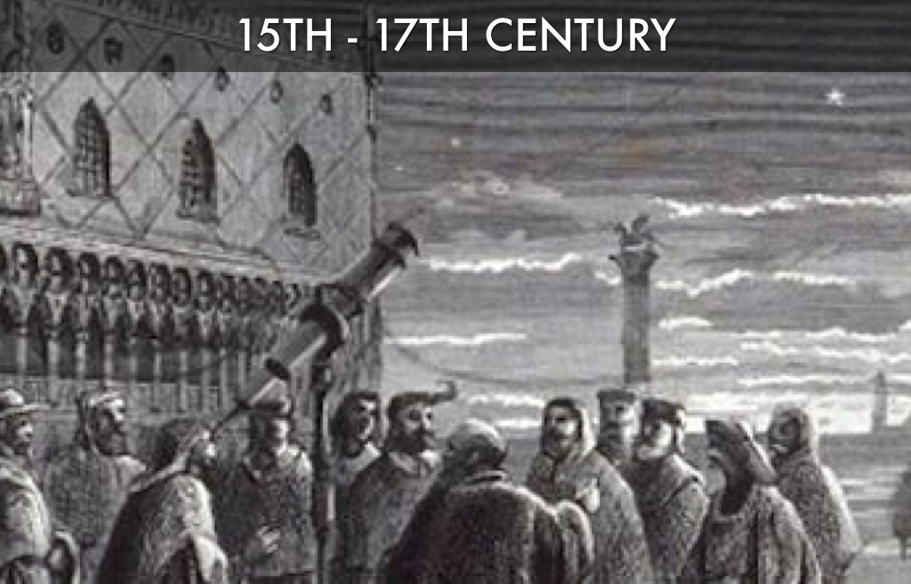
Scientific Revolution
15-17 Century

Slide 2
Objectives
Students will be able to:
Explain how & why Europe experienced an intellectual awakening in the 16th century that led to a scientific revolution
Explain how the scientific revolution led to the decline of superstition & the rise of reason in Europe
Explain how this contributed to modern scientific processes. Further, students are expected
link these scientific advances to the rise of Enlightenment philosophies on the proper role of government in people’s lives
explain how the ideas of Enlightenment philosophers were a radical change from traditional 17th & 18th century political theory & how it laid the groundwork for modern republican, federal, & democratic forms of government

Slide 3
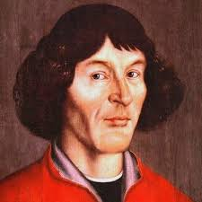
Great Minds
Nicolaus Copernicus
Polish scientist
1543 - published his argument for a helio- or sun-centered universe Although his work received little notice
Abandoned Ptolemy’s geo- or earth-centered universe which had been the accepted science since the 100s AD
A sun-centered universe was hard to accept at first because one could see the sun moving around the earth but could not feel the Earth moving

Slide 4
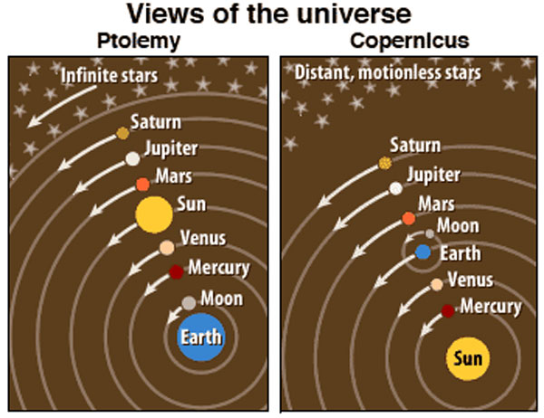
Ptolemy vs Copernicus

Slide 5
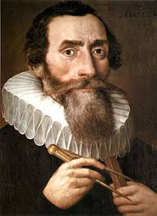
Great Minds
Johannes Kepler
Danish mathematician
About 60 years later, Kepler tested & proved Copernicus’ idea using models & mathematics
Also discovered that planets orbit the sun, not in a circle, but in an oval-shaped ellipse.

Slide 7
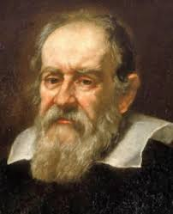
Great Minds
Galileo Galilei
Italian astronomer
Using a telescope, saw mountains & valleys on the moon, spots on the sun, rings around Saturn, & moons orbiting Jupiter
Provided more proof that Earth was not the center of the universe
Also disproved Aristotle by demonstrating that all objects fall at the same rate.
Forced to stand before an Inquisition & recant his findings due to controversy with the church

Slide 8
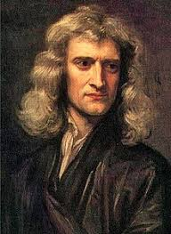
Great Minds
Sir Isaac Newton
English scientist
Built on the work of Copernicus, Kepler, & Galileo in the 1680s
Realized that the same force, gravity, that made objects fall to the earth also kept the planets in their orbits around the sun
Explained the laws of motion & developed mathematics to measure motion

Slide 10
Lasting Impacts of the scientific revolution
With the discoveries of these scientists, educated Europeans no longer believed the universe was being held in place & order by God
They had to abandon ancient views of the universe & long-standing church doctrine
They began to acknowledge the workings of physics & new understandings brought about by the Scientific Revolution

Slide 11
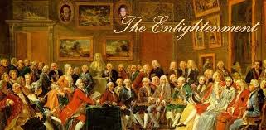
The Enlightenment

Slide 12
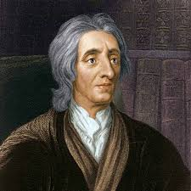
Great Thinkers
John Locke
Famous work - Two Treaties of Government
English philosopher
lived through the English Civil War
argued that a contract existed between government & people
In this contract:
the people gave up some rights to the government, but kept their “natural rights” of life, liberty, & property
government existed to protect these natural rights, which were superior to all laws & governments.
Locke rejected absolute monarchy
Believed individual rights are foundation of society, argued for private property, & stood against taxation without representation.
Also believed that subjects had the right to overthrow an oppressive government

Slide 13
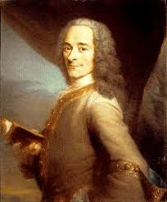
Great Thinkers
Voltaire
French writer
Famous work - Candide
Used wit & satire to criticize the French monarchy, nobility, & church control
Wrote against the slave trade, inequality, prejudice, & bigotry
Vigorously defended religious freedom & freedom of speech.

Slide 14
Volataire Quote

Slide 15
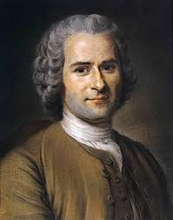
Great Thinkers
Jean-Jacques Rousseau
French writer
Famous work – The Social Contract
Contrary to other Enlightenment thinkers, he did not trust reason
He did stand against strong governments like the others
Argued that while some government control is necessary, such rule should be kept to a minimum
Moreover, governments should be freely elected, & the good of all should be valued above that of individuals.

Slide 16
Rousseau Quote

Slide 17
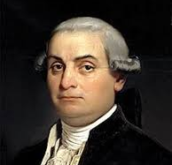
Great Thinkers
Cesare Beccaria
Italian criminologist & economist
Famous work – On Crime & Punishments
Well known for his ideas on criminal justice & prison reform
His ideas were very influential in the drafting of the Bill of Rights
7th & 8th Amendments
He published his famous work anonymously thinking the government would be against it, but it was well received & he republished using his name

Slide 18
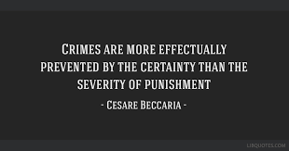
Beccaria Quote

Slide 19
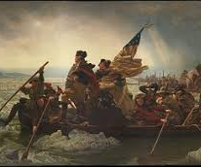
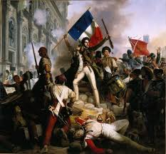
Lasting Impacts of The Enlightenment
Enlightenment thinkers & ideas heavily influenced revolutionaries around the world, including in America, France, & Haiti

