Slide 1
Revolutions in England
Element: Identify the causes and results of the revolutions in England (1689), United States (1776), France (1789), Haiti (1791), and Latin America (1808-1825)
Vocabulary: English Revolution, Glorious Revolution

Slide 2
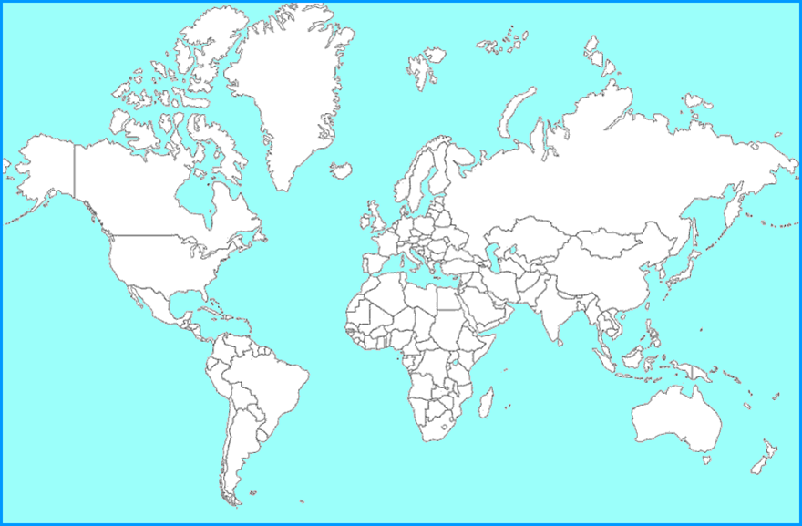
England
You are Here

Slide 3
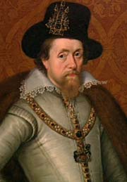
King James I
1603
Elizabeth I successor
believed in Divine Right
  a king only answers to God
clashed with Parliament
  legislative body in England; over money

Slide 4
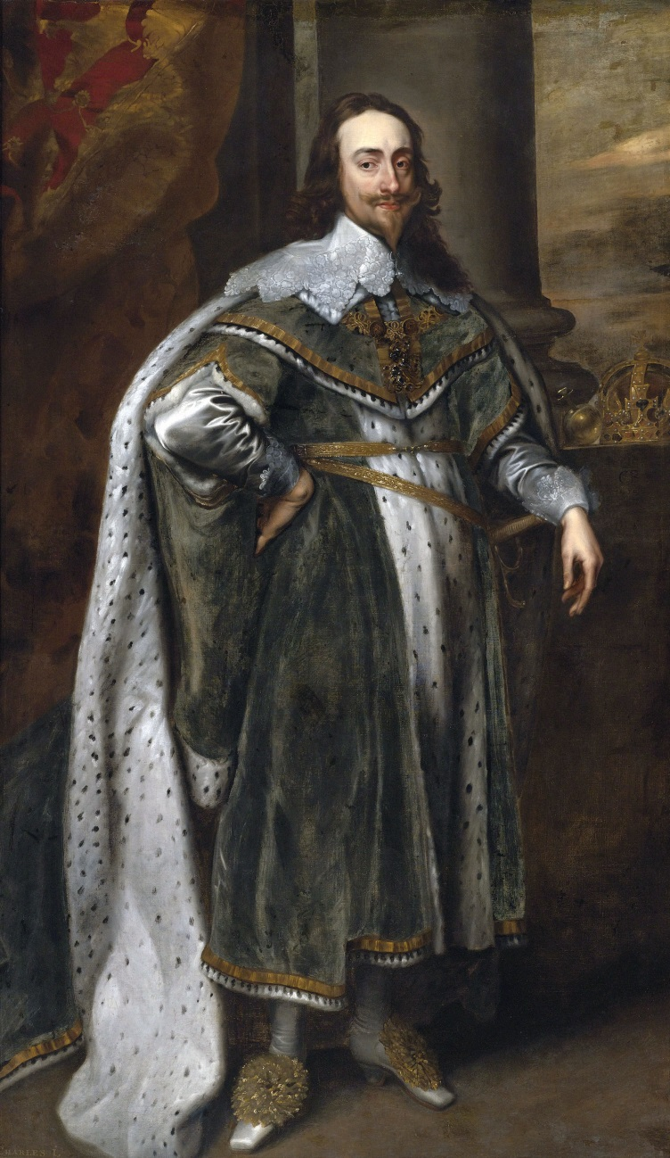
English Revolution - Causes
King Charles I:
James I successor
Forced to sign “Petition of Right” (1628)- put limits on King’s power
  signed it, ignored it, and dissolved Parliament in 1629
called Parliament back in 1641
  they again tried to limit power

Slide 5
Demands contained in the
“Petition of Rights”
no freeman should be forced to pay any tax, loan, or benevolence, unless in accordance with an act of parliament
no freeman should be imprisoned contrary to the laws of the land
soldiers and sailors should not be billeted (quartered) on private persons

Slide 6
English Revolution - Causes
greatly offended members of the House of Commons
  Charles sought to impose Catholicism on the Church of England
  many were Calvinist known as Puritans
  Puritans saw Charles’ actions as a dangerous abuse of power, and as an offense to God

Slide 7
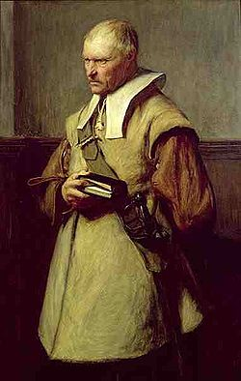
English Revolution - Causes
in 1642 a Puritan leader named Oliver Cromwell led an army in open rebellion against the king
revolution erupted during Charles I reign

Slide 8
Review…
Under the concept of “Divine Right,” who does a monarch answer to?
Who is England’s legislative body?

Slide 9
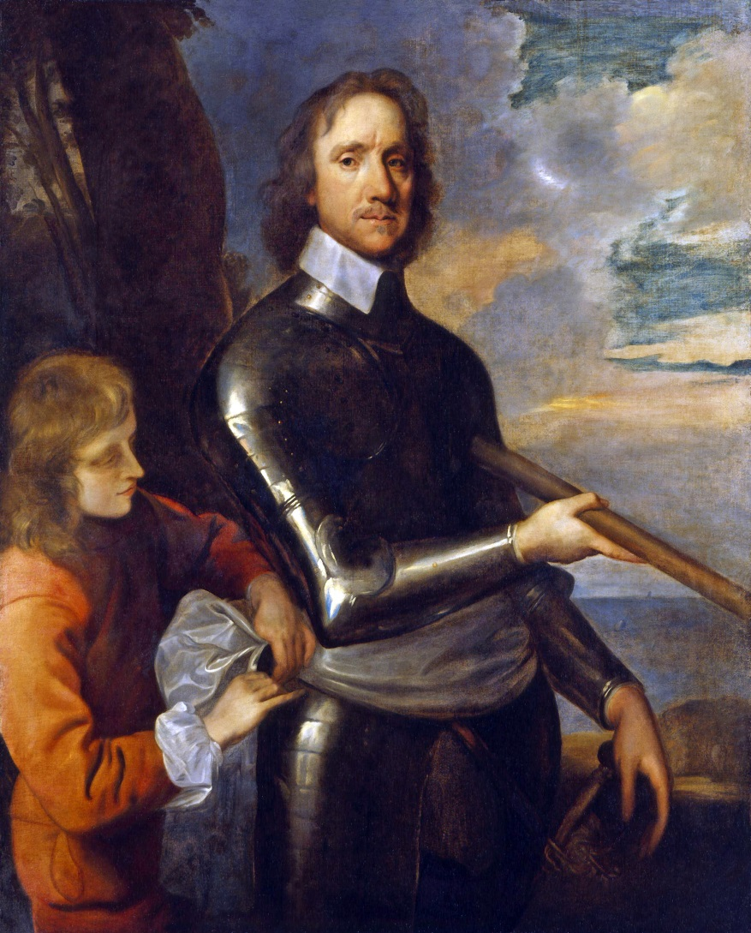
English Revolution - Result
the overthrow and execution of Charles I
Cromwell assuming leadership
expelled members of Parliament who opposed his actions

Slide 10
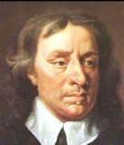
English Revolution - Result
dissolved the Parliament
assumed the title “Lord Protector of England”
established a military dictatorship until his death in 1658

Slide 11
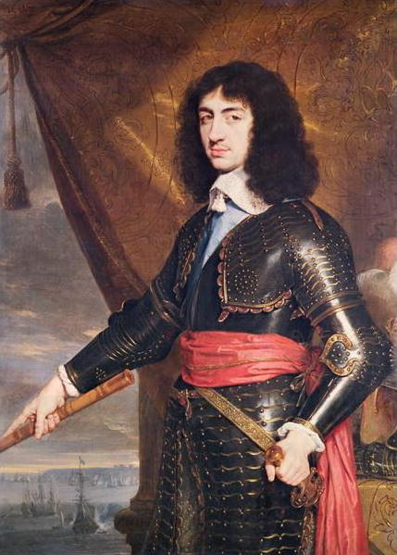
Restoration
following the death of Cromwell
re-established the monarchy under Charles’ son, Charles II in 1659
period that became known as the Restoration

Slide 12
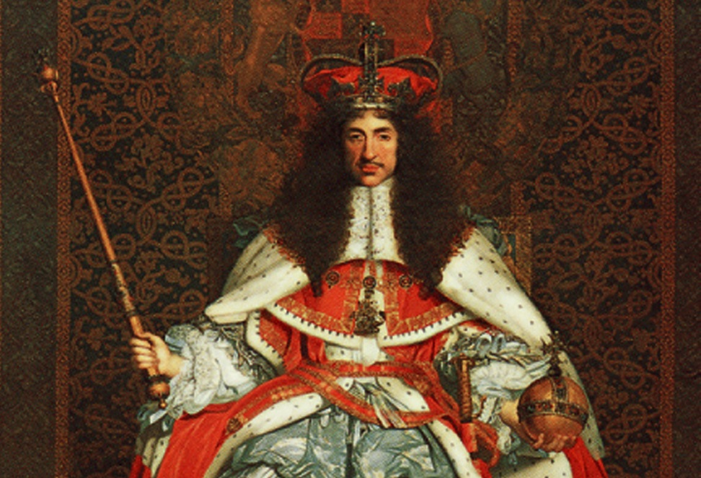
Restoration
Parliament had to approve all taxes
the king recognized that he needed Parliaments consent to carry out many of his decisions

Slide 13
Review…
Who won the Civil War in England, and what did they do to Charles I?
Oliver Cromwell ruled England as a dictator, What does that title mean?
What exactly was restored in England during the “restoration”?

Slide 14
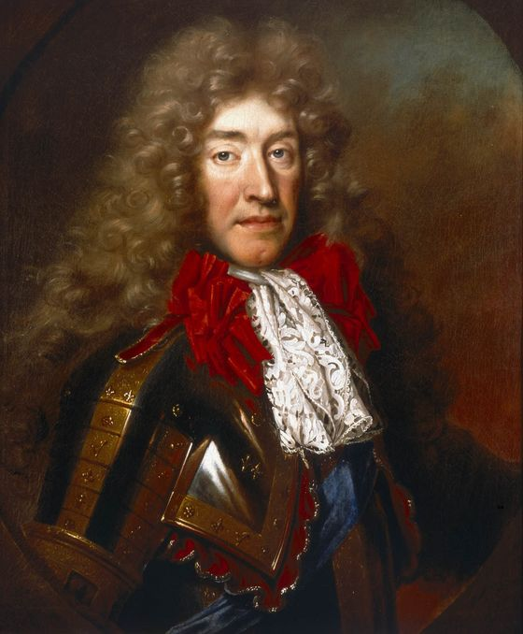
King James II
became king of England in 1685
succeeded his brother Charles II
a Catholic and viewed as a threat by members of the Anglican Church
had no male heir
many trusted that after he died one of his protestant daughters would become queen

Slide 15
Glorious Revolution - Causes
James’ second wifegave birth to a son
  also a Catholic
Protestant leaders invited James’ son-in-law, a Dutchman named William of Orange, to invade England and assume the throne

Slide 16
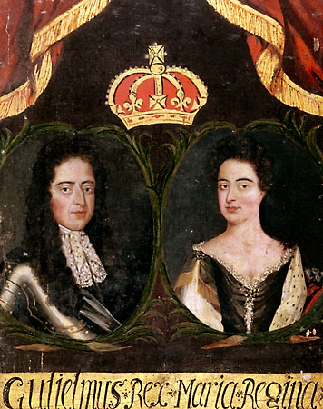
Glorious Revolution - Causes
William and his wife, Mary raised an army and landed in England in 1688 with the support of the Church of England
James and his family fled to France
surrendered the throne without a fight

Slide 17
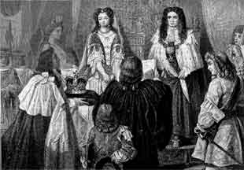
Glorious Revolution - Results
William and Mary assumed leadership of England
in exchange for Parliament’s support
  agreed to give even more power to the legislature
  accepted an English Bill of Rights

Slide 18
“English Bill of Rights”
1689
increased the powers of Parliament while limiting the powers of the king
granted freedom of worship to Puritans while continuing to limit the rights of Catholics
ripped apart old beliefs about the divine rights of kings

Slide 19
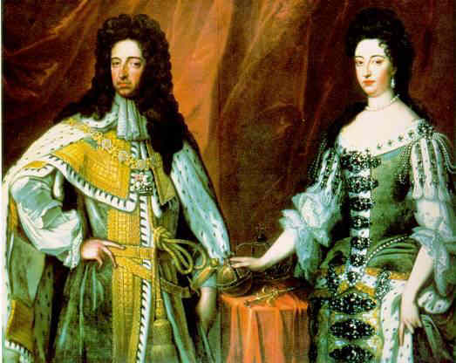
Glorious Revolution - Result
firmly established Parliament as the ultimate power within the British government
laid the foundation of England’s limited monarchy (monarchy in which the king/queen is limited by laws rather than given unlimited authority)
  Constitutional Monarchy

Slide 20
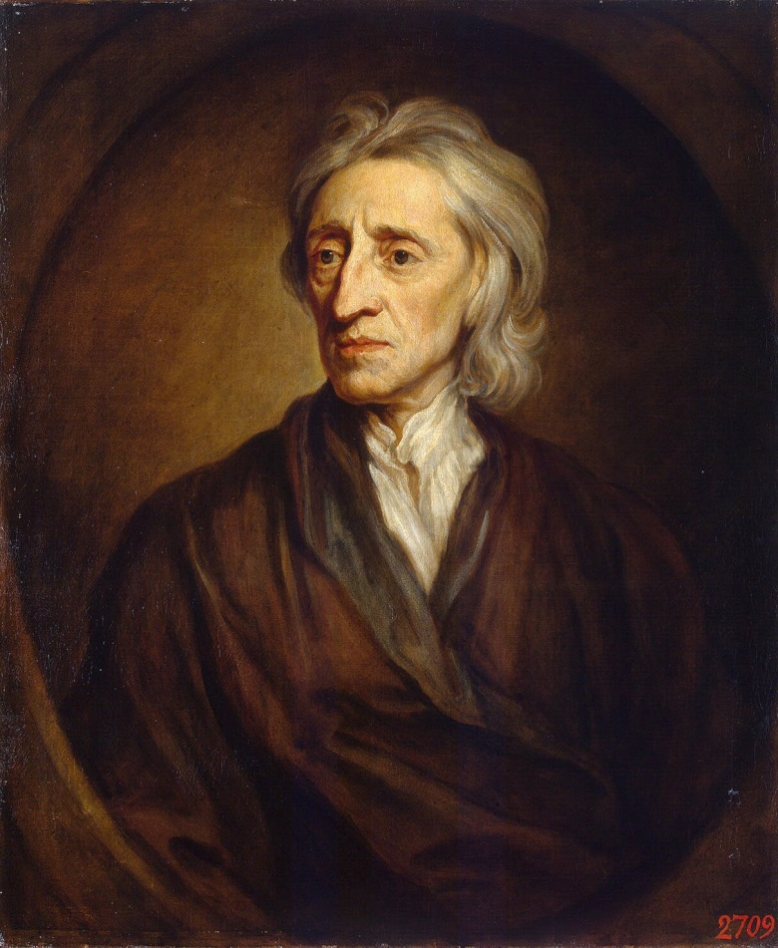
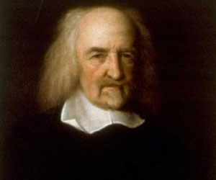
Impact on Enlightenment
  John Locke, “Second Treatise on Government”
  Thomas Hobbes, “ The Leviathan”

Slide 21
Review…
Why were the English so concerned that James II had a son?
What was so “glorious” about the Glorious Revolution?
After the Glorious Revolution, what was the official type of government in England?

