Slide 1
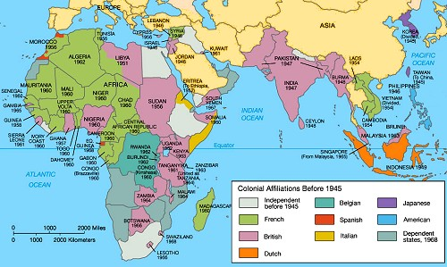
Revolutions in Asia & Africa

Slide 2
SSWH20 – Demonstrate an understanding of the global social, economic, & political impact of the Cold War & decolonization from 1945 to 1989
a. Explain the arms race, include: development of nuclear weapons, & efforts to limit the spread of nuclear weapons
b. Describe the formation of the state of Israel & the Arab-Israeli Conflict
c. Analyze the rise of nationalism & the revolutionary movements in Asia (i.e. India and China) & Africa
d. Analyze opposition movements to existing political systems, include: anti-apartheid, Tiananmen Square, & the fall of the Berlin Wall

Slide 3
Revolutions in India
Late 19th century – People of India began to push for independence from Britain
demands grew louder following World War I
During World War II, Mohandas K. Ghandi & the Indian National Congress started the Quit India movement in an effort to achieve immediate independence from the British
The British treated this movement as a rebellion, jailed Ghandi & 60,000 others
Meanwhile, the Muslim minority wanted its own state, separate from the Hindus in India
1947 – British left India after dividing the Indian sub-continent into Hindu India & Muslim Pakistan
British division of India was troubled from the start because Hindus & Muslims were often neighbors
Following independence Hindus & Muslims turned on one another, the violence resulting in the death of nearly a million Muslims & 10 million more as refugees

Slide 4
Revolutions in India
January 1948 – Hindu extremist assassinated Ghandi for his tolerance of Muslims
Border clashes continued for decades in the Kashmir province on the border between India & Pakistan
Other nationalist groups also wanted independence from India
In the 1980s, Sikhs in the Punjab province fought for self-rule, a movement that was put down by Prime Minister Indira Ghandi
A few years later, the Tamil speaking Hindu minority in Sri Lanka also pushed for their own nation
The Indian government similarly squashed the movement in Sri Lanka

Slide 5
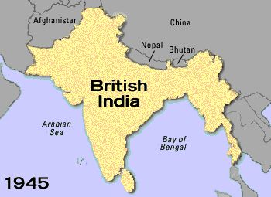
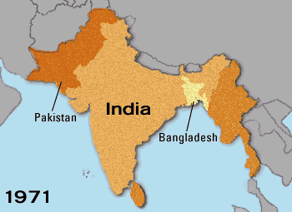

Slide 6
Revolutions in China
1930s – Civil war erupted in China between the Kuomintang Nationalist government headed by Chiang Kai-shek & the Communists led by Mao Zedong
Both sides paused the civil war to fight together against the Japanese during World War II
1945 – the civil war resumed
1949 – The Nationalists’ policies eroded their popular support, leading to Communist victory
Nationalist leaders fled to Taiwan
Mao Zedong founded the People’s Republic of China

Slide 7
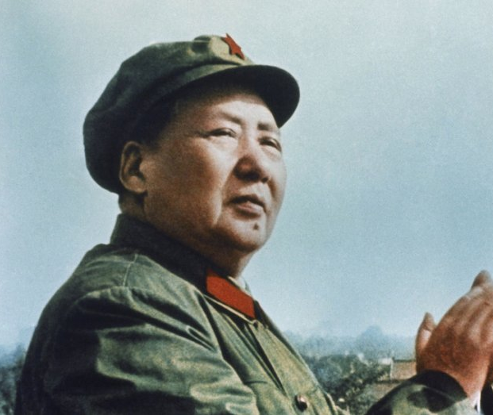
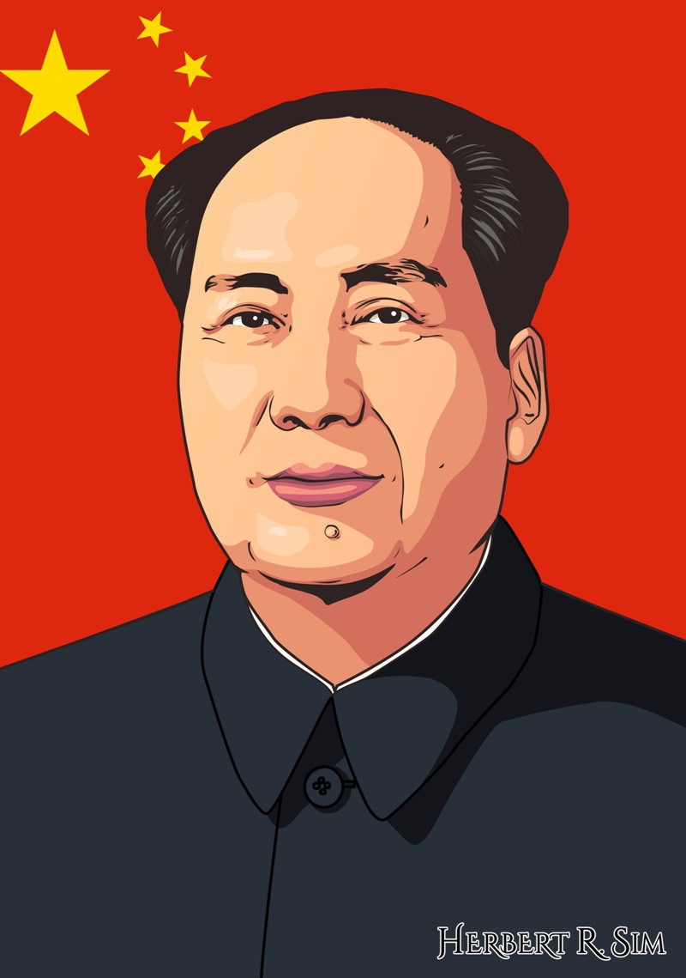

Slide 8
Revolutions in China
1953 – Mao began the 1st Five Year Plan
successfully increased agricultural & manufacturing outputs
It was a violent campaign of land reform, however, that killed millions
1958 – Mao instituted the Great Leap Forward
aimed to build on the first plan’s successes
failed & resulted in millions of people dying of starvation in just a few years
1966 – Mao pushed forward with the Cultural Revolution
a program of violent social change designed to rid China of anything from the “old way.”
After Mao’s death in 1976, moderates gained power, introduced elements of a market economy & led China to major economic growth

Slide 9
Revolutions in Africa – Gold Coast/Ghana
Africans in the Gold Coast, a British colony, were the first to gain their independence
Independence movement led by Kwame Nkrumah
inspired by U.S. civil rights efforts, Marcus Garvey, & Mohandas Ghandi
Africans held strikes and boycotts against the colonial power
1957 – achieved independence
Nkrumah elected as the first prime minister
Nkrumah changed the country’s name to an ancient African one, Ghana
Ghana’s success provided more inspiration to other colonies

Slide 10
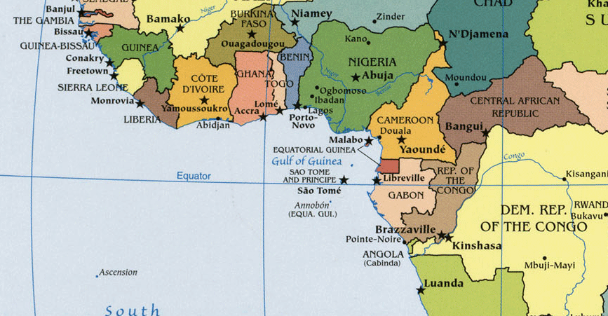

Slide 11
Revolutions in Africa – Kenya
Jomo Kenyatta led a nonviolent fight for land in Kenya
Kenya had a number of white settlers who owned the majority of the colony’s fertile land
radicals turned to guerilla fighting
The British labeled these radical fighters the Mau Mau
Thousands put into concentration camps
Thousands more killed thousands
1963 – Kenyans achieved independence
Elected Kenyatta as their first president

Slide 12
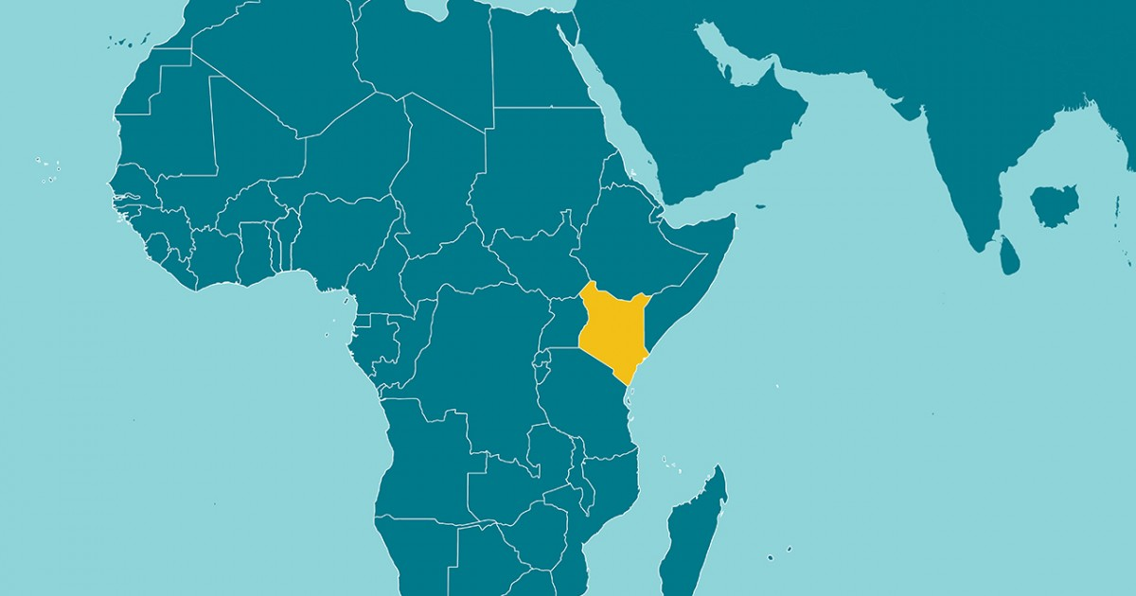

Slide 13
Revolutions in Africa – Rhodesia/Zimbabwe
Southern Rhodesia was a self-governing British colony ruled by a small white minority
This white minority claimed independence in 1965 in response to British pressure to govern by majority rule.
Africans responded with guerilla tactics & successfully opened the government to African majority rule
Southern Rhodesia became Zimbabwe
Robert Mugabe, the most radical candidate, won the first free election in 1980
Mugabe instituted a one-party system limiting political freedom

Slide 14
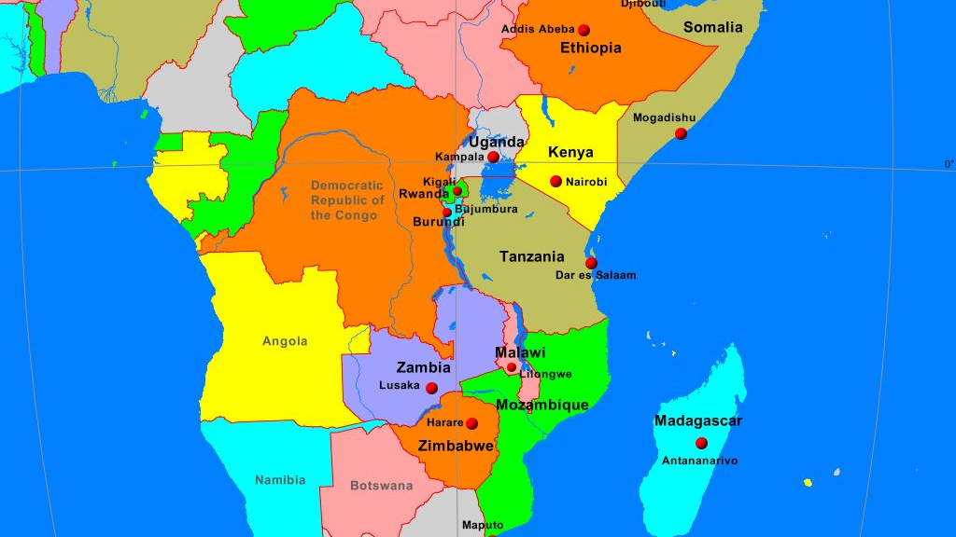

Slide 15
Revolutions in Africa – French Colonies
France anticipated that its colonies would become incorporated into France, but many Africans wanted their independence
1958 – France struck a deal that colonies like Senegal and Ivory Coast would be members of the French Community & France would remain in charge of foreign policy, but the colonies would have self-rule & would continue to receive French aid
1960 – French colonies received full independence
In Algeria, the National Liberation Front fought using guerrilla warfare from 1954 to 1962, when it finally won its independence from France

Slide 16
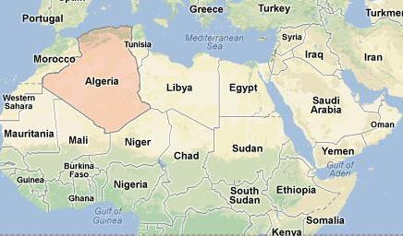

Slide 17
Revolutions in Africa – Congo
Belgium had no intention of letting go of its colonies & did nothing to transition them toward independence
As a result, when the Congo was thrust into sudden independence in response to violent protests, civil war ensued
1965 – army general Mobutu took control and built a brutal dictatorship that lasted over 30 years

Slide 18
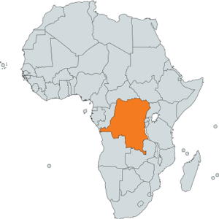
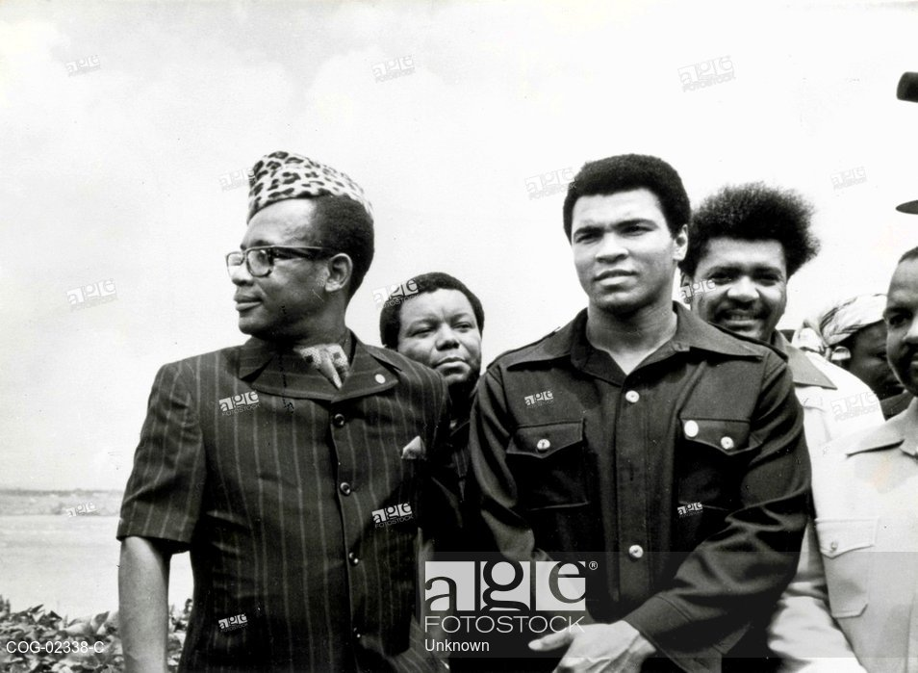

Slide 19
Revolutions in Africa – Portuguese Colonies
African nationalists fought long wars against Portugal
Portugal held onto their colonies until 1974 when the military took over in Portugal & pulled out of Africa
Guinea-Bissau, Angola, & Mozambique were hurled into independence without a good foundation for either their governments or their economies

Slide 20
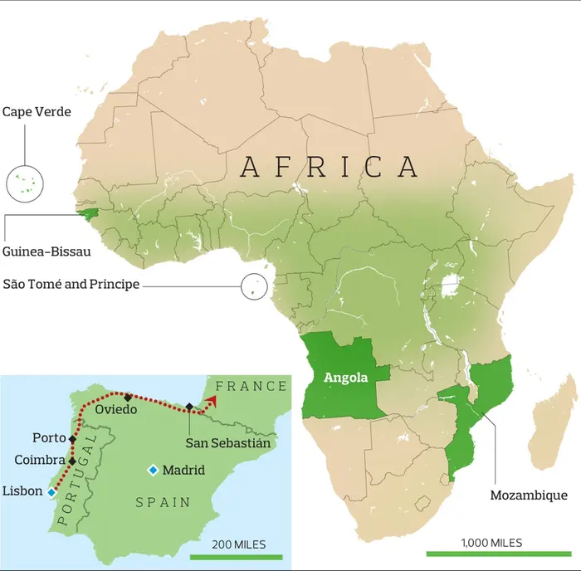

Slide 21
Revolutions in Africa – South Africa
1910 - South Africa achieved self-rule
white minority held all political & economic power
1948 – Afrikaner National Party, made up of Dutch descendants, instituted apartheid, a rigid system of racial segregation designed to maintain white power
The African National Congress (ANC) organized protests
banned by the government in 1960
For the next three decades, South Africa helped white minorities in neighboring countries maintain their power as well
1989 – President F. W. de Klerk recognized the need for reform
ended apartheid & the ANC ban

Slide 22
Resistance Movements In Asia & Africa

Slide 23
Anti Apartheid
1948 - In response to apartheid laws instituted by the white Afrikaner National Party, the African National Congress organized acts of peaceful civil disobedience
The government responded to one such march by shooting & killing more than 60 peaceful demonstrators in Sharpeville
After this, the ANC & Nelson Mandela embarked on a more violent course of action
The government banned the ANC in 1960 & arrested Mandela in 1964, but he remained a popular symbol of protest
Archbishop Desmond Tutu & others continued the fight from within & outside of South Africa
Many South African whites also joined the movement
1976 – police shot black school children who were protesting, leading to riots across the country

Slide 24
Anti Apartheid
1980s – South African government made small concessions, but Black Africans were still excluded from politics & segregated in civil life
1989 – President F. W. de Klerk instituted reforms that legalized the ANC, ended apartheid, & freed Mandela from prison
This, however, was not enough to end the violence in the nation
1994 – first multi-racial election was held
South Africans elected antiapartheid leader Nelson Mandela as president

Slide 25
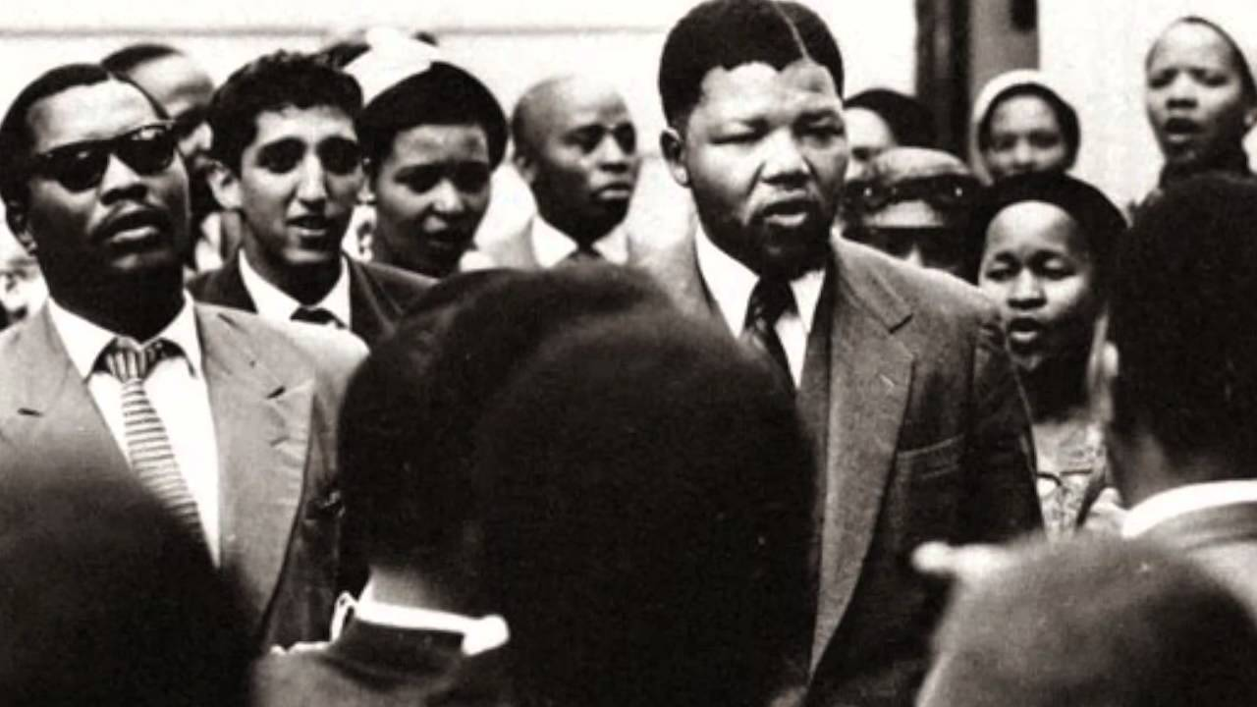

Slide 26
Tiananmen Square
During the 1980s, when moderates controlled the government following Mao’s death, many Chinese argued for more political freedom and economic reforms
This movement culminated in Tiananmen Square in Beijing
Hundreds of thousands of protesters filled the square for weeks calling for democracy
Students staged a hunger strike, & others built barricades
The government sent in troops & tanks, which finally broke through the barricades & began to fire on the protesters killing or wounding thousands
Many more were arrested
Through this show of force, the government maintained tight control & demonstrated the limits of the reforms it was willing to make

Slide 27
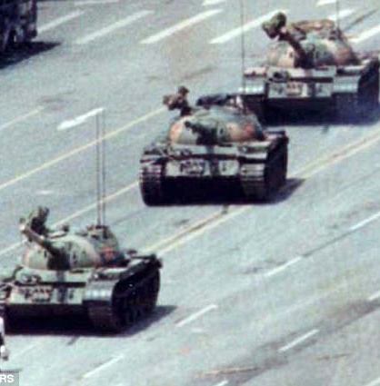
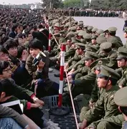

Slide 28
Berlin Wall
1961 – Communists built a wall of concrete & barbed wire in East Berlin along its border with West Berlin
They built and patrolled the wall to keep East Germans from escaping to the West, shooting anyone caught trying to cross over
The wall became a symbol of a divided Europe &, in fact, a divided world
As the Soviet system began to fall apart in the late 1980s, protests in East Germany convinced the government, which no longer had Soviet backing, to open the borders
1989 - Germans on both sides of the wall, tore down the wall, which has since become a symbol of the collapse of communism.

Slide 29
