Slide 1
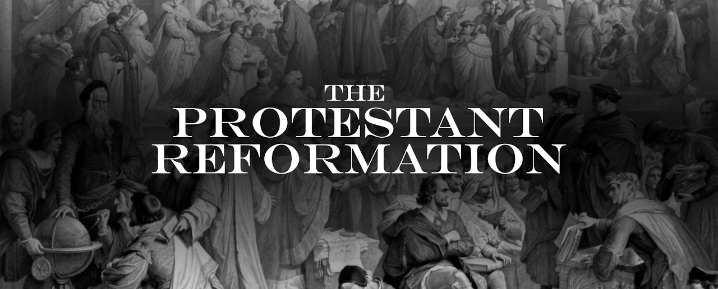
A New Schism

Slide 2
Conflicts Within The Church
During the medieval period the Catholic Church based in Rome & under the leadership of the pope served as a major source of unity for Europeans
This began to change in the 1500s
The Renaissance emphasis on individualism & secular pursuits laid the foundation for a major change in the religious landscape of Europe
Some Catholic clergy, in part influenced by the ideas of the Renaissance, began to live lavishly off of the moneys collected by the church
The clergy had access to vast amounts of wealth in the form of church tithes, rents collected from church lands, and business ventures operated by Catholic monasteries
Many clergy members used this wealth to live lavish lifestyles that alienated church leadership from the laity

Slide 3
Conflicts Within The Church
This alienation was aggravated by the presence of many poorly educated priests & monks
This led to widespread frustration among church members
In 1517, Pope Leo X authorized the sale of indulgences to fund the rebuilding of Saint Peter’s Cathedral in Rome
An indulgence served as a pardon for sins, allowing the purchaser to avoid penance or “good works” normally required by believers for forgiveness
Catholics viewed indulgences as a way to purchase a free pass to heaven for themselves or a loved one
The sale of indulgences provoked Martin Luther, a Catholic monk, to act
On October 31, 1517 Martin Luther posted the 95 Theses on the door of a church in Wittenberg, Saxony (part of modern Germany)

Slide 4
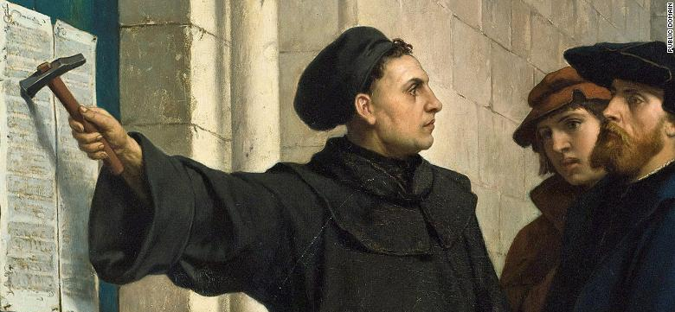

Slide 5
Conflicts Within The Church
Luther explained his grievances with the corruption he saw in the Catholic Church
The 95 Theses was taken to a printer & circulated widely in the German states
Luther quickly gained a vast following of discontented believers
Martin Luther went on to develop a theology that undermined the authority of the Catholic clergy

Slide 6
Grievances of Martin Luther
Luther explained his grievances with the corruption he saw in the Catholic Church
The 95 Theses was taken to a printer & circulated widely in the German states
Luther quickly gained a vast following of discontented believers
Martin Luther went on to develop a theology that undermined the authority of the Catholic clergy

Slide 7
Grievances of Martin Luther
Luther’s beliefs included
justification by faith
According to this principle, believers could win forgiveness with faith alone, no “good works” or penance was required
Only real source of religious truth was the Bible
argued that lay people could study the Bible and become righteous Christians without the help of the Catholic clergy

Slide 8
Grievances of Martin Luther
Initially, Luther hoped to draw attention to the corruption in the church to bring reform
The pope’s response drove Luther out of the church
In January of 1521, Martin Luther was excommunicated & because of this a new Christian faith was born
Lutheranism
With time and after much violence much of what is today northern Germany & Scandinavia became Lutheran

Slide 9
Effects of Martin Luther’s Reformation
John Calvin, inspired by Martin Luther, published Institutes of the Christian Religion in 1536
Calvin developed a theology that argued that humanity was sinful by nature & that God predetermined which people would achieve salvation at the beginning of time
People chosen by God for Heaven know as the “elect”
Argued that the “elect” should come together a form a utopian community free of sin
Calvin helped build this community in Geneva Switzerland in the 1540s
Calvin’s success in Geneva inspired others to take his faith to other regions
The Presbyterians of Scotland, the Huguenots of France, and the Puritans of England were all born out of Calvinist theology.

Slide 10
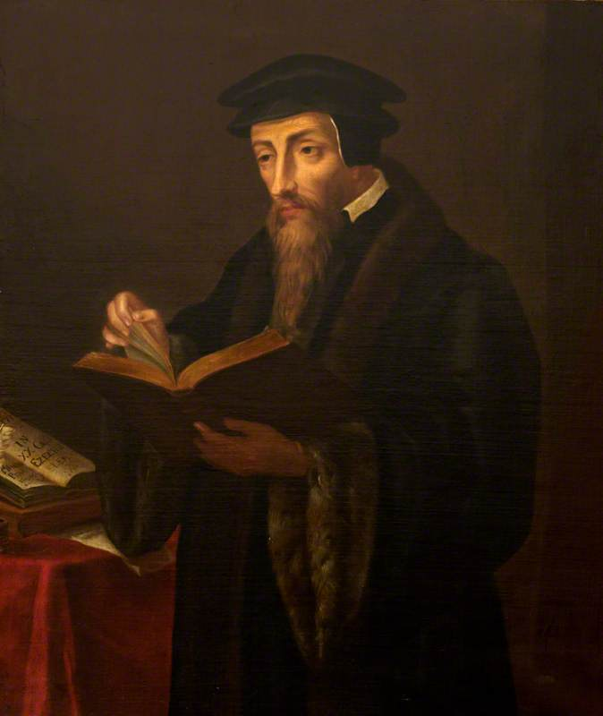

Slide 11
Henry VIII takes on the Catholic Church

Slide 12
The Crown vs The Catholic Church
While Martin Luther & John Calvin abandoned the Catholic Church for spiritual reasons, Henry VIII was more for political & personal reasons
The Tudor Dynasty of Henry the VIII came to power after a bloody civil war that resulted from the lack of a male heir
Henry VIII was desperate for a son because of this
After 18 years of marriage to Catherine of Aragon he only had one daughter, Mary
Catherine was 42 years old & it was thought that she would bare no more children
Under Catholic law divorce was impossible but Henry could ask the pope to annul the marriage if it was entered into illegally

Slide 13
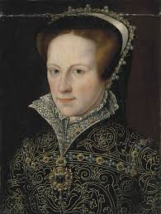

Slide 14
The Crown vs The Catholic Church
In 1527, Henry asked the pope for an annulment based on Catherine’s previous marriage to his brother
The pope refused in part because of pressure from Catherine’s nephew the Holy Roman Empire, Charles V
Henry responded by asking the English Parliament to pass legislation ending the pope’s authority in England which would grant Henry the right to divorce Catherine
In 1533, Henry divorced Catherine & married Anne Boleyn
A year later the English Parliament passed the Act of Supremacy, officially making Henry VIII the head of the church of England & ending England’s association with the Catholic Church

Slide 15
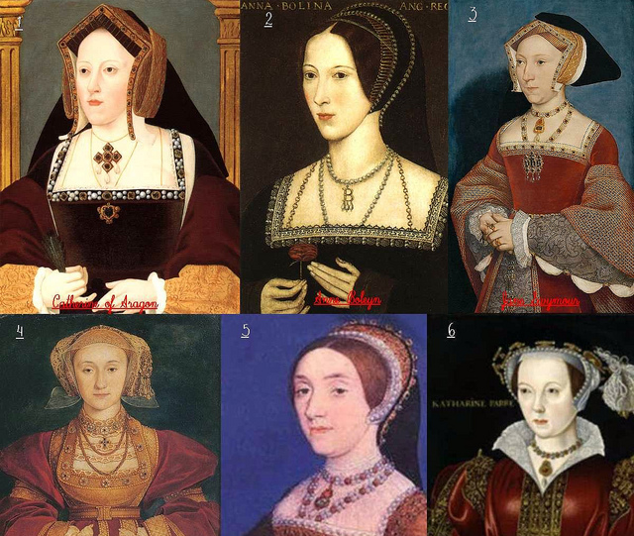
King Henry VIII’s Wives

Slide 16
The Crown vs The Catholic Church
Anne Boleyn gave birth to a daughter, Elizabeth, & fell out of favor with the king
She was found guilty of treason & beheaded in 1536
Henry immediately married Jane Seymour who gave birth to a son, Edward, in 1537
Seymour died from complications during the birth of Edward
Henry went on to marry three more women but none of these marriages resulted in children

Slide 17
The Crown vs The Catholic Church
Henry VIII died in 1547 & Edward became king at 9 years old
Edward very sickly
Edward died 6 years later leaving the throne to his oldest sister Mary
Mary was a Catholic & attempted to restore Catholicism to England, while she was partially successful her reign ended with her unexpected death in 1558
Elizabeth, a protestant, assumed the throne & permanently established the monarch of England as the head of the English Church.
Elizabeth worked to establish a church for England that would serve as a compromise between the Catholics and Protestants.
The Anglican Church, as it came to be called, included many of the rituals and trappings of Catholicism but services were delivered in English and the Bible was translated into English, something very important to Protestants. This compromise secured Protestantism in England

Slide 18
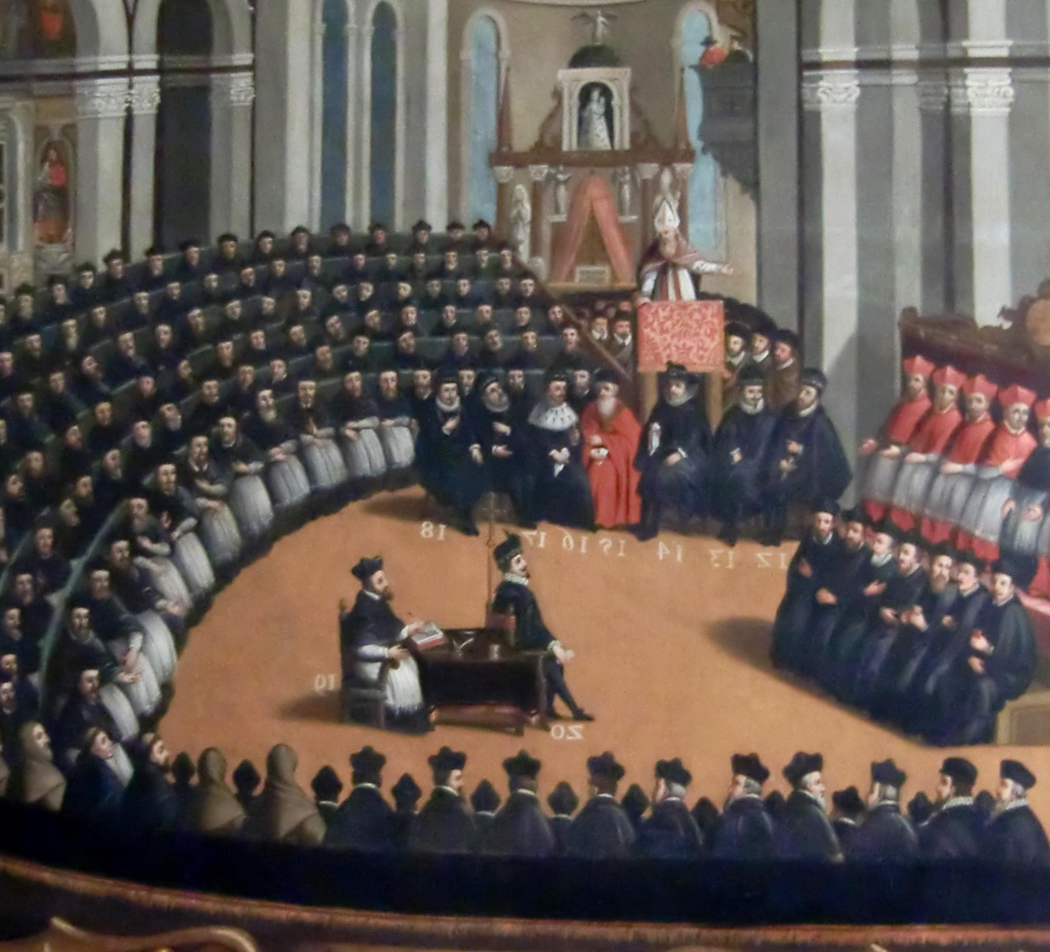
The Counter Reformation

Slide 19
The Counter-Reformation
After losing much of Northern Europe to Protestant faiths, the Catholic Church responded with the Counter Reformation
The Counter Reformation was a movement orchestrated by top clergy to clarify church doctrine, increase membership & curb corruption
Between 1534 & 1563, the Catholic Church made several moves to accomplish these goals
First, the pope authorized the creation of a new monastic order known as the Jesuits
The Jesuit order accomplished 3 important tasks for the Church
Established schools that improved the quality of the clergy
organized missions to convert non-Christians to Catholicism
slowed the spread of Protestantism in Europe

Slide 20
The Counter-Reformation
In 1545, the pope called the Council of Trent, a meeting of Catholic bishops & cardinals to establish a unified response to the Protestant threat
The Council concluded that the majority of established Church doctrine was legitimate & included:
belief that the Catholic clergies’ interpretation of the Bible was final & not open to discussion with laypersons
faith alone was not enough for salvation, believers must also do good works to achieve salvation (a direct rejection of Luther’s Justification by Faith)
Church doctrine was equal to the Bible as a source of religious truth

Slide 21
The Counter-Reformation
The Council of Trent did acknowledge that corruption was a problem including the circulation of misinformation about the power of indulgences
The Church refused to reject indulgences outright but did call for reform in the promises made to purchasers
In the end the Counter Reformation, or the Catholic Reformation as it is also called, slowed the spread of the Protestant Reformation & secured Catholicism in much of Southern Europe

