Slide 1
Polytheism in Greece & Rome

Slide 2
The Gods of Greece & Rome
Greeks & Romans worshipped many gods and goddess
Gods & goddesses took on human form & emotions
Each represented an important aspect of Mediterranean life like love, wisdom, the sea, & war
Greeks & Romans believed the gods & goddess confronted many of the same emotions as humans & as such engaged with each other & humanity in complex & often troublesome ways

Slide 3
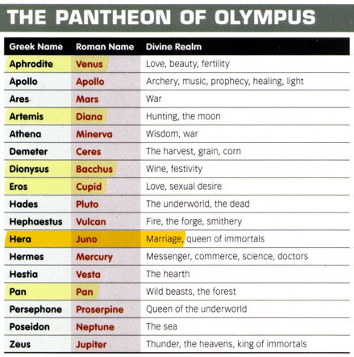

Slide 4
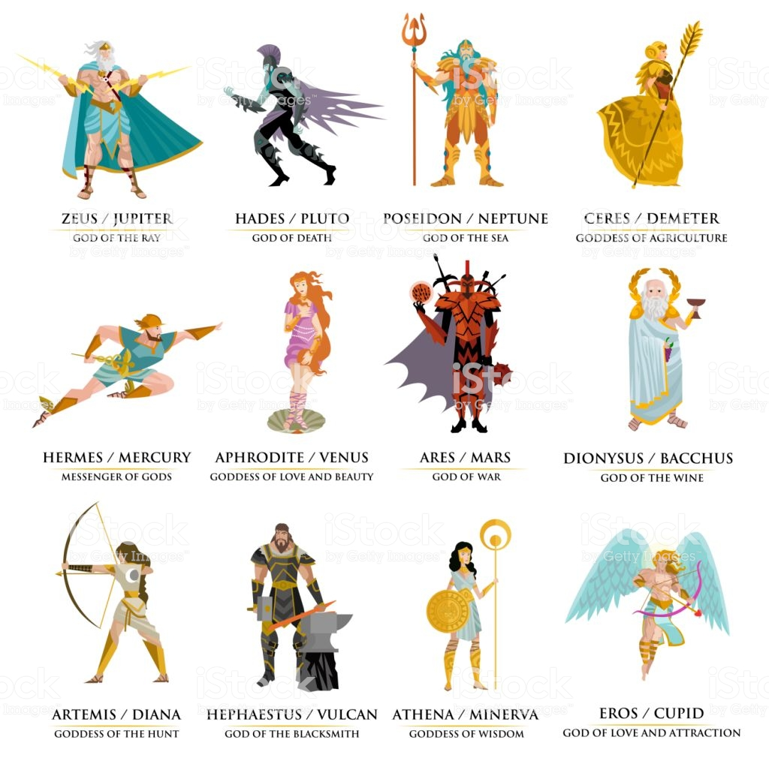

Slide 5
The Gods of Greece & Rome
These beliefs led to development of a rich tradition of mythology
Greeks & Romans believed gods & goddess confronted many of the same emotions as humans & as such engaged with each other & humanity in complex & often troublesome ways
Greeks & Romans attempted to appease gods & goddesses in a number of ways
Monumental monuments dedicated to the gods & goddesses
Elaborate gov’t run public rituals (helped justify gov’t power)

Slide 6
The Gods of Greece & Rome
While Roman religion closely resembled that of Greece it had unique traits
Roman emperors were often deified after death
A few emperors added loved ones to the pantheon gods
Emperor Hadrian ordered the deification of his close companion Antinous after his death in 130 CE.

Slide 8
Christianity In The Roman World
Christianity developed in the Jewish community of Roman controlled Palestine
Based on the teachings of Jesus Christ of Nazareth
born to a humble Jewish family
became a traveling teacher as an adult
Preached a message of reform that argued that charity & compassion were more important than strict obedience to rabbis & Jewish customs
Over time, Jesus developed a devout following
Followers believed Jesus to be the Messiah foretold by Jewish prophets
Developed into belief that Jesus was son of God

Slide 9
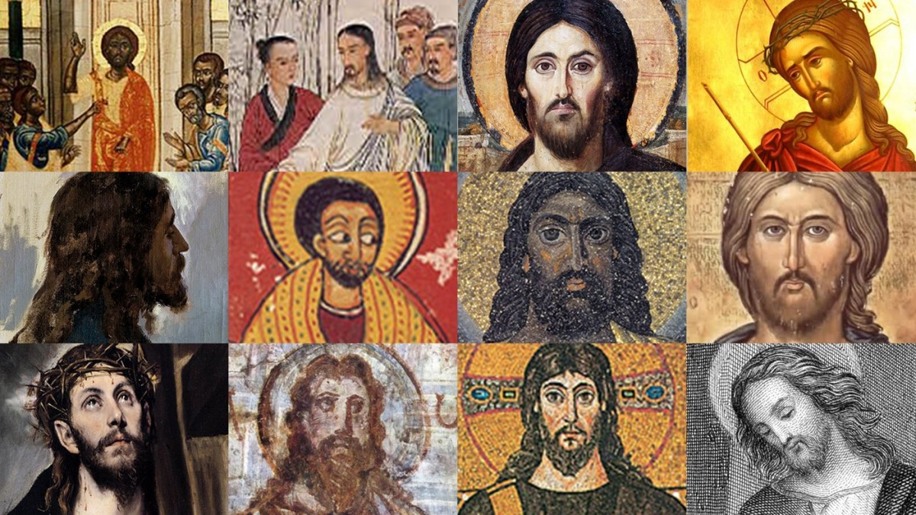

Slide 10
Christianity In The Roman World
Teachings became popular among common people of Palestine
Teachings seen as a threat to Roman authority & Jewish leadership
Roman governor of Palestine pressured by Jewish leaders to arrest & execute Jesus
Executed by crucifixion
After his death, disciples spoke of his resurrection & ascension to heaven
Used to justify claim he was son of God

Slide 11
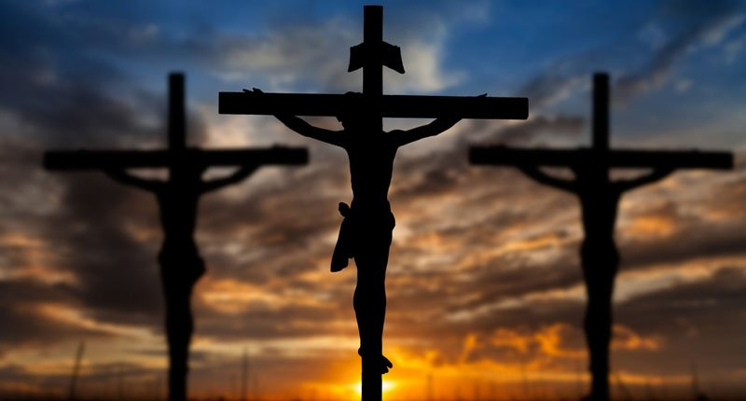

Slide 12
Christianity In The Roman World
Christianity had limited appeal to people of Palestine
Found greater acceptance among Gentile population of Roman Empire
particular among oppressed groups like slaves, commoners &women
Apostle Paul predominantly responsible for spreading Christianity throughout Roman Empire
Apostle Peter organized first organized churches
Eventually became Roman Catholic Church
Christianity still seen as a threat & followers were persecuted

Slide 13
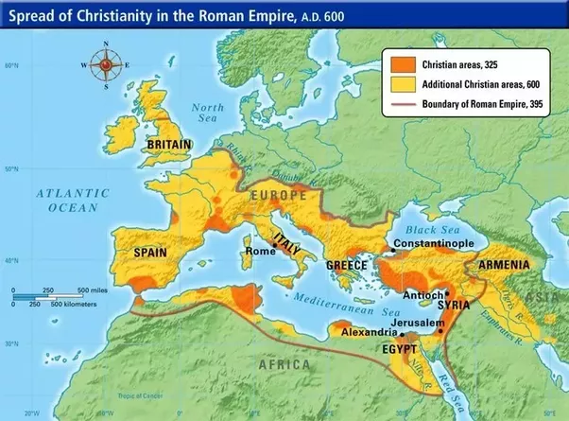

Slide 14
Christianity In The Roman World
In 313 CE, Roman Emperor Constantine converted to Christianity & issued the Edict of Milan that legalized Christianity in the empire
Christianity quickly grew to be the dominate religion of Europe due to the Emperor’s support

