Slide 1
Napoleon Bonaparte
Standard: Explain Napoleon’s rise to power, the role of geography in his defeat, and the consequences of France’s defeat for Europe.
Vocabulary: Napoleon Bonaparte, Napoleonic Code, coup d’etat, plebiscite, lycee, concordat, Battle of Trafalgar, Continental System, Peninsular War, Waterloo, Hundred Days

Slide 2
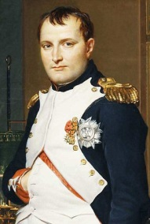
Napoleon Bonaparte
Description:
born in Corsica (1769)
attends military school
joins army at age 16
began his career in the French military during the French Revolution

Slide 3
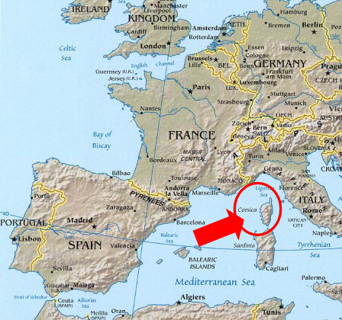

Slide 4
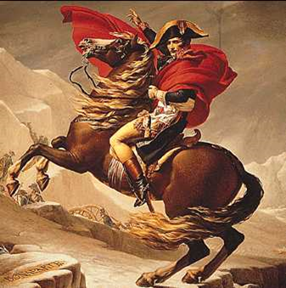
French Revolution
“Savior of French Republic”
1795: Napoleon defeats royalist rebels attacking National Convention
“Remarkable victories”
in 1796 was appointed by the Directory to lead the French army against Austria

Slide 5
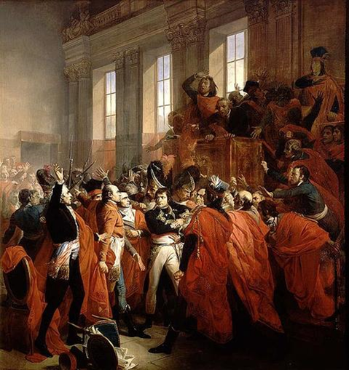
Coup d'état
in 1799
seized power in France
named First Consul of France
by 1802 negotiates peace with the rest of Europe
ended years of war with France and Europe

Slide 6
Review…
How did Napoleon Bonaparte first gain fame in France?
What country was he first given the command to fight?
Explain what a coup d’ etat is.

Slide 7
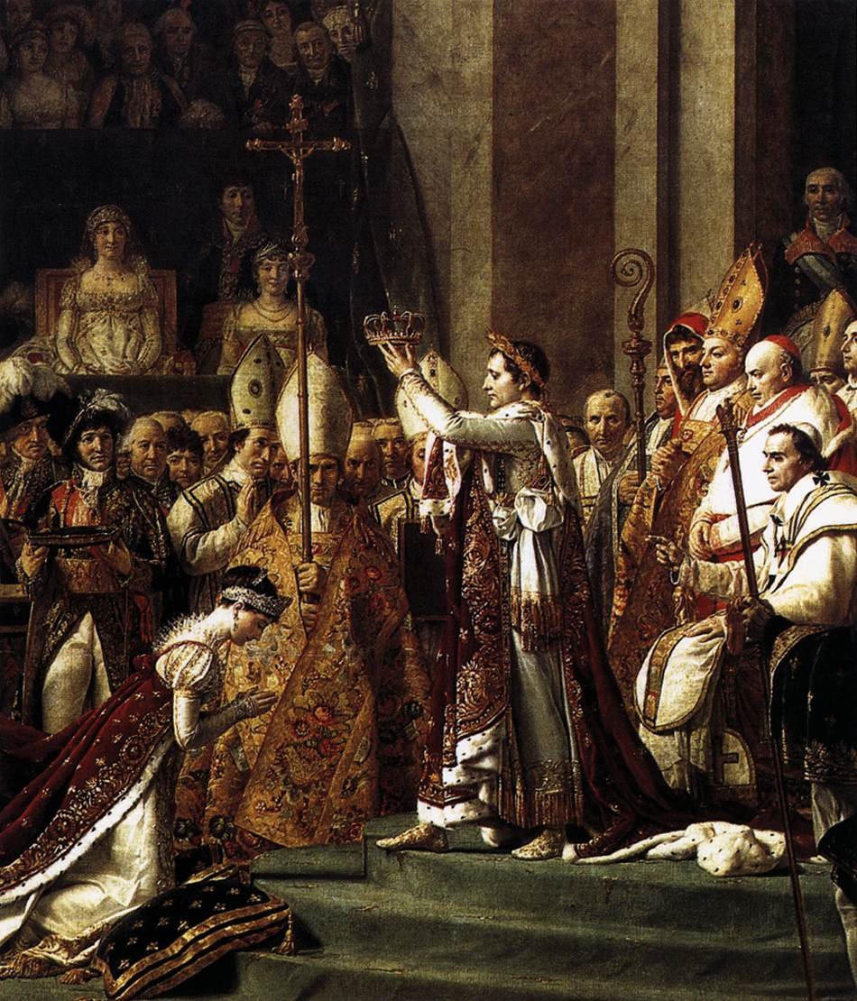
Emperor of France
in 1804
had himself crowned Napoleon I, Emperor of France

Slide 8
Revolution Reforms
Restoring Order:
established a new constitution (Napoleon w/ all power)
reorganized the way taxes were collected making it fair and more efficient
dismissed corrupt government officials
set up lycees, or schools for boys

Slide 9
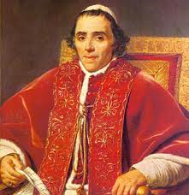
Concordat
made peace with the Catholic Church
previously viewed as an enemy of the revolution
solidified his support among many landowners

Slide 10
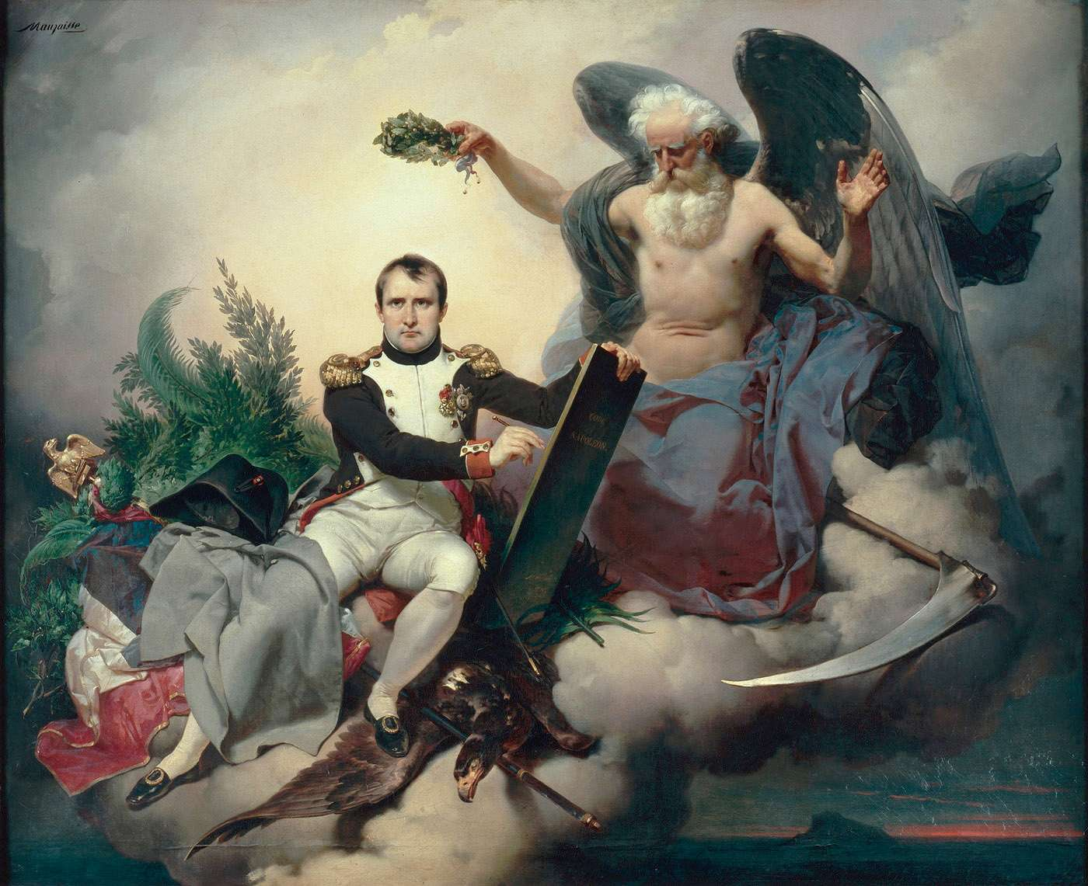
Napoleonic Codes
provided France with its first set of national laws since the revolution
these laws guaranteed equality under the law
upheld many principles of the revolution

Slide 11
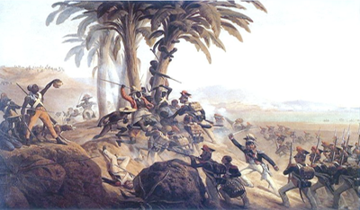
Early Issues
Haitian Independence:
1801
Napoleon attempted to retake the slave colony of Saint Domingue
attempt failed
prompted Napoleon to sell Louisiana

Slide 12
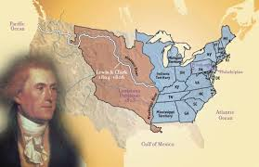
Early Issues
Louisiana Purchase:
1803
sells French territory in the United States (Louisiana Purchase) for $15 million dollars
in order to focus on Europe and to give Great Britain another enemy to worry about (U. S.)

Slide 13
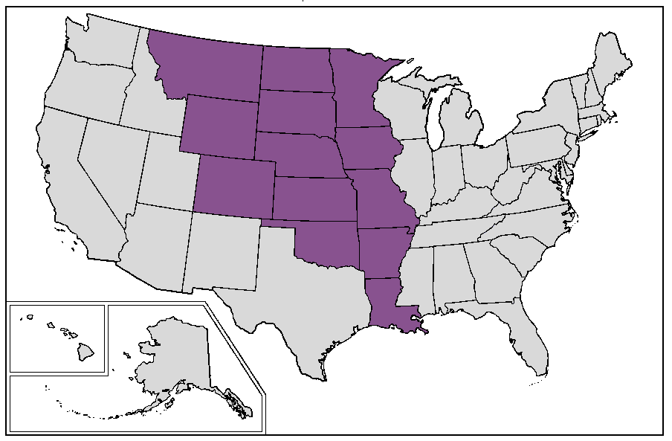

Slide 14
Review…
Explain what the Concordat Agreement restored.
Why did the French people support Napoleon’s decision to appoint himself emperor?
Napoleon sold a large portion of land to the U.S. for 15 million dollars, what is this known as?

Slide 15
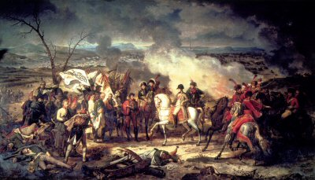
Military Campaigns
Conquering Europe:
defeated Austria, Prussia, and Russia by 1807
made Napoleon master over much of Europe
France’s borders extended from the Rhine River to northern Italy

Slide 16
Military Campaigns
Conquering Europe:
exercised authority over various dependent states
dependent states = Spain, Italy, the Netherlands, Switzerland, and parts of Germany

Slide 17
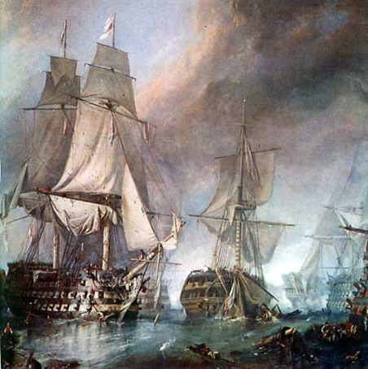
Battle of Trafalgar
1805
naval battle
the only major loss for France
ensured British dominance at sea and ending a French threat to invade Britain
forces Napoleon to give up on an invasion

Slide 18
Continental System
set up a blockade between Great Britain and the rest of Europe
forced nations he defeated to join him in his wars with Great Britain
wanted to force self-sufficiency in continental Europe and destroy trade in Great Britain
established as a way to control Britain

Slide 19
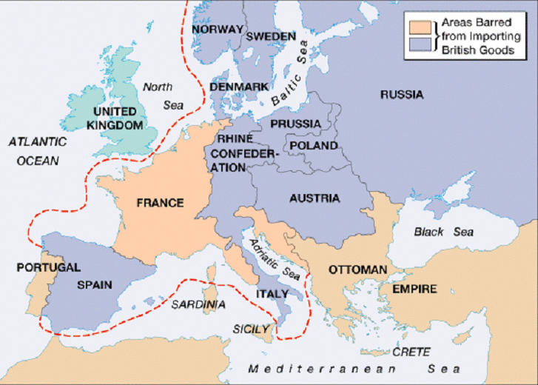

Slide 20
Continental System
Why it failed:
  the blockade did not work
  many nations ignored the blockade
  Smugglers cause problems
  Britain set up a blockade as well
French empire is at its largest from 1807-1812

Slide 21
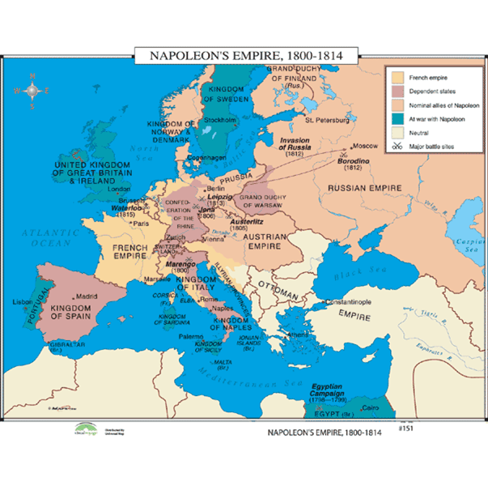

Slide 22
Review...
What was the only country Napoleon could not defeat?
In what naval battle were the British able to defeat Napoleon?

Slide 23
Fall from Power
Nationalism:
as France acquired more territory and influence, ideas and principles of the French Revolution, such as equality, nationalism, and religious toleration, spread to other countries
citizens of other nations began to develop the same sense of pride in their country
grew bitter against Napoleon
viewed as a foreign oppressor

Slide 24
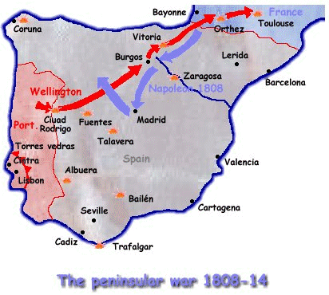
Peninsular War
Invasion of Spain:
Napoleon sends troops to Spain to attack Portugal, causing protest. (removed king)
Spanish fight as guerrillas—small groups that attack and disappear.
Napoleon loses 300,000 soldiers during this campaign

Slide 25
Review
Napoleon’s Continental System was intended to weaken what country?
Napoleon was unable to wage a successful campaign because of this tactic employed by the Spanish.
Explain the purpose of a blockade.

Slide 26
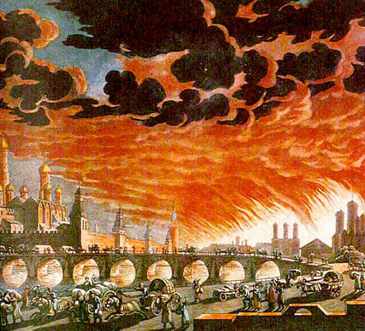
Invasion of Russia
June 1812
Napoleon’s army enters Russia with 420,000 men
Russians use scorched-earth policy—burning crops, livestock while retreating.

Slide 27
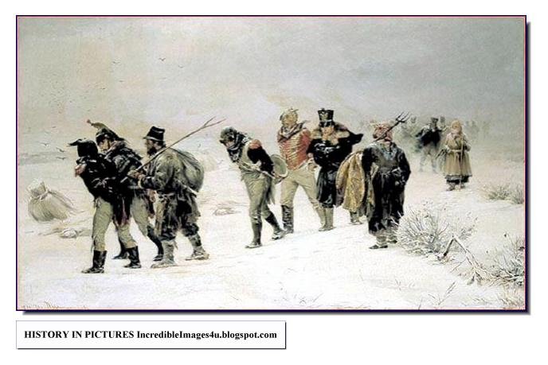
Russian Tactics
Napoleon finds Moscow abandoned and burning
Napoleon retreats, losing all but 10,000 of his soldiers to raids & the elements

Slide 28
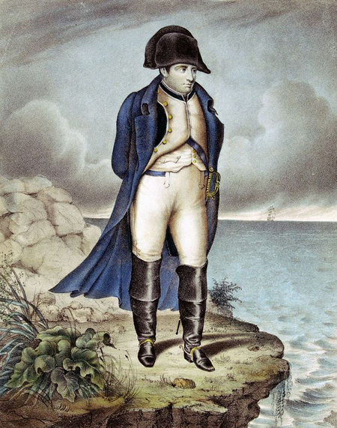
Napoleon Suffers Defeat
Britain, Prussia, Sweden, Russia, Austria join forces against Napoleon
Napoleon meets quick defeat by allied powers
Napoleon abdicates in April, 1814 and exiled to Elba

Slide 29
"Death is nothing,
but to live defeated and inglorious is to die daily."
- Napoleon Bonaparte

Slide 30
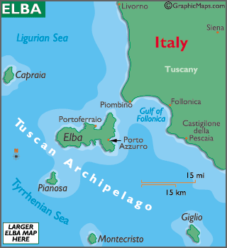
Where is Elba?

Slide 31
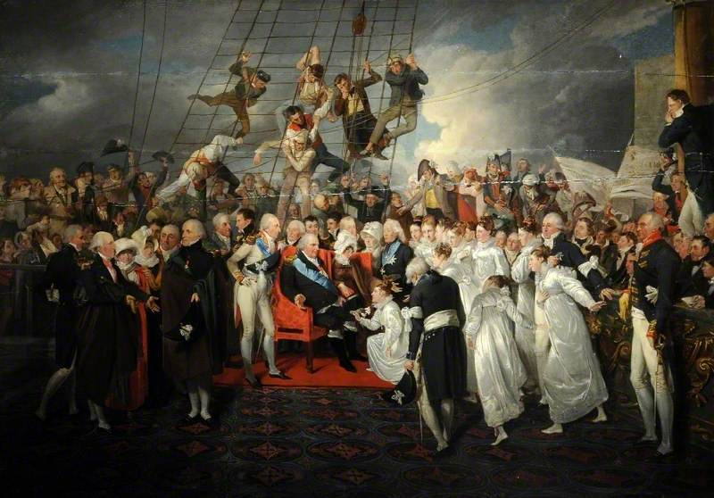
Return of the French Monarchy
supported by European powers
reestablished monarchy under King Louis XVIII
believed they had put an end to the influence of the French Emperor Napoleon

Slide 32
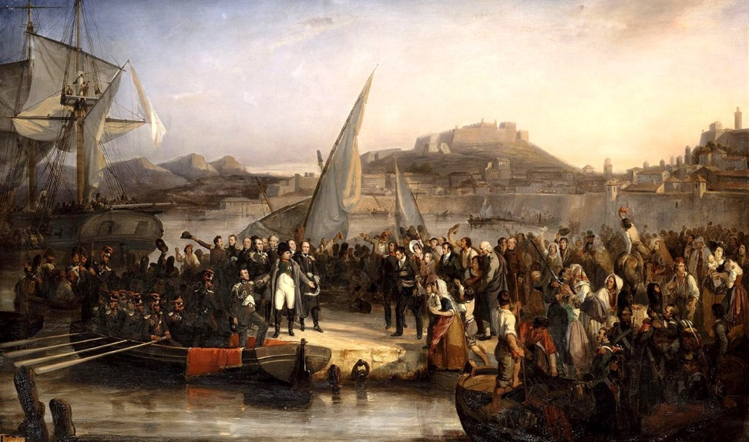
The Hundred Days
Escape:
March to June 1815
Napoleon escaped Island of Elba
returned to France
French authorities quickly dispatched troops to arrest/kill Napoleon

Slide 33
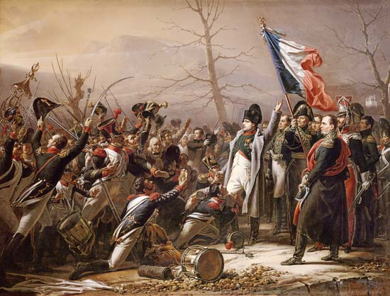
The Hundred Days
Return to Power:
halted by a regiment of soldiers
“If you would shoot your emperor, then do so now!”
troops fell in behind their hero
made one last attempt to re-establish his empire

Slide 34
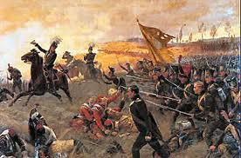
The Hundred Days
Battle of Waterloo:
Napoleon’s final defeat came on June 20, 1815
met a combined European force
under the command of the British Duke of Wellington
lured Napoleon onto a battle field with which the British were more familiar
defeated the French army
end to Napoleon’s campaign

Slide 35
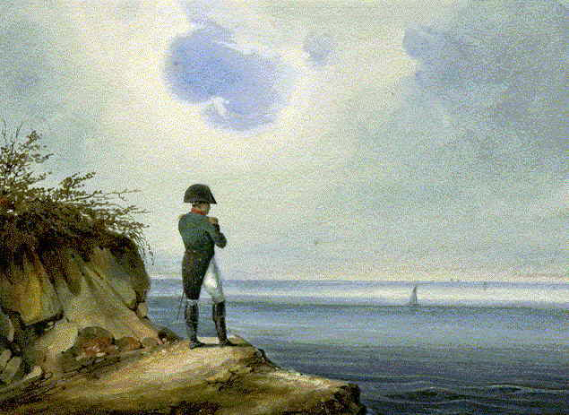
The Hundred Days
the defeat at Waterloo ends the Hundred Days
Napoleon’s last attempt at power
sent to the Island of St. Helena
he dies on St. Helena in 1821

Slide 36
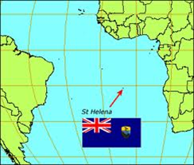

Slide 37
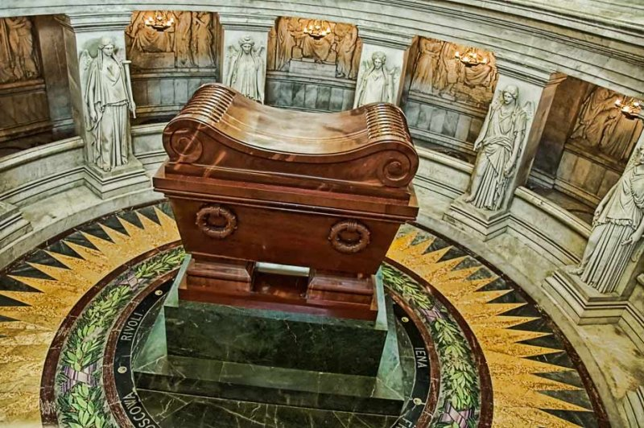

Slide 38
Review…
Even though the French never lost a major battle in Russia, they were devastated by this tactic.
This battle is famous for being Napoleon’s final defeat.
Explain the meaning of the word “exile.”

