Slide 1
Medieval Europe
Dark Ages to the Renaissance

Slide 2
Life After the Fall of Rome
The last Latin speaking (non-Byzantine) emperor lost power in Rome in 476 CE
After this, centralized political authority, long distance trade, urbanization, & literacy slowly declined in Western Europe
Germanic tribes flooded into the region & established hundreds of small kingdoms and tribal chiefdoms
The political authority tended to be weak & dependent on ruler’s ability to provide protection
Borders & thrones shifted often as war between and within kingdoms was common

Slide 3
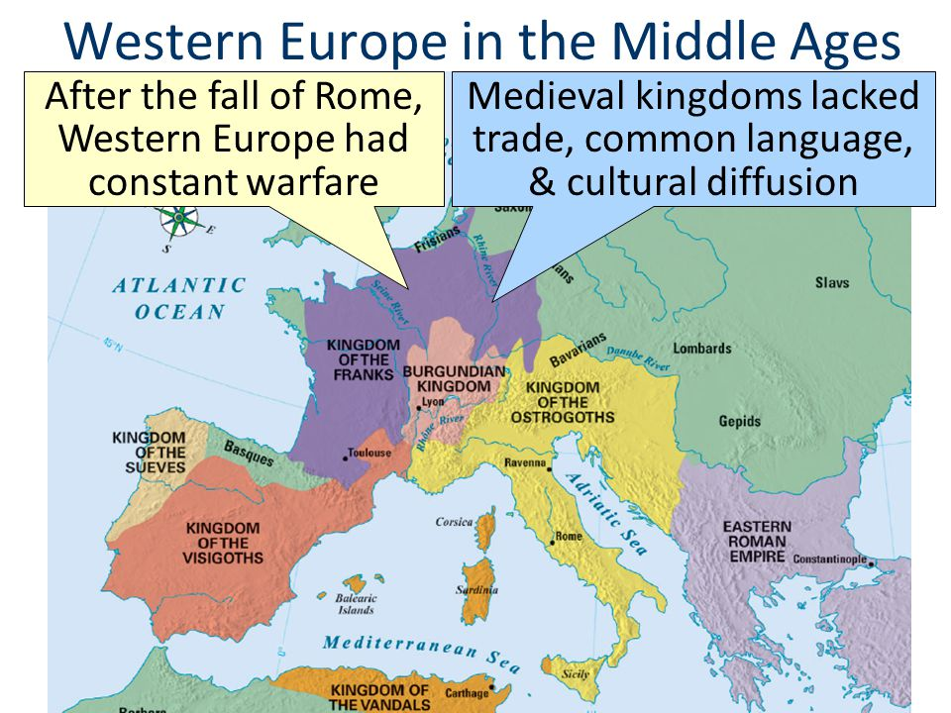

Slide 4
Unity Under the Carolingian Dyansty
A semblance of political unity & cultural revival emerged under the Carolingian Dynasty of the Franks
about 751 to 814
The Carolingian kings gained & expanded power through alliance with Roman Catholic Church
The pope crowned the first Carolingian King, Pepin, the “king by grace of God.”
This established a tradition of the pope claiming the right to confer secular political power on kings

Slide 5
Unity Under the Carolingian Dyansty
Carolingian power reached its peak under Charlemagne
built an empire that spanned most of Central Europe
The pope re-enforced this power by crowning Charlemagne the “Roman Emperor” in 800
Under Charlemagne, Europe briefly enjoyed a level of political unity that had been unseen since the fall of Rome
Charlemagne also fostered a modest intellectual revival by sponsoring the creation of schools
Weak leadership by Charlemagne’s heirs reversed much of the unity & cultural revival & Europe became a largely feudal society in the years after his death in 814

Slide 6
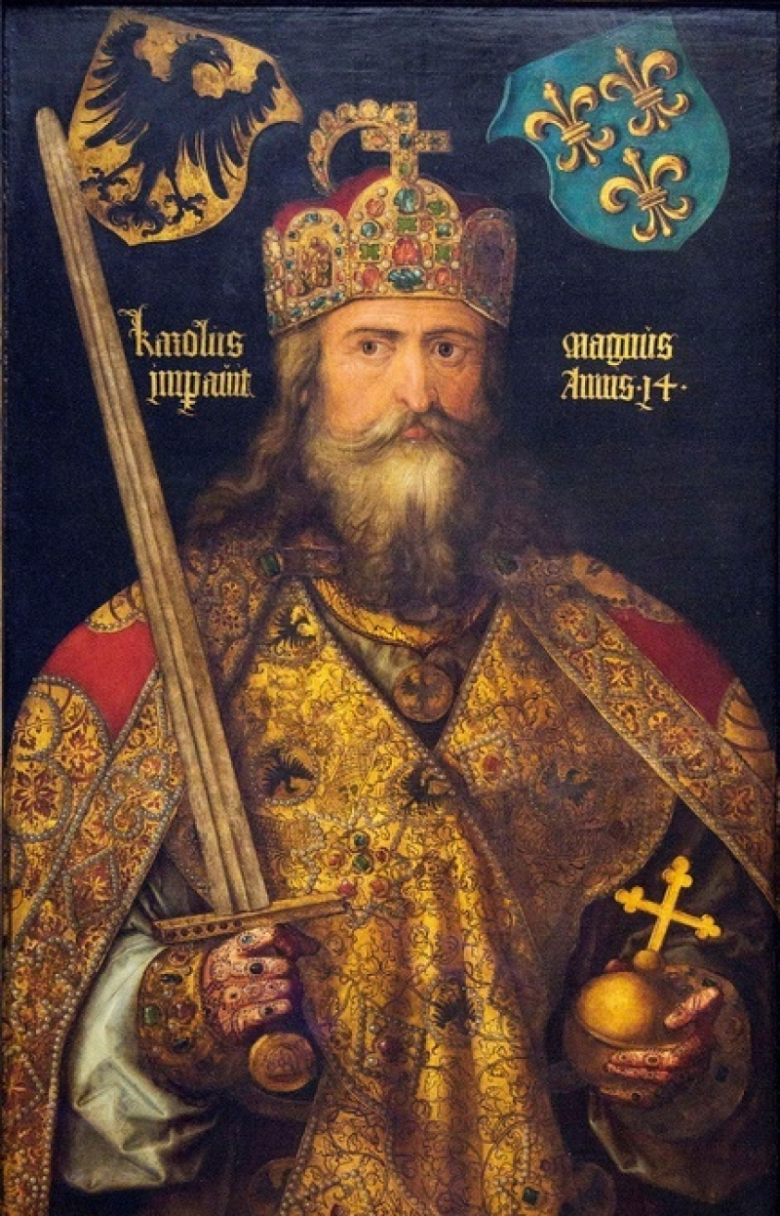
Charlemagne

Slide 7
Feudal Europe
Feudalism took shape slowly & varied from place to place
In the past has been simplified into a strict hierarchy
kings granted lands to nobles
nobles granted lands to knights in exchange for oaths of loyalty & military service
Most modern historians see it as a gross simplification of a system that would be more accurately described as a web

Slide 8
Hierarchy of Feudalism

Slide 9
Feudal Europe
At its most basic level, feudalism was a system that linked landholding with military service
Kings did grant land (called fiefs) to vassal in exchange for military service and oaths of loyalty
land grants might be quite large, made to a lord who also received a title of nobility like duke or marquess.
land grants might also be small to a knight who served in the king’s personal army
Recipients of large land grants might in turn grant out fiefs to lesser nobles or knights who served in their personal army
It was not uncommon for kings, nobles & knights to be vassal to more than one lord having received land grants & possibly even titles from more than one person
The system became more complicated as it became hereditary over time
Titles of nobility & the fiefs might pass from one family to another through marriage

Slide 10
Feudal Europe
The original inhabitants of the land granted to these vassals became serfs in most of Europe.
As a serf they were legally bound to the land and obliged to work as farmers for the lord
In other areas these inhabitants might be free peasant farmers who were free to leave but generally had no incentive to do so

Slide 11
Feudal Europe
Under feudalism Europe became highly decentralized
While long distance trade never completely disappeared, it was greatly reduced
the old Roman system of roads fell into disrepair
This decentralization forced much of Europe to become largely self-sufficient

Slide 12
Feudal Europe
Each feudal lord maintained a manor
The term manor is used to describe this self-sufficient economic system that developed on the feudal lord’s fief
most if not all of the basic necessities of life were produced here
The typical manor included the lord’s manor house, a church, workshops, a mill, a village of cottages for peasants or serfs, pastures for livestock & farmland
The peasants or serfs were obligated to provide labor to the lord & pay taxes
The lord was obligated to maintain order, provide housing & protect to the inhabitants of his manor.

Slide 13
The Roman Catholic Church in Medieval Europe

Slide 14
The Roman Catholic Church in Medieval Europe
The weak & decentralized nature of feudal states provided an opportunity for the Roman Catholic Church to emerge as both a spiritual & secular power in medieval society
When the pope crowned Pepin & later Charlemagne, he established an important & enduring precedent for political power of the Church in Europe

Slide 15
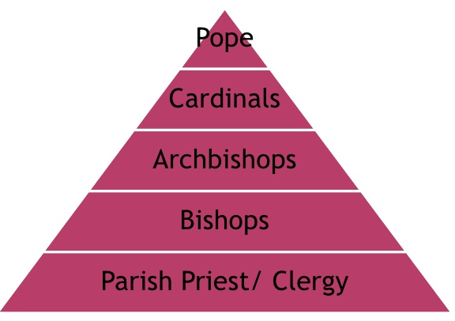
The Roman Catholic Church in Medieval Europe
While political power & the economy of Medieval Europe was highly decentralized, the spiritual unity of the continent remained unified
The popes in Rome maintained unity through a hierarchy of clergy
Pope
Cardinals
Bishops
Abbots
Parish priests

Slide 16
The Roman Catholic Church in Medieval Europe
The authority of the clergy over royalty, nobility & common people was reinforced by several factors
First, medieval Catholicism taught that only the clergy could interpret the scripture.
Reinforced by the fact bibles were written in Latin which most people could not read
Second, the clergy alone could administer 7 sacraments, or rituals, that the church said were required to achieve internal salvation in heaven
Third, the church enforced a law code (canon law), on all believers

Slide 17
The Roman Catholic Church in Medieval Europe
Canon law regulated the behavior of all church members
enforced by a network of courts that had the authority to arrest & punish violators
punishment of the most extreme forms of heresy included torture & execution.
The most powerful tool of the church in maintaining its power was the threat & use of excommunication & interdict.
Interdicts sometimes denied entire regions certain religious rites and/or sacrements
Excommunication expelled a believer from the church, thus denying them any opportunity to achieve eternal salvation & as a result condemning them to eternal punishment in hell

Slide 18
The Roman Catholic Church in Medieval Europe
Monarchs attempted to temper the power of the Church by placing allies in the clergy
Bishops served as regional church leaders throughout Europe
monarchs wanted the authority to appoint the bishops within their realms
became known as lay investiture
The church tolerated this practice until 1075 when Pope Gregory VII banned lay investiture
Holy Roman Emperor Henry IV was upset by this & called for the Pope to step down
Pope Gregory VII excommunicated Henry IV
Henry was forced to stand in the snow barefoot while wearing a itchy hair shirt & beg for forgiveness from the pope for three days

Slide 19
The Roman Catholic Church in Medieval Europe
In addition to political and religious authority, the church was also an important force in maintaining cultural unity in Europe.
While educational opportunities were rare in Medieval Europe, the network of Catholic monasteries did provide some opportunities for scholarship & research
Catholic church constructed several monumental gothic cathedrals during this period that endure as high points in European art & architecture to this day

Slide 20
Growth of Trade in the Medieval Period
The increase in trade & urbanization of Europe was precipitated by population growth that began around 800
This population growth was the product of a mixture of climatic conditions & technological innovations which led to an increase in food supply
From about 800 to 1200, Europe experienced a warm spell that allowed a fairly dramatic increase in land available for cultivation & an extension of the growing season

Slide 21
Growth of Trade in the Medieval Period
Sometime around 800, several new farming technologies were either developed or diffused to Europe from North Africa
These include the horse collar & breast-strap harness.
allowed Europeans to replace oxen with horses in agricultural work, a major advance because a horse can plow about 3 times faster than an ox

Slide 22
Growth of Trade in the Medieval Period
Other agricultural innovations include the heavy plow & the 3 field system
The heavy plow used a large metal blade to cut into the soil thus increasing the efficiency of farmer’s work
3 field system improved efficiency by increasing the amount & fertility of land under cultivation
The mild climate & improvements in technology led to rapid population growth which in part spurred what historians term a commercial revolution in Europe around 1000.

Slide 23
Growth of Trade in the Medieval Period

Slide 24
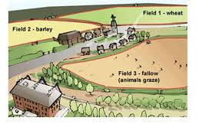
Growth of Trade in the Medieval Period

Slide 25
Growth of Trade in the Medieval Period
During the early years of this commercial revolution regional fairs emerged.
Fairs were generally held on religious holidays in or near the few small towns that existed in Medieval Europe
Peasants from nearby manors would travel to fairs to buy & sell goods
Traveling merchants that brought exotic goods from the east
As fairs became larger & more frequent they spurred the growth of towns.
As towns grew, they became increasingly independent existing largely outside of the authority & traditions of the feudal system
Towns grew into cities, particularly in areas with access to seaborne trade like Italy & Flanders.

Slide 26
Growth of Trade in the Medieval Period
At the height of this commercial revolution several new business institutions developed
included the guilds & banks
Guilds were organizations of merchants & artisans that worked together to regulate business practices to ensure the profitability & viability of their respective commodities
Banking provided loans & infrastructure for the monetization of the economy

Slide 27
Growth of Trade in the Medieval Period
The commercial revolution & urbanization in Europe gave birth to a new social class in the region
made up of artisans, merchants & bankers
lived in cities that were outside of the jurisdiction of the feudal system.
Many feudal monarchs attempted to bring these cities under their authority, but were successful
Cities like Venice & Florence became independent republics ruled by this new class that became known as bourgeoisie or burghers

Slide 28
Growth of Trade in the Medieval Period
In 1347, a Genoese merchant fleet carrying the bubonic plague docked in Sicily, four years later the plague spread to almost all of Europe
killed about one-third of the population
Bubonic plague both fostered & reversed the trends set in motion by the commercial revolution
fear and death diminished populations in European cities, decreased trade and drove up prices
severely undermined the feudal system
led to economic growth & development
The massive deaths brought on by the plague increased demand for peasant labor which in turn increased their ability to demand higher wages.
When nobles refused to increase wages, serfs & peasants fought back in violent rebellions in England, France, Italy, and Belgium
Grip of nobility on the peasantry of Europe was weakened allowing greater freedom to pursue economic self-interest

Slide 29
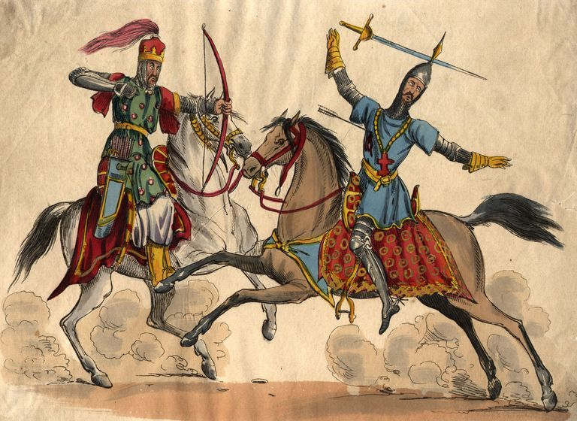
The Crusades

Slide 30
The Crusades
In 1037, the Seljuk Turks established an empire in the Middle East
Seljuk power threatened the Byzantine Empire by 1093
led emperor to solicit help from Pope Urban II
Urban responded by calling for the first Crusade to free Jerusalem from Muslim rule.
The first Crusade set off in 1096 & lasted until 1099
successfully drove Turks from Jerusalem
established 4 small Christian kingdoms in the Middle East
Success of first Crusaded short lived
in less than 100 years Jerusalem was back in the hands of the Muslim Turks
Christians of Europe organized several Crusades over next 300 years but were never able to retake Jerusalem

Slide 31
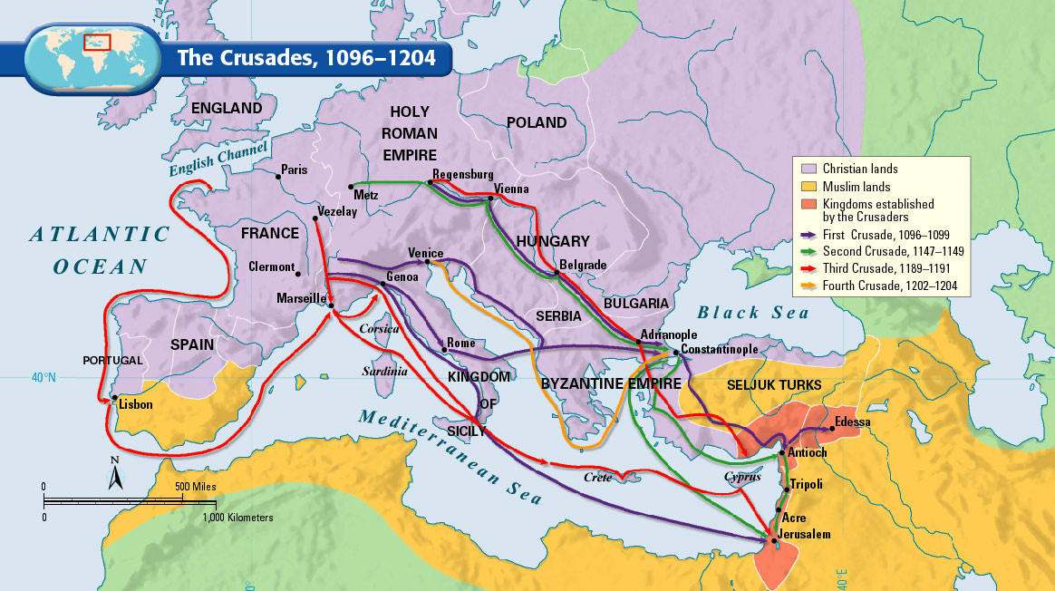
The Crusades

Slide 32
The Crusades
Motivation for the Crusades was a mix of genuine religious zealotry, economic self-interest, & political opportunism
Devout Christians found motivation in the fact that Seljuk Turks denied Christian pilgrims access to Jerusalem & pope’s promise of guaranteed salvation for all those who died on Crusade
Those seeking economic advantage hoped that Crusades would offer opportunities for booty & land
particularly inviting to the younger sons of nobles
Under feudal tradition, the oldest son inherited his father’s land & titles leaving little opportunity to younger brothers
The Crusades offered these young men a chance to obtain land & titles in newly conquered territory
Italian merchants sought profit from financing & transporting Crusader armies & hoped that success on the battlefield would bring Christian control of lucrative trade routes.
The popes hoped that Crusades would bring peace to Europe by uniting quarreling knights against a common enemy abroad & reinforce power of the papacy in secular affairs

Slide 33
The Crusades
Stated goals of Crusades were only realized for a brief period, other effects on Europe long endured
The Crusades stimulated Mediterranean trade
The coastal Crusader states established in the first Crusade facilitated trade between Asia & Europe
exposure of Europeans to Asian goods while on Crusade increased demand for Asian commodities
Europeans were also exposed to Muslim scholarship while on Crusade
included translated works of many of the classical Greek philosophers
Many of these works had largely been forgotten in Europe & were only rediscovered by Europeans by way of Arab translations
Arab, Persian, & Greek scholarship helped spur an intellectual awakening in Europe in the early 15th century

Slide 34
The Crusades
The Crusades also helped to undermine the feudal order in Europe.
The Crusades offered opportunities to all levels of society
Kings found greater power & influence as the armies consolidated under their leadership
Serfs gained freedom & sometimes wealth from participating in Crusades
A few lucky nobles gained titles & land in the short-lived Crusader States
To the east, the Crusades left a legacy of animosity
During the fourth Crusade, motivated by economic opportunity, Western European Christians sacked and looted Constantinople. This attack only increased the divide between the Roman Catholic Church & Eastern Orthodox Church
Years later in the 19th and 20th century the history of the European Crusades against the Muslim world became a tool of Turkish and Arab nationalism

