Slide 1
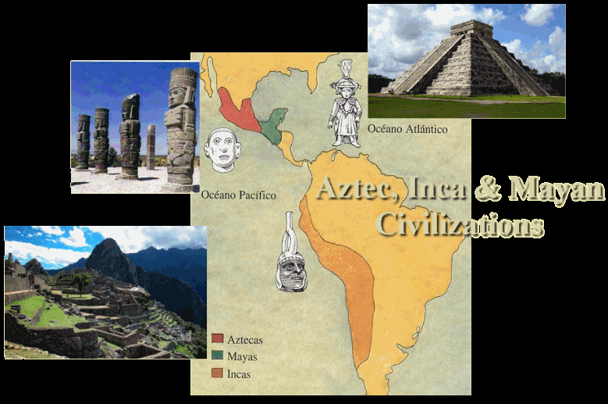
Mayans, Aztecs, & Incas
Meso American Civilizations

Slide 2
Georgia Standards of Excellence
SSWH8 - Describe the diverse characteristics of societies in Central and South America.
a. Explain the rise and fall of the Mayan, Aztec, and Inca Empires.
b. Compare and contrast the Mayan, Aztec, and Incan societies, include: religion, culture, economics, politics, and technology.

Slide 3
Mayans, Aztecs, & Incas

Slide 4
Mayan Civilization
Mayan Civilization emerged out of the cultural footprint left by the Olmec Civilization
Maize cultivation led to the development of villages that grew into urban centers around 800 BCE
Mayan civilization fully emerged by 250 CE
While the Mayan shared a common culture they never achieved political unity, instead approximately 40 independent city-states dominated the region from Southern Mexico to Honduras
Some of the more powerful states exerted authority over smaller dependent states located nearby
The Mayan classical age lasted from about 250 CE to 900 CE

Slide 5
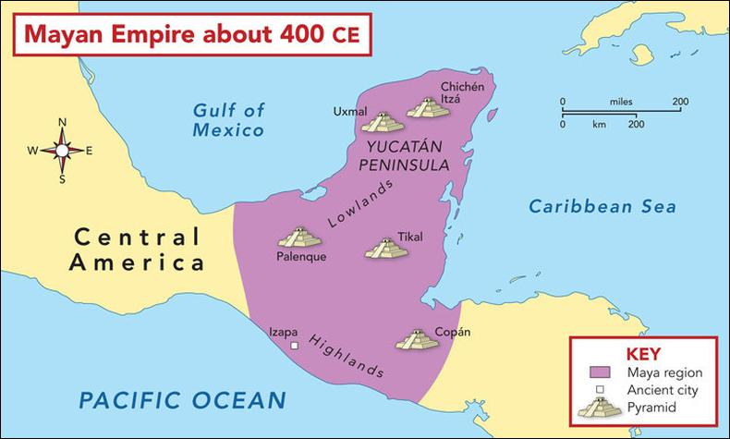
Mayan Civilization Map

Slide 6
Mayan Civilization
The Mayan classical age lasted from about 250 CE to 900 CE
The Mayan Civilization decline began around 800 CE when many of the urban centers were abandoned
The reasons for the Mayan decline are unclear
Scholars suggest that possible causes could include volcanic activity, excessive warfare, disease, overpopulation, or soil exhaustion
By 900 CE, most Mayan cities were abandoned and the population lived in villages led by tribal chiefs

Slide 7
Aztec Civilization
As Mayan culture faded in 800 CE, the Toltec rose in the valley of Mexico and dominated the region from about 800 to 1100
In the wake of the fall of the Toltec, the Aztecs migrated into the valley of Mexico where they struggled to integrate themselves among the urban agricultural societies surrounding Lake Texcoco in the heart of the valley of Mexico
In their early years in the valley, the Aztecs worked as farm laborers and mercenaries for their more powerful neighbors
With time their strength grew and they founded twin capitals, Tenochtitlan and Tlatelolco, on a small island in Lake Texcoco in 1325

Slide 8
Aztec Civilization

Slide 9
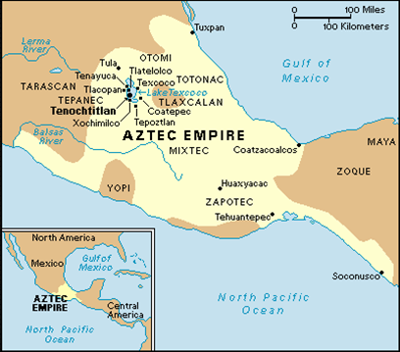
Aztec Civilization

Slide 10
Aztec Civilization
Around the same time the older tribal organization of leadership gave way to a monarchical system borrowed from neighboring societies
This consolidation of leadership allowed the Aztecs to start the process of imperial conquests which began with agricultural lands around Lake Texcoco
Once the Aztec capitals were economically secure, they formed an alliance with two powerful city-states located on the shores of the lake and began the process of building a vast tribute empire

Slide 11
Aztec Civilization
The development of this empire was motivated by several factors
Like earlier civilizations of Mesoamerica, the Aztec religion required regular human sacrifice with the preferred victims being prisoners of war
This need for sacrificial victims led to almost constant “flower wars” during which Aztecs would capture warriors from neighboring regions to deliver to the priests of Tenochtitlan for sacrifice.
Another motivation was the fact that political power and social status was based on the success of these campaigns
Aztec emperors were compelled by tradition to legitimize their rule with successful wars of conquest
While much of the Aztec nobility was hereditary, commoners and nobles alike could earn social promotion by successfully securing captives in battle
Finally, these wars served an economic function by building a vast tribute empire that subsidized the cities of Tenochtitlan and Tlatelolco
Subject people within the vast Aztec empire were required to send the capitals regular payments of maize, beans, cotton cloth, jade, gold and sacrificial victims

Slide 12
Aztec Civilization
In 1502 Montezuma II became the emperor of the Aztecs
By this point, the tribute demands that the Aztecs placed on their subjects was breeding resentment and instability
Montezuma instituted reforms to try and quell the unrest but this came too late
In 1519 Hernán Cortés arrived on the coast of Mexico with 600 conquistados
Shortly after arrival Cortés met La Malinche, a native woman who served as his translator
With La Malinche’s help, the Spanish learned of both the vast wealth in the Aztec capital of Tenochtitlan and the widespread anger among the Aztec subjects
Cortés was able to use this anger to establish alliances with native armies as he marched toward the Aztec capital

Slide 13
Aztec Civilization
Montezuma may have initially welcomed Cortés into the capital because of rumors that he was the god Quetzalcoatl
Aztec prophecies predicted Quetzalcoatl return and some may have believed that Cortés was the fulfillment of this prophecy
Once in the city, the Spanish took Montezuma hostage and began looting the palace
The Aztecs and their remaining allies were initially able to drive the Spanish from the city but their success was short lived
The Spanish had several advantages that proved insurmountable to the Aztecs
Native allies gave the Spanish a numeric advantage
Smallpox, spread by the Spanish, devastated the densely populated cities of the valley of Mexico
Steel weapons, horses, war dogs, guns, and armor also proved helpful to the Spanish in their defeat of the Aztecs
In August of 1521 the Spanish ended the Aztec Empire

Slide 14
Incan Civilization

Slide 15
Incan Civilization
The Incan Empire grew out of the economic and cultural footprint of the Chaven (c. 900 BCE to 200 BCE), Moche (c. 100 to 800) and Wari (c. 500 to 1000) civilizations
In the early 1400s, the Inca were one of several competing military powers in the southern highlands of Peru
In this early stage of their history, the Inca were organized into chiefdoms based on kinship groups
In about 1430 Wiraqocha Inka began to consolidate his power over these groups and established a hereditary monarchical system of government centered in Cuzco
Once firmly in power, Wiraqocha Inka began a period of imperial conquest that lasted until about 1525
Early conquests by the Inca may have been motivated by drought or military threats from rival states to the west or south
Over time, the motivation shifted to the desire to capture booty and eventually territory

Slide 16
Incan Civilization
Pre-Incan civilizations of the Andean Region learned early on how to exploit the microclimates that range from the coast to the mountain valleys to the rainforests of the interior
Incan imperial ambition was driven by the desire to take control of enough territory to allow the exploitation of all of these microclimates
The system of political legitimacy that justified the power of Incan emperors also motivated imperial conquest
Upon an emperor’s death political power would pass to the most able son but the wealth (mostly in the form of vast agricultural estates like Ollantaytambo) would pass to the rest of the family.
The family members that inherited the wealth were expected to use this wealth to maintain an elaborate cult around the mummy of the deceased emperor

Slide 17
Incan Civilization
This system of split inheritance required each emperor to acquire wealth through the conquest of new territory
By 1525 the Inca built a vast empire bound together by a professional army and elaborate bureaucracy that managed affairs by dividing the empire into four parts and eight districts all unified by an extensive network of roads, storehouses, garrisons, and frontier forts
Smallpox arrived in the Andean region well before the Spanish in 1520s
The disease caused political turmoil when it killed the emperor and led to a civil war
When the war ended, Atahulpa became emperor but his hold on power remained tenuous

Slide 18
Incan Civilization
In 1530 Francisco Pizarro arrived with 180 Spanish Conquistadors
He was able to use the political instability to his advantage and captured Atahulpa
Pizarro and his men executed Atahulpa which caused even greater political instability in the empire and allowed the Spanish to take the city of Cuzco in 1533
By 1536, the Spanish defeated the last Incan rebellion and took control of the Inca’s empire

Slide 19
Maya, Aztec, and Inca: Religion
The Mayan, Aztec, and Incan civilizations were all polytheistic with an emphasis on the worship of the sun.
This focus on the worship of the sun led to the development of elaborate and quite accurate calendars in all three societies.
Faith in each of these civilizations required elaborate rituals that included sacrifice.
Human sacrifice was most common in the Aztec Empire, with thousands of prisoners or war, criminals, slaves, and people given in tribute sacrificed a year.
Human sacrifice was also common in the Mayan civilization but not done as frequently
While human sacrifice did occur in the Incan Empire, it was uncommon
Sacrifices of camelids and textiles were much more typical

Slide 20
Maya, Aztec, and Inca: Religion
Emperors in each of these civilizations fulfilled an important spiritual role
In the Mayan and Aztec civilizations, emperors and other nobles were considered intermediaries to the gods
Mayan emperors and priests participated in elaborate bloodletting rituals during which the faithful believed they were communicating with the gods
In Incan society the emperors were considered descendants of the sun and therefore divine
As a result, Incan emperors were revered in both life and death
All three civilizations also constructed monumental architecture in the name of faith
The Mayan and Aztecs built tall pyramids that served as temples and the Inca utilized expert stone work to build elaborate temples in which the walls were covered in sheets of gold

Slide 21
Maya, Aztec, and Inca: Social
The Mayan, Aztec, and Incan societies were all highly stratified
Each had a hereditary nobility that dominated the government
In the Mayan and Aztec culture this stratification included ethnic Mayans and Aztecs with a substantial wealth gap between the elite and common peasants
Social divisions between ethnic Inca were not as dramatic as the wealth from the empire was used to support a relatively comfortable life for the ethnic Inca living in Cuzco
In this case, the non-Inca subject peoples of the empire made up the underclass of peasants
In all three of these cultures, the basic unit of society was a family based clan
In both the Incan and Aztec Empires the clan system was used by the state to allocate civic and military duty
This system was particularly important in the Incan Empire. The basic unit of the Incan society was the ayllu, a clan made up of a large group of people who claimed a common ancestor
The ayllu members worked collectively to support the members and fulfill their duty to the state

Slide 22
Maya, Aztec, and Inca: Economy
Agriculture was the foundation of the economy for the Maya, Aztecs, and Inca
All three depended heavily on the cultivation of maize, beans, and squash
The Andean region’s many microclimates made the Incan economy much more diverse
Potatoes and quinoa were staples in the Andes but not in Mesoamerica
Pastoralism was also unique to the Inca
In the high mountain valleys of the Andes the Inca and their subject peoples kept vast herds of llama and alpaca for meat, textiles and transport
Commercial trade was much more common in the Mayan and Aztec civilizations than in the Incan Empire
Several factors contributed to this difference
Each ayllu in the Incan empire controlled territory in several different microclimates
Therefore, each family group was largely self-sufficient making commercial trade less important
Also the Incan state used an elaborate labor tax system called the Mit’a
This labor tax system assigned duties to each ayllu which included cultivating crops and producing manufactured goods for urban elite further reducing the need for commercial trade

Slide 23
Maya, Aztec, and Inca: Economy
Commercial trade was much more common in the Mayan and Aztec civilizations than in the Incan Empire
Several factors contributed to this difference
Each ayllu in the Incan empire controlled territory in several different microclimates
Therefore, each family group was largely self-sufficient making commercial trade less important
Also the Incan state used an elaborate labor tax system called the Mit’a
This labor tax system assigned duties to each ayllu which included cultivating crops and producing manufactured goods for urban elite further reducing the need for commercial trade
Both the Aztec and Mayan societies had a robust merchant class that transported luxury goods over great distances leading to thriving markets in each major city where merchants and common people bartered for a great variety of goods

Slide 24
Maya, Aztec, and Inca: Political
While the Aztecs and Inca ruled a unified empire the Mayan civilization was divided into approximately 40 independent city-states that dominated the region from Southern Mexico to Honduras
Some of the more powerful states exerted authority over smaller dependent states located nearby
Each city-state was ruled by a hereditary monarch/priest who maintained power through faith and force
The polytheistic religion of the Maya required regular human sacrifices
Prisoners of war were the preferred victims of these ritual sacrifices leading to almost constant warfare between neighboring Mayan city-states
Success in these wars and bloodletting rituals cemented the king’s power as he was seen as an intermediary between the people and the gods

Slide 25
Maya, Aztec, and Inca: Political
Aztec emperors also had an import spiritual role that including leading wars for the capture of sacrificial victims.
These emperors were not hereditary however, instead they were selected from the noble families of the Aztec capitals by a council of aristocrats with whom they had to share power
Like the Maya, the Incan emperors were hereditary and their power was also justified by successful military campaigns and a connection to the gods
Human sacrifice was far less common in the Incan civilization so the wars were principally about the accumulation of land and wealth
The Incan Empire’s government was much more centralized than the other two civilizations
The Aztec Empire utilized military force to extract tribute in the form of material goods from subject people
While the Inca also extracted tribute, it was in the form of labor
The Incan state took direct ownership of the land it conquered and utilized an elaborate labor tax system called the Mit’a to direct the labor of subject people to the service of the state.
This system required a much more centralized form of administration in the Incan lands
The empire was divided into regions with local administrators that directed the hereditary leaders of the family clans or ayllus located within their region

Slide 26
Maya, Aztec, and Inca: Technology
The major technological advances of the Mayan, Aztec and Inca revolved around the cultivation of crops
All three made major advances in selective breeding, calendar making, and irrigation
They also share major advances in stone architecture
All three built monumental architecture out of stone with the Inca achieving an impressive level of refinement
Incan stone cutters built walls out of perfectly cut stones that interlocked and were reinforced with bronze rings allowing the buildings to withstand the earthquakes that are common in the region

Slide 27
Maya, Aztec, and Inca: Technology
These civilizations also developed advanced systems of record keeping
The Aztecs and Maya developed a written language that utilized hieroglyphics
The Inca utilized a system of strings and knots called the quipu that allowed numeric record keeping
The Inca and Aztecs developed technologies to address the unique characteristics of their homes
For the Inca, this included an elaborate system of paved roads that included suspension bridges and advanced terracing techniques
These roads and terraces facilitated the Inca’s ability to exploit the many microclimates of their Andean home
The Aztecs developed a complex system of dikes and aqueducts to manage water on their island home in Lake Texcoco
Texcoco was a terminal lake with a high salt content
Aztec engineers devised methods to control the salinity of the lake and allow the cultivation of crops on man made islands built around their capital

Slide 28
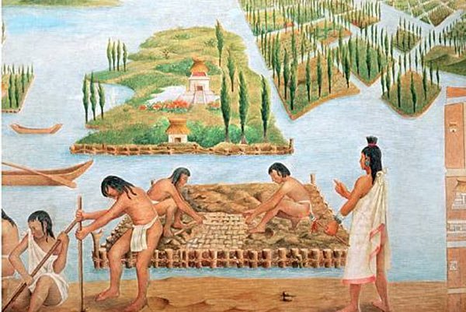
Inca – Terrace farming Aztec – chinapas

Slide 29
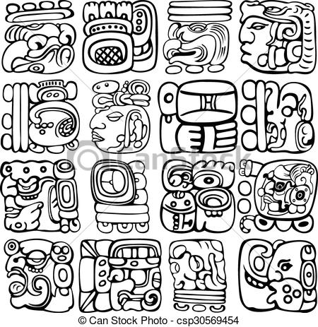
Incan – Quipa Aztec & Maya – Heiroglypics

Slide 30
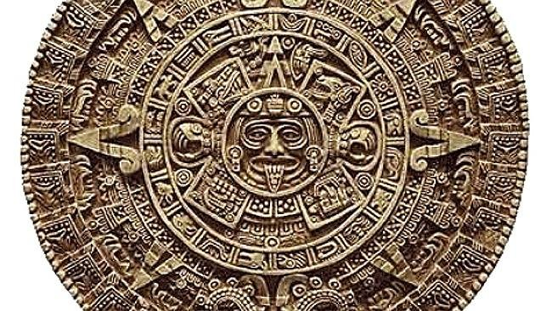
Mesoamerican Calendar

Slide 31
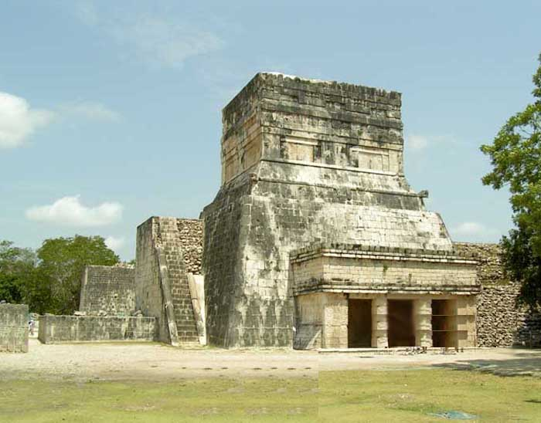
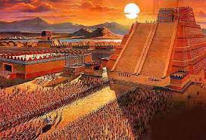
Mesoamerican Temples

Slide 32
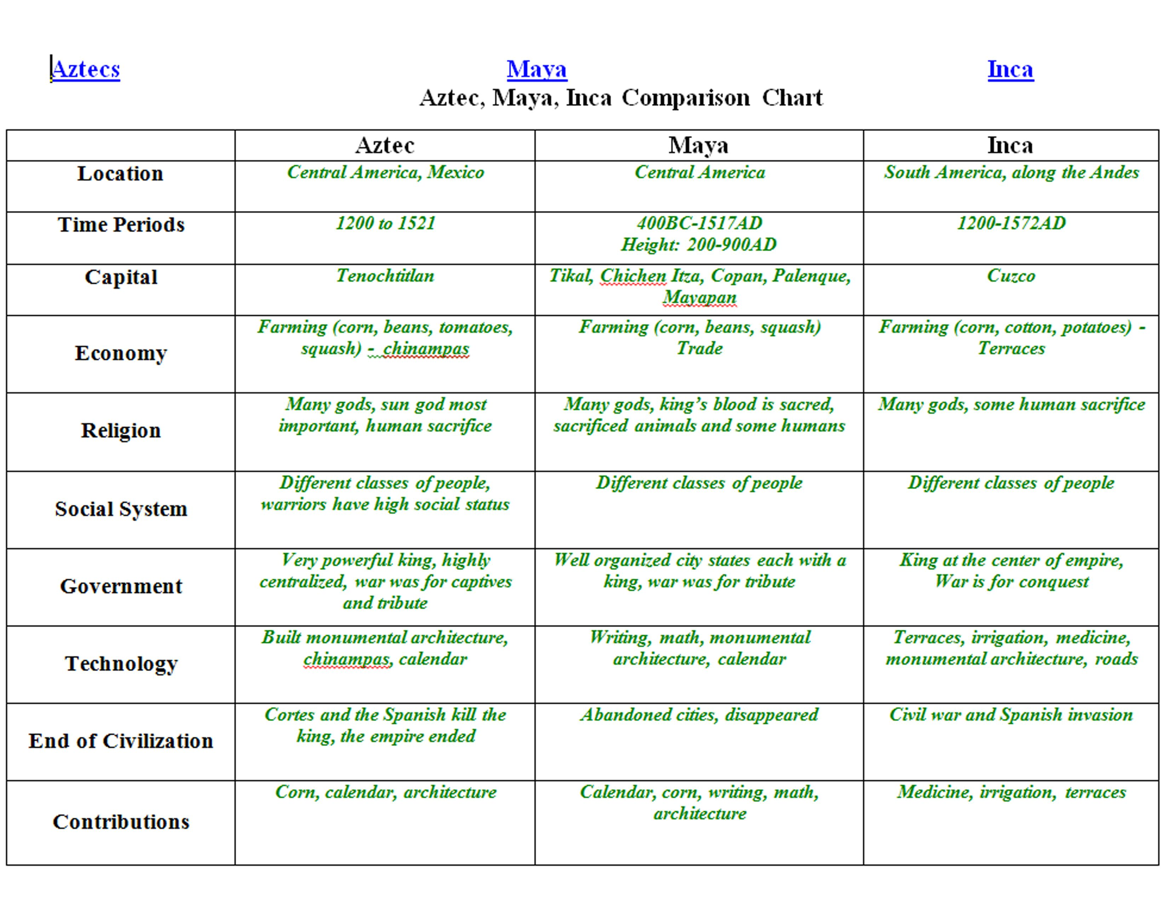
Compare and Contrast of Mayans, Aztecs, and Incas

