Slide 1
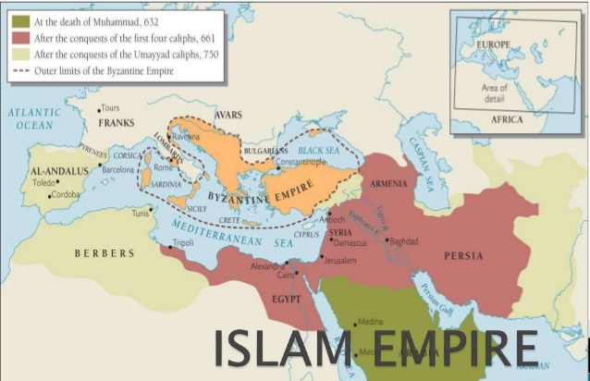
Islam & The Islamic empire

Slide 2
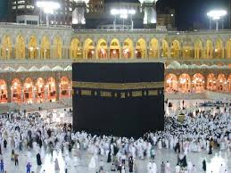
Origins of Islam
In 570, Muhammad was born in Mecca
During this time, the northern portion of Middle East was dominated by the Christian Byzantine Empire & the Zoroastrian Sassanid Persian Empire
There was no centralized authority within the Arabian peninsula
Independent tribes ruled & benefitted from the lucrative trade routes
Tribes traded frankincense & myrrh with the Persians & Byzantines
Mecca was an important trading town
Mecca also served as important religious site for polytheistic Arabs because of the Ka’ba

Slide 3
Origins of Islam
Muhammad became a merchant & eventually married a wealthy widow, Khadijah
Financially secure, Muhammad now turned to spiritual pursuits which included meditating in the mountain caves outside of Mecca.
In about 610, Muhammad began to have visions while meditating.
He believed that these visions were the Angel Gabriel delivering a message from the one true God (Allah in Arabic)
The message delivered in these revelation outlined the basic beliefs of Islam & were eventually recorded in the Quran

Slide 4
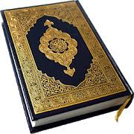
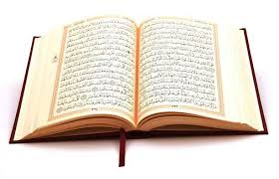
Origins of Islam
Muslims believe only the Quran contains God’s words
They do also believe that the Jewish and Christian holy books contain religious truth
Christians & Jews are called “People of the Book”

Slide 5
Basic Beliefs of Islam
Basic beliefs of Islam are outlined in the 6 Articles of Faith
the belief in one God that created all of things belief
that God sent a series of messengers (prophets) including Noah, Abraham, Moses, & Jesus.
Each prophet delivered a divine message which is preserved in the Books of God, these include the Torah, Gospels, Psalms, and Scrolls.
According to Islam, Muhammad is God’s final messenger and he has delivered God’s exact words in the form of the Quran

Slide 6
Basic Beliefs of Islam
Muslims look to the Hadith & Sunnah
words and deeds of the Prophet Muhammad
Used to guide everyday life.
Five Pillars of Islam
Basic practices of Islam (Faith, Prayer, Charity, Fasting, & Hajj)
Muslim scholars have used these various sources of religious truth to compile Shariah, or Islamic, law
regulates public & private affairs in Muslim states.

Slide 7
Islam spreads
Muhammad began to share his message with the people of Mecca after 610
The message was not well received as it threatened Mecca’s traditional role as a pilgrimage destination for the polytheistic Arabs.
Muhammad led his followers to the city of Medina in 622 to flee persecution.
Most of the population of Medina accepted Muhammad as the Messenger of God & converted
The Meccan migrants & the converts of Medina, unified under a single faith, now formed the Umma, a political and religious body of Islam.
The conflict with Mecca continued until 630
the armies of the Umma successfully defeated Mecca.
by his death in 632, most of the Arabian Peninsula was unified under the authority of the Umma.

Slide 8
Islam spreads
Leadership of Islam passed to a successor called a caliph.
Under the first 4 caliphs, the Umma now known as a caliphate continued to expand.
By 661, the caliphate included all of the Arabian Peninsula, Persia, Palestine, & Egypt
Political authority of the caliphate spread quickly but Islam did not
Civil war broke out in 656 due to conflict over leadership of the religion

Slide 9
Islamic Empires
The Umayyads won the civil war & ruled from 661 to 750 (Umayyad caliphs remained in power in Spain until 1031).
Under the Umayyads the caliphate expanded to include all of North Africa, the Iberian Peninsula, & parts of Central Asia.
The Umayyad government & army was dominated by Arabs, however the empire was ethnically diverse.
Ethnic conflicts led to unrest & in 750 the Umayyad dynasty was overthrown

Slide 10
Islamic Empires
The Abbasid Caliphate replaced the Umayyads & held the position until the last Abbasid Caliph was killed by the Mongols in 1258.
The Abbasid caliphs were never able to maintain the level of political unity or centralized authority of the Umayyads.
Abbasid authority never extended to Iberia & by 969 a rival caliphate, the Fatimids,controlled Northern Africa & parts of Palestine & the Arabian Peninsula.

Slide 11
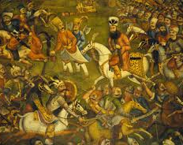
The Split Within Islam
Sunni vs Shi’ite

Slide 12
Conflict Within Islam
While alive, Muhammad never established a plan for leadership of the Umma
After his death the 1st 3 caliphs were selected from among his close companions & generally ruled without controversy until year 656
656 - rebels from the army assassinated Uthman, the third caliph
The assassins then nominated Ali, a relative of Muhammad for the position
Many in the community believed that Ali was Muhammad’s legitimate heir because of sermon delivered by the Prophet at Ghadir al-Khumm in which he alluded to Ali as leader
Ali accepted the position of caliph but he faced a challenge from 2 of Muhammad's close friends & his favorite wife A’isha
This challenge resulted in the Battle of the Camel from which Ali emerged victorious

Slide 13
Conflict Within Islam
Following the Battle of the Camel, Ali faced another challenge
Came from a relative of the slain Uthman, the Syrian governor Mu’awiya
This led to more armed conflict
Battles were inconclusive
Ali & Mu’awiya agreed to a truce
Ali was assassinated by a group of his followers in 661
Assassins were angered by Ali’s willingness to negotiate with Mu’awiya
Ali’s assassination cleared the way for Mu’awiya to assume the position of caliph
Established the Umayyad Caliphate

Slide 14
Conflict Within Islam
However, Ali’s son Husayn revolted in 680 hoping to reestablish his family’s right to rule
The Umayyad caliph ordered Husayn & his family massacred
The violent death of Husayn made him a martyr to his followers
Husayn’s followers broke away & formed the Shi’a branch of Islam
Supports of the Umayyads became known as the Sunni.

Slide 15
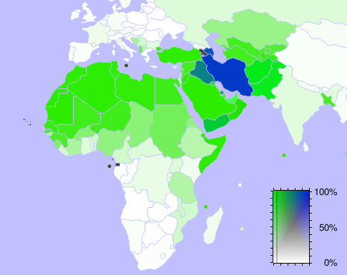
Map of Followers of Islam Blue = Shi’Ite Green = Sunni

Slide 16
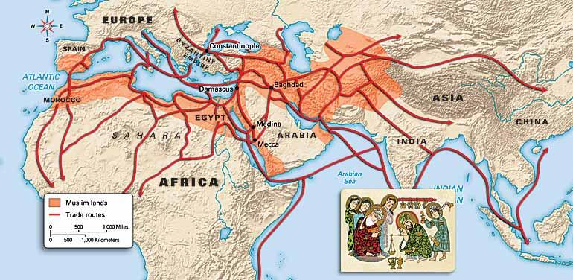
Economic Impact of Islam

Slide 17
Islamic Trade Routes
The Islamic world laid at the heart of 4 of the world’s major trade routes in the period from 600 to 1300
The stability offered by these vast Islamic caliphates fostered the growth of these trade routes & prosperity of the regions they connected
These trade routes include the Mediterranean, Trans-Saharan caravan route, Silk Road, & the Indian Ocean maritime system
Together these interconnected routes linked the manufactures, mines markets of China, Southeast Asia, India, East Africa, the Middle East, Central Asia, West Africa, & Europe

Slide 18
Islamic Trade Routes
Trade along Islamic trade routes included the exchange of key commodities
China - silk and porcelain
South & SE Asia - spices & textiles
Africa - ivory, slaves, & gold
Europe - glass
Middle East - metalware, slaves, & textiles

Slide 19
Islamic Trade Routes
Trade along Islamic trade routes was facilitated by technological advances
Arab dhow made travel in the Indian Ocean easier
it was equipped with a triangular lateen sail that increased the ship’s maneuverability
Arabian camel saddles that diffused to North Africa improved the security & efficiency of trans-Saharan trade
The common moral code that Islam offered also promoted the growth of trade in the region
Taken together, these Afro-Eurasian trade routes that meet in the Muslim world spurred the entire region’s economic growth
This growth is evidenced by the increased prosperity in major trading cities like Timbuktu, Mombasa, Alexandra, Constantinople, Venice, Hormuz, Baghdad, Melaka, Calicut, Canton, & Hangzhou among others

Slide 20
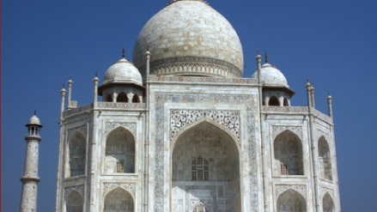
Major Contributions of Islam

Slide 21
Major Contributions of Islam
2 key factors intercepted in the period 600 to 1300 to make the Islamic world a center of learning
1st - the Islamic world was at the intersection of Afro-Eurasia’s major trade routes
this fostered a cosmopolitan atmosphere were intellectuals from different regions could meet and exchange ideas
Early scholarship from Greece & Rome was translated, preserved & improved upon.
Indian mathematics including the number system that becomes known as Arabic numerals in the West was applied to the development of algebra
Chinese paper making technology allowed the creation of vast libraries & Chinese technologies related to navigation, astronomy, & gunpowder were refined
These refinements would eventually facilitate the age of exploration in Europe.

Slide 22
Major Contributions of Islam
2nd - the expectation that all believers read the Quran promoted literacy in a universal language, Arabic, & the establishment of an extensive educational system
Baghdad, Damascus, Cordoba, & Timbuktu among other cities became what we might call university towns
This intellectual development was centered on the madrasas, a religious college were scholars studied many disciplines of learning
In the field of science, Ibn Sina authored Canon of Medicine which became the authoritative medical text in the Middle East & Europe until the 1600s
In the field of geography, Ibn Battuta’s Travels vastly improved knowledge of cultural & physical geography in the Islamic world & beyond.

