Slide 1
Industrialization & Urbanization
Social Impacts

Slide 2
Standard & Essential Questions
SSWH15 - Describe the impact of industrialization and urbanization.
c. Examine the social impact of urbanization, include: women and children.
EQ – What social impacts did industrialization & urbanization have on women, children, & overall society?

Slide 3
Social Impacts
Cities of industrialized nations grew at unprecedented rates in the 18th, 19th & 20th centuries.
Industrialization & Urbanization had many impacts, both positive & negative
The impacts varied by social class

Slide 4
Social Impacts: Social Classes
The Upper Class/Wealthy
Factory owners & managers
Enjoyed lavish lifestyles
paid for by profits from industrialization
The Middle Class
Middle class—skilled workers, merchants, rich farmers, professionals
Emerging middle class looked down on by landowners, aristocrats
Middle class has comfortable standard of living
The Working Class
Laborers’ lives not improved; some laborers replaced by machines
Luddites, other groups destroy machinery that puts them out of work
Unemployment a serious problem; unemployed workers riot

Slide 5
Social Impacts
Living Conditions
Sickness widespread; epidemics, like cholera, sweep urban slums
Life span in one large city is only 17 years
Wealthy merchants, factory owners live in luxurious suburban homes
Rapidly growing cities lack sanitary codes, building codes
Cities also without adequate housing, education, police protection
Working Conditions
Average working day 14 hours for 6 days a week, year round
Dirty, poorly lit factories injure workers
Many coal miners killed by coal dust

Slide 6
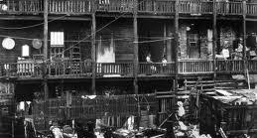
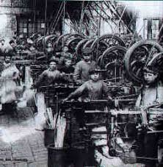
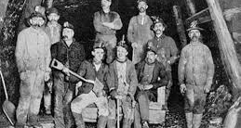

Slide 7
Social Impacts
Daily Life
Concept of men as the breadwinner developed; men socialized with each other at the end of the day
Middle class women hired domestic help; more time for education & employment
Working class women found more domestic jobs because more families were hiring
Families became more organized by gender roles; middle-class families had more leisure time

Slide 8
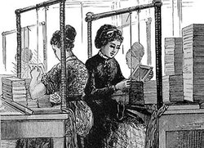
Social Impacts: Wealthy & Middle Class
Women of wealthy & middle class
Some worked prior to marriage
Once married conformed to social norms of the time
Victorian morality - values that supported chastity, not committing crimes, a strict code of conduct within society
Seen as homemakers, mothers, & social arbiters of family
Social arbiters – decide moral & social issues
Allowed women to pursue leadership roles outside of homes
Some women in wealthy & middle class did become leaders of reform movements
Anti-slavery, prohibition, child labor, women voting rights, etc.

Slide 9
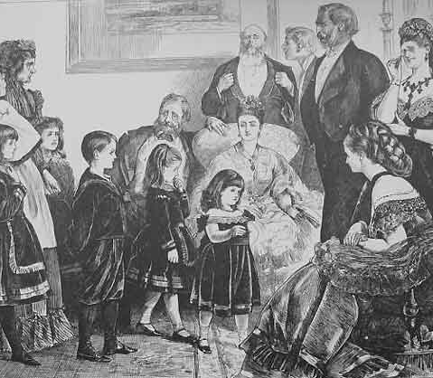
Social Impacts: Wealthy & Middle Class
Children of Wealthy & Middle Class
The children of wealthy & middle class families received quality educations
Boys – trained for jobs similar to fathers
Girls – trained for domestic roles like mothers

Slide 10
Social Impacts: Working Class
Wages among the working class kept families in poverty
Forced women & children into the workforce
Women with children did domestic work
Other women worked in factories
Many children started work as young as 5 years old
Working class children rarely educated
Families worked in separate facilities mostly
Prior to Industrial Revolution, poor family worked together
Very little social mobility for working class families

Slide 11
Social Impacts: Short term & Long term
Immediate Benefits
Creates jobs, enriches nation, encourages technological progress
Education expands, clothing cheaper, diet and housing improve
Workers eventually win shorter hours, better wages and conditions
Long-Term Effects
Improved living and working conditions still evident today
Governments use increased tax revenues for urban improvements

