Slide 1
Industrialization & Urbanization

Slide 2
Unit 7 - Georgia Standards of Excellence
SSWH15 - Describe the impact of industrialization and urbanization.
a) Analyze the process and impact of industrialization in Great Britain, Germany, & Japan.

Slide 3
Unit 7 - Georgia Standards of Excellence
Essential Questions
What factors led to industrialization in Great Britain, Germany, & Japan?
What impact did industrialization have in Great Britain, Germany, & Japan?

Slide 4
Industrialization & Urbanization
12th Century - Many of the key elements of industrialization, including mass production and mechanization, first appeared in Song China
18th Century - In Great Britain, sustained innovations in technology led to dramatic and permanent transformations of society

Slide 5
Industrialization & Urbanization – Factors Great Britain
Several factors converged to make Britain the birthplace of the Industrial Revolution
Great Britain was rich in many of the key ingredients to early industrialization such as coal, iron, waterways, & harbors
Agricultural Revolution of 18th Century
2 reasons for this:
Exploration
Columbian Exchange introduced new crops like potatoes & corn which were perfect for cool climate of Britain
Increased agricultural yield
Enclosure Legislation by Parliament
General Enclosure Act - enabled any village, where 3/4 of landowners agreed, to enclose its land
Farmers more likely to use new technologies such as crop rotation, selective breeding, & mechanization of planting
Less disease spread by livestock

Slide 6
British Coal Deposits

Slide 7
Industrialization & Urbanization – Factors Great Britain
The Agricultural Revolution produced 2 other key ingredients in industrialization:
1) Capital (investment, income, resources, etc.)
Innovation in farming increased efficiency & output which enriched property owners
2) Labor (work force)
Population increased population due to increase output in farming
The need for fewer farmers led those who were out of work to move to cities.
The displaced farmers became a reliable & affordable labor force.
Land was also available due to the clearing of forest form increased farming yeild

Slide 8
British Population Before/After Industrial Revolution

Slide 9
Industrialization & Urbanization – Factors Great Britain
Britain's abundant natural resources, capital, and a large labor force fed the ever increasing demand for manufactured goods both at home & abroad
Population growth fueled the demand in Britain
Abroad, British colonization of the Americas, the African slave trade, & the Asian trade in luxury goods fueled the demand
Prior to the Industrial Revolution, British manufacturing was done in small batches in workshops & homes
Mid 1700s – British manufacturing moved to factories

Slide 10
Industrialization & Urbanization – Factors Great Britain
1759 - Josiah Wedgwood transformed the production of pottery by introducing division of labor
Each worker was given on small simple task in the manufacture of pottery
Division of labor increased productivity & quality
Decreased production costs
Wedgwood’s division of labor became a model for mass production in Britain

Slide 11
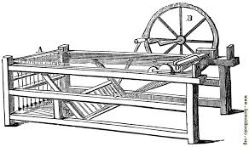
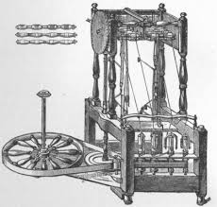
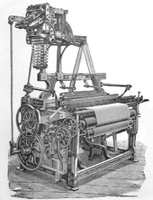
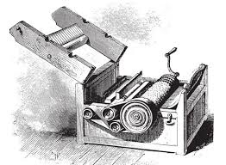
Industrialization & Urbanization – Factors Great Britain
Mechanization came to Britain soon after division of labor
Use of machines was mainly in textile industry
A number of inventions led the charge into mechanization
1764 – Spinning Jenny
Faster weaving
1769 – Water Frame
Used water power for weaving
1784 – Power Loom
Sped up production
Better quality work
1793 – Cotton Gin
Boosted cotton production

Slide 12
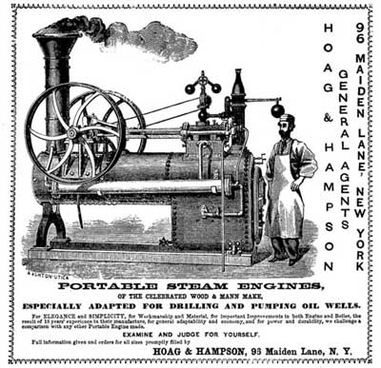
Industrialization & Urbanization – Factors Great Britain
Britain’s factories were fully mechanized by 1800
Machines became more efficient & affordable
3 reasons why
1) Iron
Used for thousands of years but was expensive
New ways of removing impurities made it easier to produce & cheaper
2) Introduction of steam power
1764 – James Watts invents the steam engine/financed by Matthew Boulton
Factories no longer depended solely on waterways for power
Waterways no longer only way for transportation of products
British roadways improved
Introduced steam powered ships & railroads
1807 – Robert Fulton produces 1st Steam Ship

Slide 13
Industrialization & Urbanization – Factors Great Britain
3) Interchangeable parts
1801 – Eli Whitney introduced interchangeable parts (firearms)
Increased productivity & reduced production costs
Became know as “American System of Manufactures”
The Railway Age Begins
Steam-Driven Locomotives
In 1804, Richard Trevithick builds first steam-driven locomotive
In 1825, George Stephenson builds world’s first railroad line
The Liverpool-Manchester Railway
Entrepreneurs build railroad from Liverpool to Manchester
Stephenson’s Rocket acknowledged as best locomotive (1829)
Railroads Revolutionize Life in Britain
Railroads spur industrial growth, create jobs
Cheaper transportation boosts many industries; people move to cities

Slide 14
Industrial Urban Areas of Great Britain
London
Birmingham
Manchester
Liverpool

Slide 15
Industrialization & Urbanization – Factors Germany
Britain began the Industrial Revolution but Germany became Europe’s industrial powerhouse
In 18th century, Germany did not exist as a country
German speaking lands were divided into a multitude of kingdoms, principalities, duchies, & a variety of other forms of political union
Kingdom of Prussia was the most powerful
1835 – Prussian leaders began to study the British way of manufacturing, hired British engineers, & send children to study British industrial management
1850’s – factories, railroads, & coal mines were “sprout[ing] from the earth like mushrooms.”
1913 – German was unified & was 2nd only to the U.S. in manufacturing

Slide 16
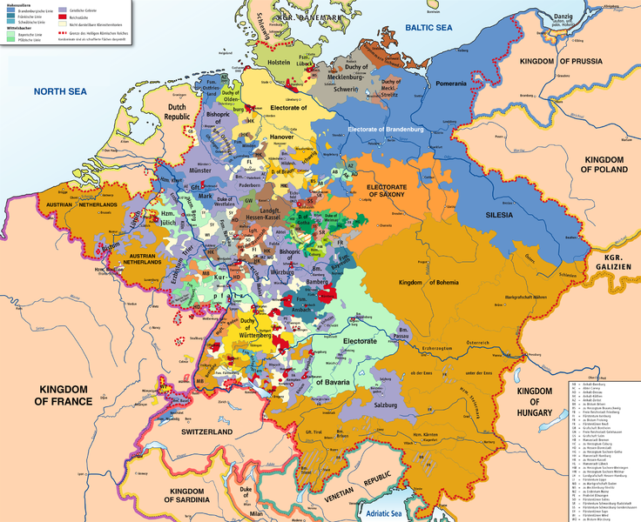

Slide 17
German Factories

Slide 18
Industrialization & Urbanization – Impacts Europe
Industrialization in Europe & the U. S. created an endless demand for more raw materials to produce goods & more markets to sell those goods
Led to European & American imperialism in the mid 1800’s
Africa & Asia fell victim to this imperialism
almost all of Africa, South Asia, Southeast Asia & coastal China under the control of either a European nation or the United States by 1900
Japan was faced with the very real possibility of becoming the victim of imperialism during this time

Slide 19
Industrialization & Urbanization – Factors Japan
At the start of the 19th century, Japan was basically a feudal society loosely ruled by the Tokugawa Shogunate
For 165 years Japanese law had forbid most foreign interactions
While Japan had some contact with the outside world, isolationist policies kept Japan from taking part in most of the political, social & technological advances of the last 150 years
1853 – The U.S. Navy came to Japan asking for docking privileges & trade rights
Japan was in no position to refuse

Slide 20
Industrialization & Urbanization – Factors Japan
The shogun accepted the Treaty of Kanagawa
opened Japan to US business interests
1864 – British & French ships shelled the southwestern coast of Japan in retribution (revenge) for Japan’s treatment of their nationals
Japanese citizens rebelled against the shogun
British & French attacks along with the provisions of the Treaty of Kanagawa & knowledge of the failures of China to repel European & American military forces led to a rebellion
Shogun seen as weak & incapable

Slide 21
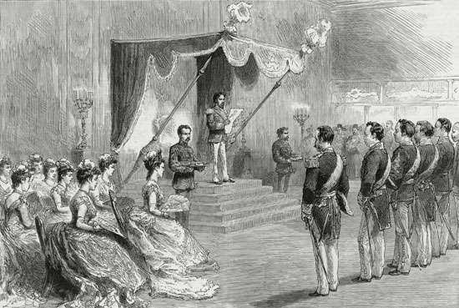
Industrialization & Urbanization – Factors Japan
1868 – Shogun removed following a short civil war
New government put in place under Meiji Restoration
Claimed to restore emperor to power (emperor only figurehead)
Japan run by a group of oligarchs
Government did not want Japan to fall victim to imperialism

Slide 22
Industrialization & Urbanization – Factors Japan
Meiji government instituted reforms to modernize Japan
Hundreds of Japanese students were sent to study in the United States, Britain and Germany
American, British and German experts of all stripes were hired to come to Japan to train Japanese bureaucrats, military officers, educators, and students
A network of public education was established that included vocational, technical, and agricultural schools as well as research universities
Created a modern army fashioned after Prussia, a modern navy fashioned after Britain, & a modern imperial government bureaucracy fashioned after Germany
Government established state owned factories that produced textiles and consumer goods for sale abroad
Once factories became profitable they were sold to private investors known as zaibatsu
Profits from the sale of factories funded reforms allowing Japan to avoid dangerous foreign debt.

Slide 23
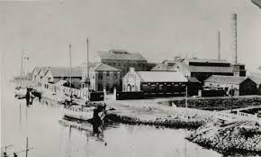
Industrialization & Urbanization – Impacts Japan
The efforts of the Meiji government were very successful
Japan never fell victim to imperialism
1900 – Japan builds itself into an imperial power
1905 – Japan shocked the world by defeating Russia in the Russo-Japanese War.

Slide 24
Industrialization & Urbanization – Impacts Great Britain, Germany, & Japan
All 3 countries became military powers
Used military power to establish empires
Britain – large parts of Africa, all of South Asia, & ports in China
Germany – colony in New Guinea & several colonies in Africa
Japan – controlled Korea, Taiwan & Manchuria
Industrialization undermined old social orders
Influence of nobility declined & shifted to new urban middle class who managed & owned businesses
New urban working class emerged; exploited for labor
Standard of living increased for some
Danger of factories

Slide 25
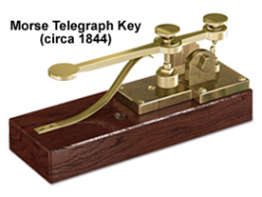
Industrialization & Urbanization – Impacts Great Britain, Germany, & Japan
Consumer products became cheaper
Steam engines shortened trips & telegraph made global communication nearly instant

