Slide 1
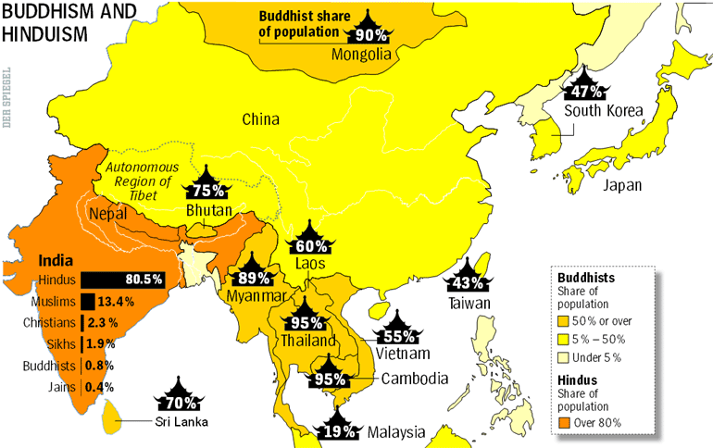
Hinduism, Buddhism, & Confucianism
Impacts on India & China

Slide 2
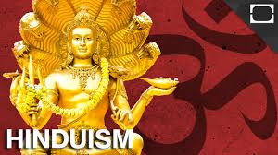
Hinduism
Indo-European religious traditions, preserved in the the Vedas, blended with the indigenous traditions of the Dravidian population to create a nascent form of Hinduism.
These religious traditions began to formalize around 750 to 550 BCE with the writing of the Upanishads.
Centered on the basic belief that all living things are reincarnated after death with the quality of the next life based on the deeds (Karma) of the individual in the previous life.
Humans are expected to live according to the Dharma & good conduct is rewarded with an eventual release from the cycle of reincarnation called Moksha.

Slide 3
Hinduism
This faith, combined with the dominance of the Indo-European Aryans over the indigenous Dravidians led to the creation of a rigid social class system called Caste or Varna.
Five hereditary social classes based on ethnicity and occupation.

Slide 4
Hindu Caste System

Slide 5
Hinduism
Hinduism fully developed during the Gupta Dynasty (320 CE to 550 CE).
During this period the hereditary nature of the occupational classes of the Caste System, patriarchy, the belief in a pantheon of Gods, a rich tradition of epic literature and the construction of monumental Hindu architecture were developed.
These traditions, established Gupta Dynasty, endured for centuries among the population of South Asia.

Slide 6
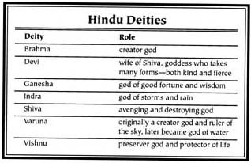
Hindu Caste System

Slide 7
Hinduism
Hinduism fully developed during the Gupta Dynasty (320 CE to 550 CE).
During this period the hereditary nature of the occupational classes of the Caste System, patriarchy, the belief in a pantheon of Gods, a rich tradition of epic literature and the construction of monumental Hindu architecture were developed.
These traditions, established Gupta Dynasty, endured for centuries among the population of South Asia.

Slide 8
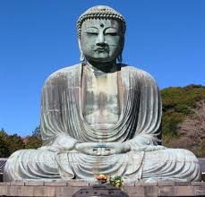
Buddhism
Hinduism’s dominance in the region was challenged by the emergence of new faiths including Jainism and Buddhism in around 500 BCE.
While Buddhism had little success in gaining adherents in South Asia it did spread along trade routes and become a major faith in East and Southeast Asia.
Buddhism was founded by a Hindu prince named Siddhartha Gautama
rejected the caste system & the pantheon of Hindu Gods and
taught that spiritual enlightenment (Nirvana) & escape from the cycle of reincarnation could be reached by accepting the Four Noble Truths & following the Eightfold Path.

Slide 9
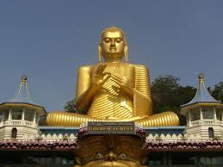
Buddhism
In the period after c. 500 BCE Buddhism offered an alternative to the sometimes oppressive nature of Hinduism's caste system & patriarchal traditions.
The popularity of Buddhism reached its peak in the Mauryan Dynasty (324-184 BCE) under the Emperor Ashoka.
made it state policy to promote the spread of Buddhism.
These policies ensured that Buddhism would endure as a major world religion.

Slide 10
Buddhism
During the Gupta Dynasty (320 CE-550 CE) Buddhism fell out of favor in South Asia but endured as a major faith along the trade routes in the Indian Ocean and the Silk Road.
This endurance was facilitated by the tradition of monasticism in the Buddhist faith.
nuns and monks established monasteries in remote areas along major trade routes.
spread the faith among traveling merchants & offered a life free of the traditional confines of patriarchy & caste for both women and men.

Slide 11
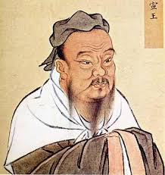
Confucianism
Confucius (c551-479 BCE) lived in the waning days of the Zhou Dynasty, a period of social and political upheaval.
His philosophy, recorded by his followers in the Analects, proposed a solution to this unrest.
He argued that the long established traditions of filial piety and the Mandate of Heaven held the key to social order.
Family served as a model for society as a whole.

Slide 12
Confucianism
The eldest male of the family held a moral obligation to lead and care for his household with wisdom and benevolence in exchange each member of the family was obliged to obey.
Confucius believed that the hierarchy of family could be expanded to bring order to society as a whole.
Argued that humans were innately good & that if treated with respect would obey righteous leaders,
The Analects laid out five relationships that were rooted in long held Chinese traditions and would bring peace and order to society.

Slide 13
Confucianism
The eldest male of the family held a moral obligation to lead and care for his household with wisdom and benevolence in exchange each member of the family was obliged to obey.
Confucius believed that the hierarchy of family could be expanded to bring order to society as a whole.
Argued that humans were innately good & that if treated with respect would obey righteous leaders,

Slide 14
Confucianism
The Analects laid out five relationships that were rooted in long held Chinese traditions and would bring peace and order to society.
Each relationship was based in reciprocal respect and duty, they include:
Subject to ruler
Son to father
Wife to husband
Younger brother to older brother
Friend and friend..

Slide 15
Confucianism
In an ideal Confucian society, wise superiors protect & respect their subordinates, subordinates obey and respect their superiors
All obey the golden rule: “never do to others what you would not like them to do to you.”
Confucianism created a fairly rigid social hierarchy, strongly supported patriarchy, encouraged education, and supported the tradition of ancestor veneration in China from the Han Dynasty onward

