Slide 1
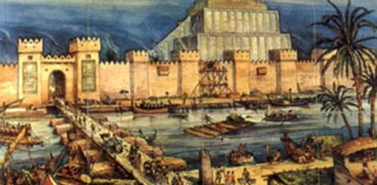
Early Civilizations
Mesopotamia & Ancient Egypt

Slide 2
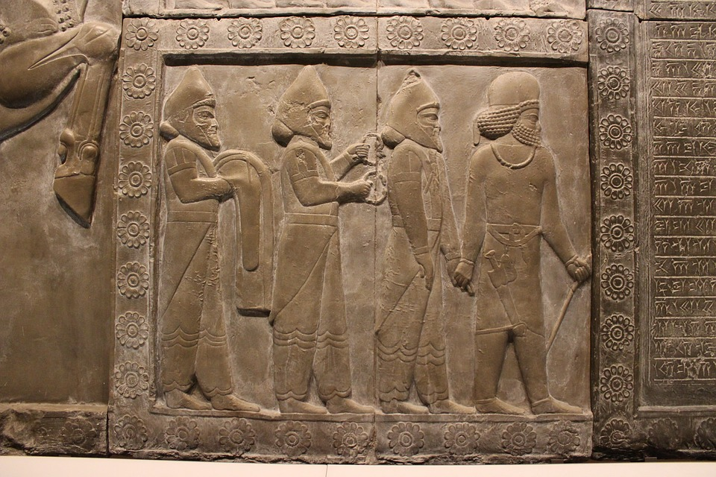
Mesopotamia
Emerged as farming communities 5,000 to 7,000 years ago
Improved agricultural technologies, like irrigation canals, lead to population growth & development of first urban centers
Ur & Uruk
Geography
Located what is known as the “Fertile Crescent”
Between Tigris & Euphrates Rivers

Slide 3
Maps of Mesopotamia

Slide 4
Mesopotamia
Geography
Desert Region
Susceptible to flooding
Left silt deposits which made land fertile
Flooding was very unpredictable
No natural boundaries
Open to invasion
Religion
Polytheistic
Gods represented elements of nature
Gods feared & seen as unpredictable
Sacrifices given to appease gods
Ziggurats built in honor of gods
Belief that afterlife was a fearful and gloomy place

Slide 5
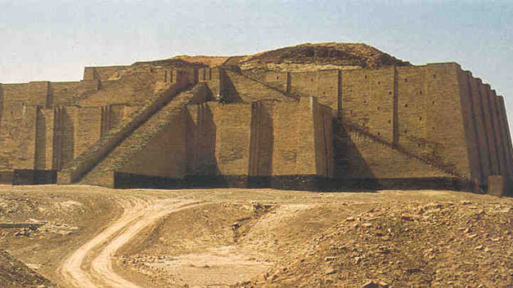

Slide 6
Mesopotamia Political History
First phase of Mesopotamia’s political history, known as Sumer
Dominated by several independent & warring city-states (hereditary monarchs)
Each city-state had a walled urban area made up of simple mudbrick dwellings & a ceremonial and administrative center dominated by a Ziggurat.
Outside of city walls, city-state controlled the large areas of surrounding farmland land
Around 4,000 years ago King of Akkad, Sargon, conquered this region creating the world’s first empire
Empire short lived due to invasions & insurrection
Babylonians (2nd phase) brought important political innovation when they unified the region in the 18th century BCE

Slide 7
Mesopotamia Political History
Babylonian King Hammurabi introduced the World’s first written law code
The Old Babylonian Empire as it is known by historians also witnessed a flowering in mathematics and literature
Babylonian Empire also fell to invasion
Led to rise of many warring empires
Hittites (Indo European people) arrived about 2000 BCE bringing iron technology
Assyrians, rose in power around 1900 BCE
Persians who began to build a long-lived empire around 550 BCE.

Slide 8
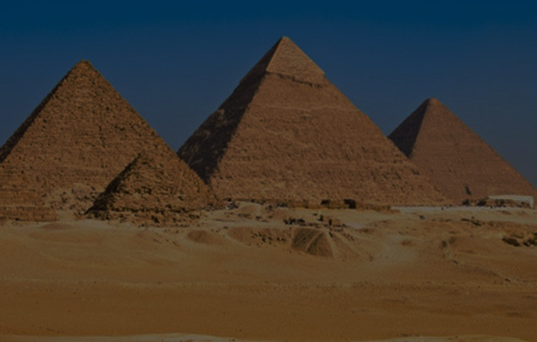
Ancient Egypt
Also developed as farming communities around 5,000 to 7,000 years ago
Improved technology led to rise of the kingdoms of Upper & Lower Egypt
Geography
Located in desert region of N. Africa
Nile River Valley
Annual Flooding
Left silt deposits which made the land fertile
“Gift of the Nile”
Natural boundaries
vast desert and seas

Slide 9
Maps of Ancient Egypt

Slide 10
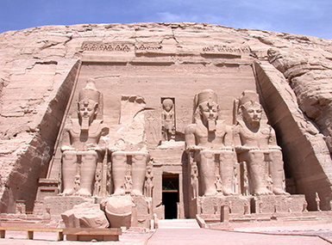
Ancient Egypt
Religion
Polytheistic
Gods that could be depended on to provide bounty and prosperity
Believed that good deeds in life rewarded with afterlife rich in same pleasures they enjoyed while alive
elaborate burial practices that included the construction of tombs and mummification

Slide 11
Ancient Egypt Political History
Egypt saw fewer invasions
Relatively stable for over 2,000 years
Began about 3,000 BCE with unification of Upper and Lower Egypt into a single kingdom ruled by a divine hereditary monarch known as the Pharaoh
Pharaohs aided by elaborate bureaucracy that included priests, administrators and scribes
Government was able to undertake elaborate public works projects like construction of Pyramids that served as tombs for the Pharaoh

Slide 12
Ancient Egypt Political History
Periods of Ancient Egypt
Old Kingdom (c. 2649 to 2150 BCE)
First Intermediate Period
Middle Kingdom (c. 2030-1640 BCE)
Second Intermediate Period
New Kingdom (c. 1550-1070)
The intermediate periods mark the only major times instability in Egypt before 1070 BCE.
During the Second Intermediate Period, Egypt experienced its first major invasion from the Hyksos of Mesopotamia who introduced the region to the horse, chariot and compound bow.

Slide 13
Mesopotamia & Egypt Links
After 1070, the political histories of Egypt and Mesopotamia intersected as they both experienced invasions from groups like the Hittites (who introduced Iron to the region), Assyrians and Persians
Fertile river valleys combined with technological advances like irrigation canals and plows allowed both Mesopotamia and Egypt to produce surplus food
Agricultural surplus allowed for specialization & development of social classes
Both societies had the same basic social hierarchy with the royal family at the top followed by priests, government officials, landowners, soldiers, and scribes constituting a ruling class followed by merchants and artisans in the middle and peasant farmers at the bottom

Slide 14
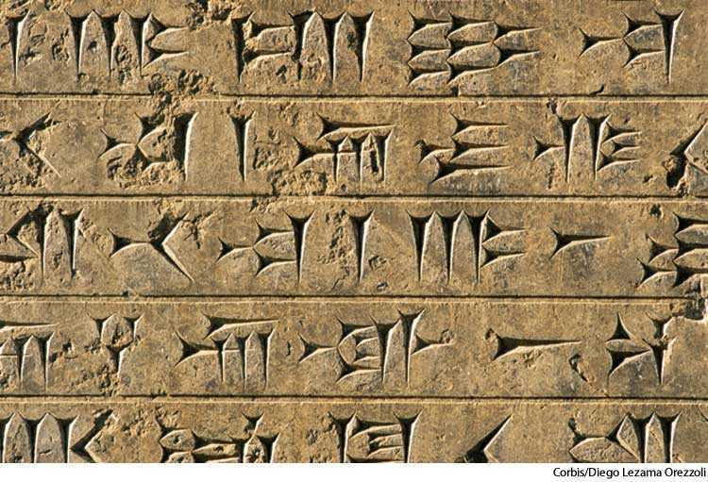
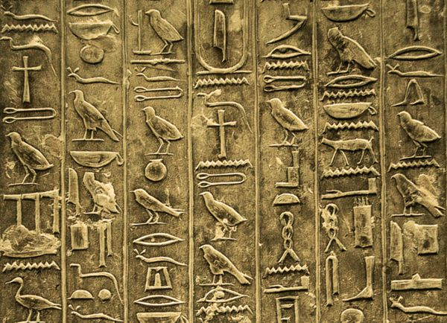
Mesopotamia & Egypt Links
Specialization of labor allowed both societies to make notable cultural and technological advances.
Both Mesopotamia and Egypt developed complex systems of writing, cuneiform and hieroglyphics respectively
Both also developed advanced literary, artistic and architectural traditions including The Epic of Gilgamesh from Mesopotamia.

Slide 15
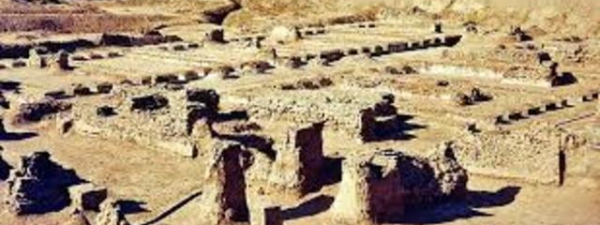
Early Civilizations
Indus Valley & Yellow River

Slide 16
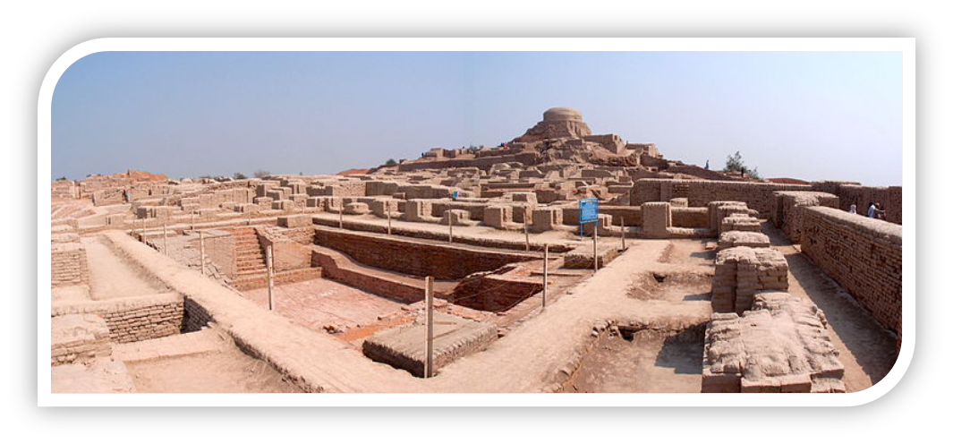
Indus River Valley
Farming villages first appeared in South Asia about 3200 BCE Climate of the region is dominated by monsoon rains
Urban centers appeared about 2500 BCE
Mohenjo-Daro
Harappa
Geography
Located in the fertile plain between the Indus and Ganges rivers
Mountains to the north and west partially isolate its people

Slide 17
Indus River Valley

Slide 18
Indus River Valley
Little is known about these early civilizations because historians are unable to decipher the written language of the region
urban planning in Mohenjo-Daro and Harappa indicate the presence of a strong central government.
The cities were elevated and surrounded by earthen walls and levees to protect them from flooding.
Inside the walls, the streets were laid out on a grid system.
Homes were constructed of baked brick, each with its own bathroom
City-wide sewer and plumbing system
Each city had a fortified citadel in the center
likely served as the political and religious center
Generally viewed as very peaceful
Archaeologist have found a large number of children’s toys & few weapons

Slide 19
Indus River Valley
Economy
Dependent on agriculture
Evidence of trade with Middle East and Central Asia.
Urban decay set in around 1750 BCE
possibly brought on by earthquakes & soil exhaustion
A new group of people, the Indo-European Aryans, migrated into the region in about 1500 BCE
Eventually established the Magadha Kingdom which controlled a portion of northeast India by the second century BCE.

Slide 20
Yellow River (China)
Geography
The farming villages between the Huang He and Yangtze Rivers of China grew into cities about 2000 BCE
Urban areas both benefited & suffered because of the rich but loose yellow silt deposited by the flooding of Yangtze
Loess
While the soil supported agriculture its loose nature made major shifts in the course of the river and massive floods common.
These struggles are recorded in Chinese legend as the Xia Dynasty whose Emperor Yu is said to have brought flood control and irrigation to China.

Slide 21
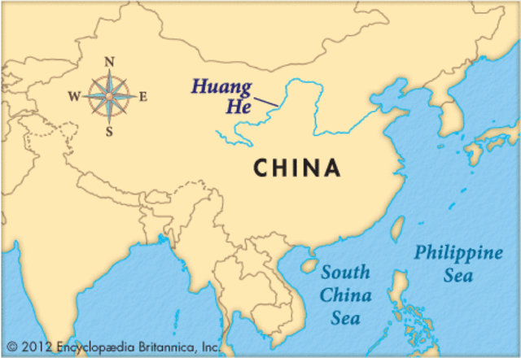
Map of the Yellow (Yangtze River)

Slide 22
Yellow River (China)Political History
1700 BC – Shang emerges as first documented dynasty of China
Began long tradition of governance that included hereditary monarch supported by a complex bureaucracy
Urban centers were walled & surrounded by large agricultural areas
Writing system, complex urban planning, irrigation and flood control developed during this period
Economy
Dominated by agriculture
Trade & craft production also

Slide 23
Yellow River (China)Religious History
This period also saw the emergence of foundational and interconnected Chinese religious principles
Concepts include:
Yin & Yang
offered an early and enduring understanding of the universe as balanced between male and female forces
Daoism
founded by Lao Tsu
asked humanity to respect and live in harmony with nature
ancestor worship venerated deceased family members in the hope that they would intercede with the powers in Heaven on behalf of the living

Slide 25
Early Civilizations
Bantu & Olmec

Slide 26
Bantu (Africa)
Agricultural villages became common in West Africa below the Sahara desert about 4,000 years ago
These villages developed iron technology in time, which they used to produce tools of agriculture
Extensive linguistic evidence suggests that West Africans from around the modern border between Nigeria and Cameroon began to use this technology to clear forest to the southeast for farming
This led to a slow migration of these Bantu speaking people to the southeast and south from about 500 BCE to 600 CE
This migration brought agriculture, iron technology, and a new language to a region previously dominated by hunter gathers
Anthropologist believe that this migration laid the foundation for a common cultural heritage present in much of West, Central, East and South Africa.

Slide 27
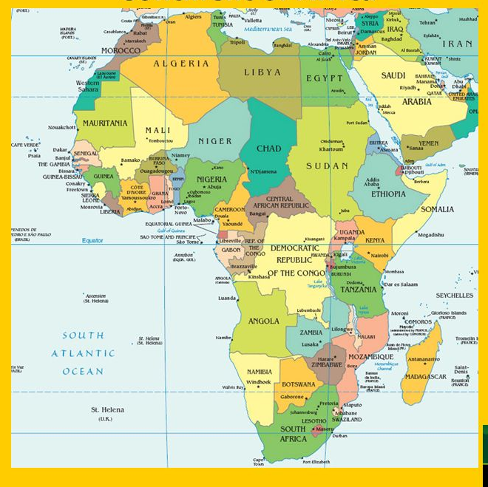
Map of Bantu Migrations in Africa

Slide 28
Olmec (Meso-America)
Civilizations also developed in the Americas in this period
Geographic isolation made them more unique but they followed many of the same patterns of civilizations in Afro-Eurasia
Agricultural villages based on the cultivation of corn, beans, and squash emerged about 3500 BCE.
These villages grew into a variety of urban centers around 1200 BCE
The most influential was the Olmec culture found in modern Mexican states of Veracruz and Tabasco
Political authority and social stratification developed in these urban areas as a result of agricultural surplus and the need to mobilize large numbers of people to construct irrigation systems, ceremonial buildings and to drain land for farming

Slide 29
Olmec (Meso-America)
Sophisticated urban planning based on the movement of the stars, the creation of monumental artwork including several giant Olmec head statues, and the construction of monumental architecture indicate a strong central government able to mobilize the labor of the population over time

Slide 30
Olmec (Meso-America)
Each Olmec city was likely independently ruled by a hereditary monarch who maintained power by presenting himself as an intermediary to the gods
These rulers, assisted by a class of priests, performed awe inspiring rituals on large platforms in the center of each city that included bloodletting and human sacrifice
These rituals served to reinforce the power of the state & laid the cultural foundations for the civilization that followed
Olmec economy like other ancient civilizations was dominated by agriculture but sophisticated trade networks and craft production also existed

