Slide 1
Culture
Ethnic Studies

Slide 2
What is Culture?
Merriam-Webster
1a: the customary beliefs, social norms, and material traits of a racial, religious, or social group
also : the characteristic features of everyday existence (such as diversions or a way of life) shared by people in a place or time
Dictionary.com
5: the behaviors and beliefs characteristic of a particular social, ethnic, or age group

Slide 3
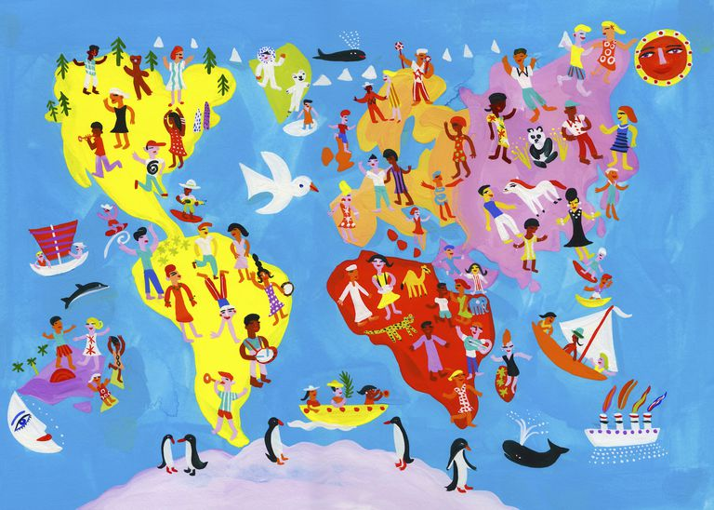
What does culture mean to you?

Slide 4
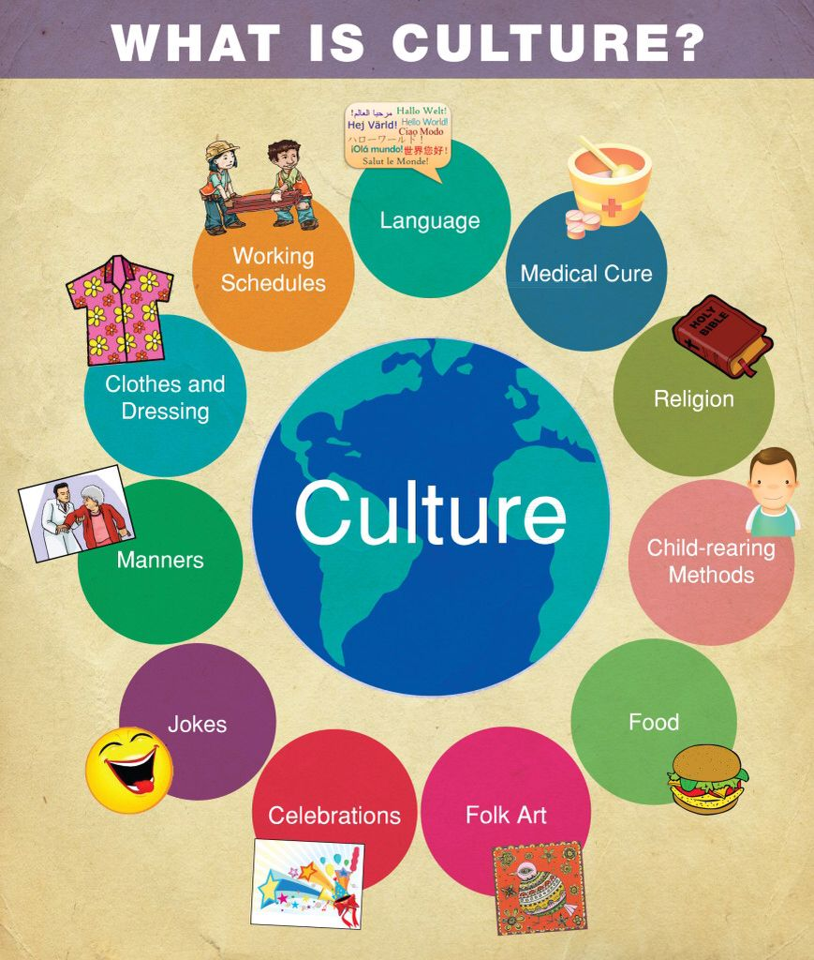
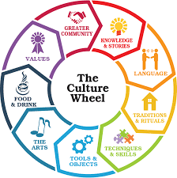
Culture Wheels

Slide 5
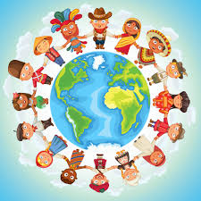
Your Culture
Bring examples of your culture
Examples can include:
-Food
-Music
-Dance
-Clothing/dress
-Language
-Etc .
Be creative

