Slide 1
Absolutism
Element: Examine absolutism through a comparison of the rules of Louis XIV, Tsar Peter the Great and Tokugawa Ieyasu.
Vocabulary: absolutism, Louis XIV, Peter the Great, Tokugawa Ieyasu
Essential Question: How did absolutism impact the world during the 17th and 18th centuries?

Slide 3
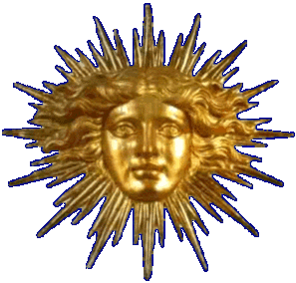
Absolutism
Definition:
the belief that the ruler has complete control
Examples in the Ancient World:
Shi Huangdi of the Qin Dynasty
Caesar’s of the Roman Empire
Charlomagne of the Franks
Suleyman the Magnificant of the Ottoman Empire

Slide 4
Immediate Causes of Absolutism
Religious and Territorial conflicts created fear and uncertainty
The Growth of Armies to deal with conflict caused rulers to raise taxes to pay troops
Heavy taxes led to addition unrest and peasant revolts

Slide 5
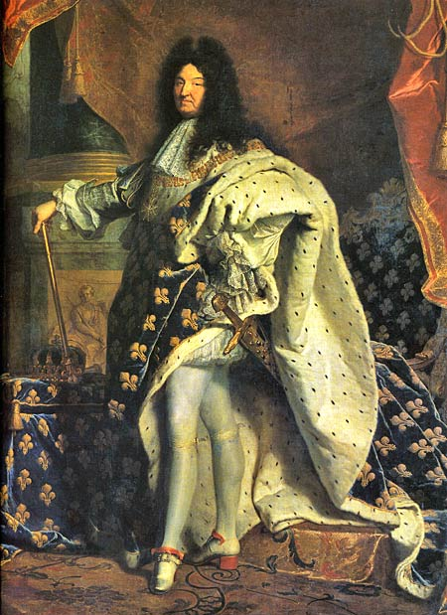
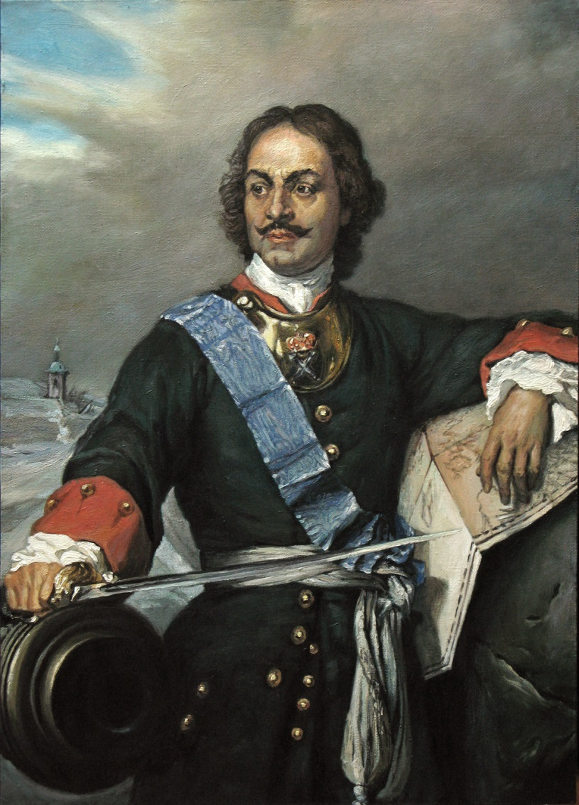
Absolute Rulers

Slide 6
Centralized Government
Tokugawa Ieyasu:
by 1603
daimyo that unified Japan
became new shogun

Slide 7
Centralized Government
Louis XIV:
increased power of government agents
known as the intendants
kept central power

Slide 8
Centralized Government
Peter the Great:
became an absolute ruler
forced change on the people
had to “westernize”

Slide 9
Stop and Think!
How did these three absolute rulers establish a more centralized government?

Slide 10
Eliminated Competition
Tokugawa Ieyasu:
defeated rivals at the battle of Sikigahara
earned loyalty of all Daimyo

Slide 11
Eliminated Competition
Louis XIV:
made sure local officials communicated regularly with him
Cardinal Richelieu will pass away

Slide 12
Eliminated Competition
Peter the Great:
survived his brother and co-ruler
his brother died of illness

Slide 13
Stop and Think!
How did these three absolute rulers eliminate competition?

Slide 14
Controlled Land Owning Masses
Tokugawa Ieyasu:
Daimyo ruled at local level
Alternate Attendance Policy
a hostage system

Slide 15
Controlled Land Owning Masses
Louis XIV:
weakened the power of the nobles
excluded them from his council
forced nobility to live at the capital
believed in mercantilism as a means to make money

Slide 16
Controlled Land Owning Masses
Peter the Great:
reduced nobles power
promoted lower ranking families
gave lower class grants of land

Slide 17
Stop and Think!
How did these absolute rulers take control over the nobility and use this control to their advantage?

Slide 18
Controlled Religion
Tokugawa Ieyasu:
by 1612
outlawed Christianity
drove out Christian missionaries

Slide 19
Controlled Religion
Louis XIV:
appointed France’s Cardinal Richelieu as a minister and advisor of the state

Slide 20
Controlled Religion
Peter the Great:
Government controlled Russian Orthodox Christianity
Monarch viewed as head of the Church
abolished position of the patriarch
created the Holy Synod that reported to the monarch

Slide 21
Stop and Think!
How did controlling religion contribute to the power of absolute rulers?

Slide 22
Built New Grand Capital
Tokugawa Ieyasu:
moved capital from Kyoto to Edo
modern day Tokyo
Daimyo placed in charge of building program

Slide 23
Built New Grand Capital
Louis XIV:
built palace of Versailles
became a “Patron of the Arts”

Slide 25
Built New Grand Capital
Peter the Great:
established a new capital St. Petersburg
the “window on Europe”
became a “Patron of the Arts”

Slide 27
Stop and Think!
Why do you think building a grand new capital would help absolute rulers become more powerful?

Slide 28
Traits of Absolutism
Centralized Government
Eliminated Competition
Controlled Land Owning Masses
Controlled Religion
Built New Grand Capital

Slide 29
Immediate Effects of Absolutism
Rulers increased the size of their courts to appear more powerful
Rulers created bureaucracies to control their countries economies
Gained support of the working class through control of the land owning masses
Rulers regulated religious worship and social gatherings to control the spread of ideas

Slide 30
Long-term Effects of Absolutism
rise of the Enlightenment
English political reforms that influence U.S. democracy
revolution in France
western European influence on Russia

Slide 31
Stop and Think!
How did absolutism impact the world during the 17th and 18th centuries?

