Slide 1
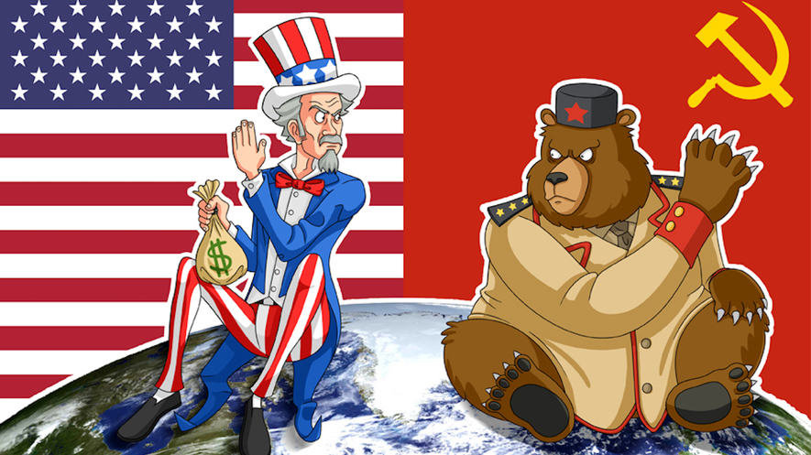
A Post-War World

Slide 2
SSWH20 – Demonstrate an understanding of the global social, economic, & political impact of the Cold War & decolonization from 1945 to 1989
a. Explain the arms race, include: development of nuclear weapons, & efforts to limit the spread of nuclear weapons
b. Describe the formation of the state of Israel & the Arab-Israeli Conflict
c. Analyze the rise of nationalism & the revolutionary movements in Asia (i.e. India and China) & Africa
d. Analyze opposition movements to existing political systems, include: anti-apartheid, Tiananmen Square, & the fall of the Berlin Wall

Slide 3
Learning Objectives
Students will be able to:
explain the social, economic, & political changes that took place in the Middle East, Africa, India, & China
describe the extent to which these changes were shaped by the Cold War rivalry between the U.S. & the Soviet Union

Slide 4
Overview
From 1945 to the 1980s the United States & Soviet Union were bitter rivals competing for global influence
The U.S.-Soviet rivalry resulted from a tense end to World War II
Competition between democracy/capitalism & communism
Intense arms race
Cold War never resulted in armed conflict between the 2 superpowers but it did profoundly shape the world in the period

Slide 6
Overview
From 1945 to the 1980s the United States & Soviet Union were bitter rivals competing for global influence
The U.S.-Soviet rivalry resulted from a tense end to World War II
Competition between democracy/capitalism & communism
Intense arms race
Cold War never resulted in armed conflict between the 2 superpowers but it did profoundly shape the world in the period

Slide 7
Cold War: Origins
During World War II the United States spend nearly $2 billion dollars for research & development of the atomic bomb
U.S. was in a race to beat both the Axis powers & the Soviets to the creation of a nuclear weapon
1945 – U.S. had successfully built 2 atomic bombs
Both bombs were dropped on Japan in August of the same year
1949 – Soviets secured nuclear weapons technology
Began the arms (weapons) race between the U.S. & Soviet Union
1952 – U.S. built the 1st hydrogen-bomb, a weapon with much greater destructive power
Soviets following suit within a year
The arsenals amassed on each side created fear & tension between the 2 nations
Also created a balance of power based on the principle of “mutually assured destruction,” meaning that each side could completely destroy the other many times over

Slide 8
Cold War: Origins
Over the course of the Cold War, Soviet & U.S. leaders made efforts to limit the use & spread of nuclear weapons
1963 – U.S., Soviet Union, & Britain signed the Nuclear Test Ban Treaty
By banning tests in the atmosphere, space, & underwater, they hoped to minimize the environmental impacts of radiation
The agreement still allowed for tests to take place underground
1968 – Nuclear Non-Proliferation Treaty, signed by 137 countries, aimed to limit the spread of nuclear weapons technology
Disarmament efforts continued through the 1970s, but were impeded by the interests of the military and arms manufacturers as part of the military-industrial complex

Slide 9
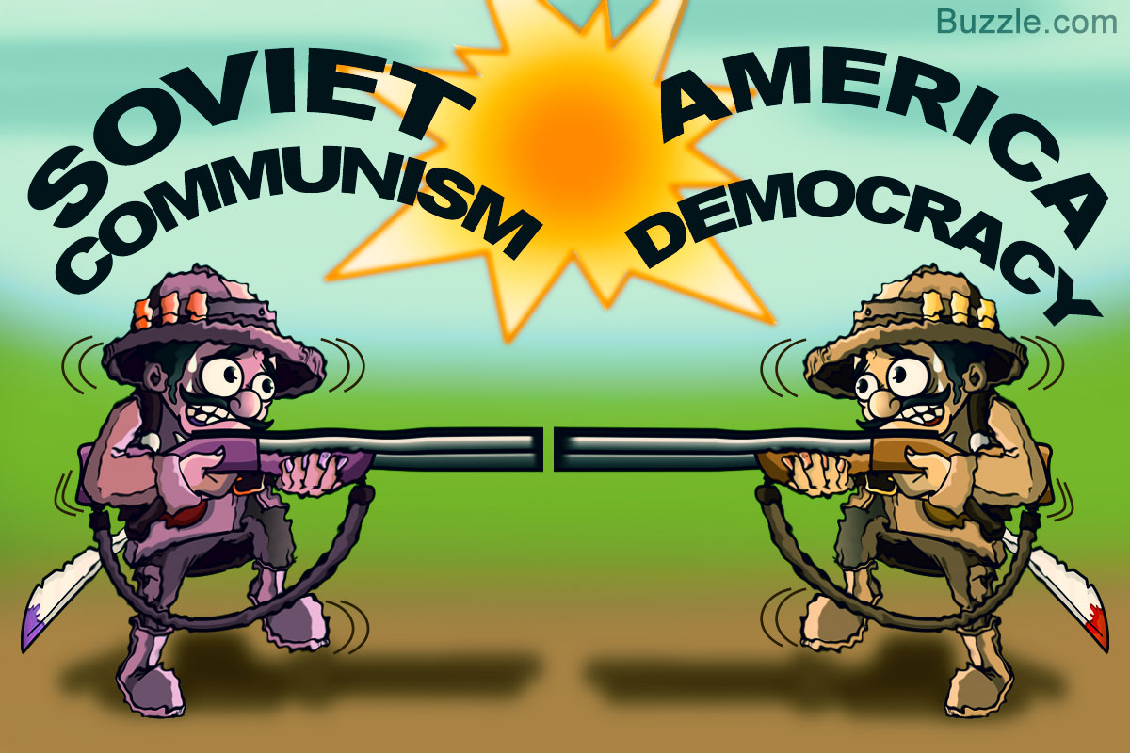

Slide 10
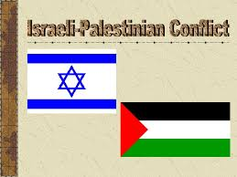
Israel & the Arab-Israeli Conflict

Slide 11
Israel & Arab-Israeli Conflict
1939 – Britain, who controlled Palestine, reversed its 1917 Balfour Declaration, which had promised to secure a Jewish homeland
This deepened conflict between Jews & Arab Palestinians, both of whom had historical claims to the land
Following World War II, Holocaust survivors poured into Palestine, & built up American support for their own nation-state
Tensions continued to grow, & in 1947 Britain turned the problem over to the United Nations
November 1947 – United Nations voted to separate Palestine into 2 separate states
1 Jewish & 1 Arab
Plan was accepted by Jews, but rejected by the Arabs

Slide 12
Israel & Arab-Israeli Conflict
May 1948 – Israel declared independence
Arab neighbors quickly attacked new nation
The war ended with Israel winning the war & increasing its territory, while some 700,000 Palestinians were uprooted & left as refugees
Lands given to Jewish immigrants
Situation left peace unsettled in the region
1967 – Israel responded to Egyptian military movements & won the Sinai Peninsula & Gaza Strip from Egypt, the Golan Heights from Syria, & the West Bank & Eastern Jerusalem from Jordan in 6 days of conflict
resulted in much greater territory for Israel & many more Palestinian refugees
The Palestinian Liberation Organization (PLO), led by Yasir Arafat gained support among Arab Palestinians
The PLO fought for the destruction of Israel through guerilla warfare including, bombings & airplane hijackings
Israel responded with force & the conflict continued

Slide 13
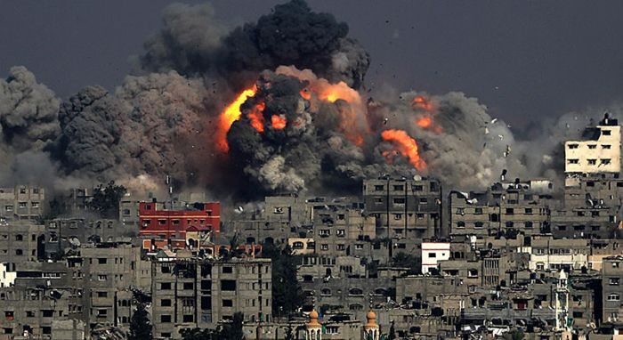

Slide 14
Israel & Arab-Israeli Conflict
1993 – PLO & Israel reached a peace agreement, known as the Oslo Accords
This historic, yet fragile, deal gave Palestinians the Gaza Strip & the West Bank territories, where they could govern with limited self-rule
Agreement would be done under an independent Palestinian Authority, which recognized Israel & pledged to end terror attacks
Both Jews and Arabs rejected the Oslo Accords
Jews because Israel gave up land
Arabs because they didn’t secure their own state
The Palestinian terror campaign & violent Israeli reprisals continued
2003 – United States, Russia, the European Union, & United Nations presented a “road map for peace” to Israelis & Palestinians, with steps to take toward a settled peace in the region
Little progress has been made, each side blaming the other for slow movement toward peace

Slide 15
