Slide 1
A Changing World

Slide 2
SSWH21 – Examine change & continuity in the world since the 1960s
a. Identify ethnic conflicts and new nationalisms, include: Pan-Africanism, Pan-Arabism, & the conflicts in Bosnia-Herzegovina & Rwanda.
b. Describe the reforms of Khrushchev & Gorbachev & the breakup of the Soviet Union in 1991 that produced independent countries.
c. Analyze terrorism as a form of warfare in the contemporary world.
d. Examine the rise of women as major world leaders, include: Golda Meir, Indira Gandhi, & Margaret Thatcher.

Slide 3
Objectives
Students will be able to:
explain how nationalism, capitalism, communism, & social reform movements continued to transform governments, reshape the map of the world, & caused violent conflict in the 2nd half of the 20th century
explain the factors that led to the demise of the Soviet Union & the rise of the United States as the world’s only superpower
examine the proliferation of violence by non-state actors targeted at civilians that resulted from the profound changes in this period & discuss the growth in the use of the term terrorism to describe these events.

Slide 4
Pan-Africanism & Pan-Arabism

Slide 5
Pan-africanism
Pan-Africanism had its roots in early 20th century
Reemerged in 1960s & 1970s
Advocated for Black Nationalism & the unity & cooperation of African peoples in Africa & around the world
Pan-Africanism in the United States
manifested as the Black Power movement
inspired African Americans to explore African cultural roots
Pan-Africanism in Africa
1963 – Organization for African Unity was formed in an effort to correct damage done by colonialism
2002 – The African Union, influenced by the European Union, organized to promote the political & economic integration of African countries

Slide 6
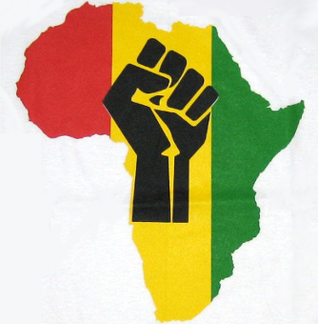
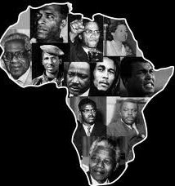

Slide 7
Pan-arabism
Pan-Arabism also had its roots in the early 20th century
This nationalist movement emphasized Arabs’ common history and language, & aimed to create a single Arab state
After the 1960s, the movement was much less about merging Arab states together, & more about creating institutions that would promote trade, foster cultural exchange, build up common economic goals, & provide military cooperation between Arab countries
It emphasized political cooperation while keeping the existing states intact
In reality, the Arab states did little to achieve these goals as trade barriers remained in place & the restricted movement of people continued
The Persian Gulf War in the early 1990s highlighted the deep divisions that existed between Arab states

Slide 8
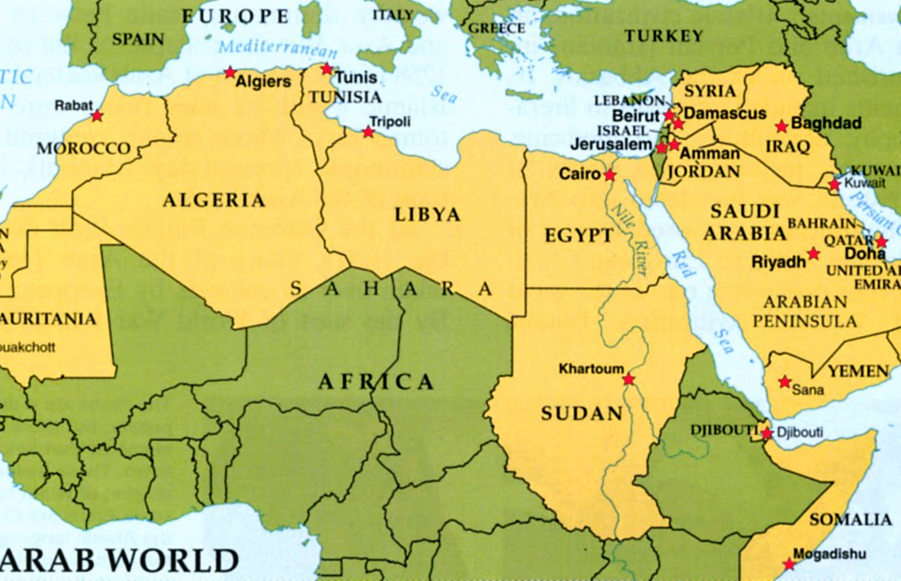

Slide 9
Bosnia-Herzogovina

Slide 10
Bosnia-Herzogovina
Following World War I the country of Yugoslavia was formed
Under Soviet influence
Consisted of Bosnia & Herzegovina, Serbia, Croatia, Montenegro, & Slovenia
1990 – Soviet rule ends & Yugoslavia was politically free
Yugoslavia left in poor economic condition
Ethnic tensions came quickly to the surface
Yugoslavia, though united by a common language was both ethnical & religiously diverse
1991 – Croatia & Slovenia asserted their independence
1992 – Bosnia claimed independence, but ethnic diversity in Bosnia led to conflicts & violence

Slide 11
Bosnia-Herzogovina
Bosnian Muslims were the largest group, but not a majority
Bosnian Serbs, a smaller minority
wanted to remain with Serbian-controlled Yugoslavia
Bosnian Serbs began a system of ethnic cleansing, using terror & murder, to rid Bosnia of Muslims
Foreign powers were slow to intervene
UN made efforts to protect Muslims
Serbs continued to bomb Muslim area & UN safe zones
1995 – NATO intervened & bombed Serbian targets
Led to peace talks
Talks resulted in the Dayton Accord, which gave Bosnian Serbs control over limited territory while recognizing the authority of the Muslim-controlled state government.

Slide 12
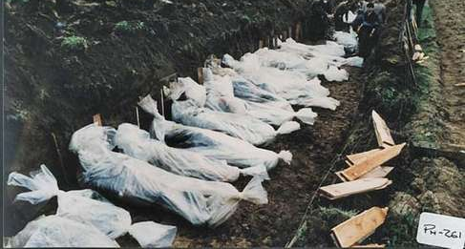
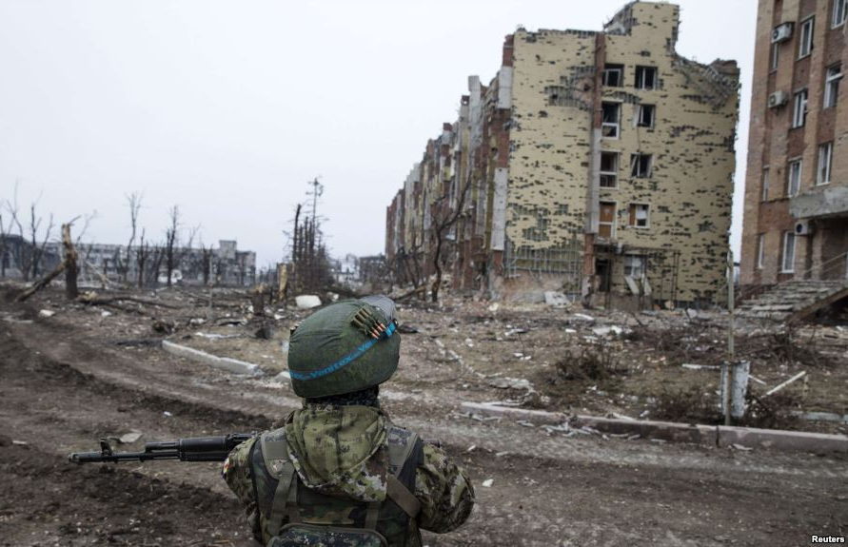

Slide 13
Rwanda
1994 – Hutus massacred approximately 800,000 Tutsis in a matter of 100 days
Foreign powers slow to intervene
The roots of this genocide date back to German colonial rule which strengthened the Tutsi minority & set up a Tutsi monarchy
1961 – Hutu coup set up a Hutu national government
Periodic violence flared up throughout the 1960s & 1970s, & again in 1991
led to negotiations that would allow Tutsis to be part of the government
Hutu extremists opposed this move

Slide 14
Rwanda
The organized massacre of Tutsis & moderate Hutus began when a plane carrying the Rwandan president was shot down over the capital
The extremists encouraged an estimated 200,000 Hutus across the country to participate in the genocide by killing their Tutsi neighbors
The killing ended as the Tutsis fought back & took over the capital
UN peacekeeping forces arrived in meaningful numbers in June, after 700,000 were already dead and millions more had fled to neighboring countries, mostly Zaire

Slide 15
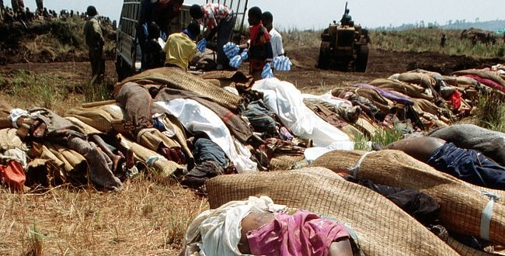
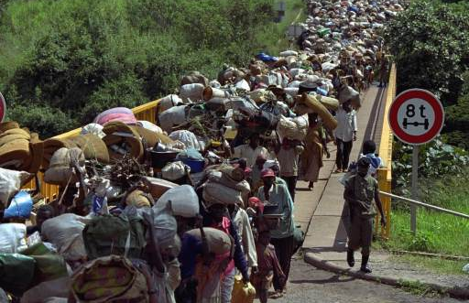

Slide 16
Fall of The Soviet Union

Slide 17
Khrushchev reforms
1958 – Nikita Khrushchev came to power in the Soviet Union
embarked on a policy of de-Stalinization
criticized & made Stalin’s crimes known
eased censorship
eased restrictions on artists & intellectuals
freed political prisoners
ended the secret police’s fear tactics
enacted economic reforms that gave more control to local communities & tried to refocus the economy to create more consumer goods

Slide 18
Soviet Union Falls apart
1985 – Mikhail Gorbachev took power
issued broad reforms in the Soviet Union
reform efforts were two-pronged
Glasnost referred to “openness”
ended censorship & allowed people to openly discuss problems in the Union & with the Communists
Perestroika, meaning “restructuring”
aimed to remake the government & economy to allow for more efficiency & productivity
Gorbachev worked to streamline bureaucracy & allowed for limited private enterprise
These changes resulted in economic turmoil, food shortages, & high prices
The reforms also opened the way for political unrest

Slide 19
Soviet Union Falls apart
Eastern European countries, seeing the Soviet’s weakness, declared independence
nationalism rose throughout the Soviet Union
Gorbachev was unable to hold them all together
1991 – A coup by hardline communists against Gorbachev in 1991 failed
severely weakened his ability to govern & maintain the Soviet Union
He resigned later in the year, ending the Soviet Union
As the Soviet Union fell apart, the remaining republics each declared their independence

Slide 20
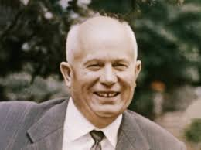
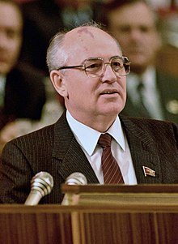

Slide 21
Rise of Terrorism

Slide 22
Terrorism
Terrorism is an ancient tactic, but its use around the world has increased since the 1960s
Terrorism refers to violence against civilians for political purposes
It is meant to get the attention of governments
terrorists believe that even harsh reprisals are productive by garnering sympathy for their causes
Terrorist acts include bombings, hijackings, kidnappings, & shootings

Slide 23
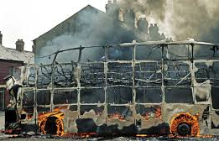
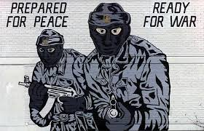
Northern Ireland
During the 1960s & 1970s, both sides of the conflict in Northern Ireland, Catholics and Protestants, used terrorist tactics
The British sent in troops who violated the civil rights of IRA (Irish Republican Army) members & Catholic communities
Peace was finally reached in 1998 with the Good Friday Agreement

Slide 24
Terrorism in Latin America
Since the 1960s, urban terrorists in Latin America have targeted banks, stores, police departments, public buildings & military posts in fights against repressive governments & U.S. economic domination
Terrorist organizations plagued civilians & governments throughout Latin America, notably in Peru, Columbia, Brazil, & Mexico
Some were Marxist organizations
others were motivated by nationalism

Slide 25
Terrorism in Latin America
In the 1990s, the terrorist organization al-Qaida, led by Osama bin Laden, targeted the foreign influence in Arab countries, specifically by the United States
1998 – al-Qaida built its terror brand with bombings of United States embassies in Kenya & Tanzania
2000 – bombing of the USS Cole
September 11th, 2001 – Al-Qaida orchestrated the hijacking of 4 airplanes in the United States
two of them flew into the World Trade Center Towers in New York City
one into the Pentagon outside Washington, D.C.
fourth plane was retaken by the passengers who crashed it into a field in Pennsylvania
American reprisals were swift & harsh
Within a month, U.S. forces were deployed to Afghanistan where it was believed that the Taliban was harboring bin Laden
The government also responded with increased watchfulness & a global “war on terrorism.”

Slide 26
